Slide 1
VEGETABLES
Vegetables are herbaceous edible plants cultivated for the consumption of fresh roots, tubers, bulbs, soft stems, immature flowers, leaves or fruit in fresh, conserved, or frozen condition.

Slide 2
Forms of consumption
Fresh salads
Cooked salads
Fruit
Cooked food
Main food
Secondary constituents used to improve taste

Slide 3
NUTRITIONAL VALUE
Protein
Carbohydrates
Fat
Inorganic salts
Vitamins
Antioxidant compounds
Plant fibers

Slide 4
Table 1A: Main nutrient constituents in vegetables (in 100 g of edible part)
Vegetable | Water (%) | Energy (cal) | Protein (g) | Fat (g) | Carbohydrates (g)
Cucumber | 95.1 | 15 | 0.9 | 0.1 | 3.4
Endive | 93.1 | 20 | 1.7 | 0.1 | 4.1
Sweet corn | 72.7 | 96 | 3.5 | 1.0 | 22.1
Kohlrabi | 90.3 | 29 | 2.0 | 0.1 | 6.6
Carrots | 88.2 | 42 | 1.1 | 0.2 | 9.7
Watermelon | 92.6 | 26 | 0.5 | 0.2 | 6.4
Zucchini | 94.6 | 17 | 1.2 | 0.1 | 3.6
Squash | 91.6 | 26 | 1.0 | 0.1 | 6.5
Cauliflower | 91.0 | 27 | 2.7 | 0.2 | 5.2
Fresh onions | 89.4 | 36 | 1.5 | 0.2 | 8.2
Dry onions | 89.1 | 38 | 1.5 | 0.1 | 8.7
Cabbage | 92.4 | 24 | 1.3 | 0.2 | 5.4
Brussel sprouts | 85.2 | 45 | 4.9 | 0.4 | 8.3
Parsley | 85.1 | 44 | 3.6 | 0.6 | 8.5
Fennel | 90.0 | 28 | 2.8 | 0.4 | 5.1
Lettuce | 94.0 | 18 | 1.3 | 0.3 | 3.5
Eggplant | 92.4 | 25 | 1.2 | 0.2 | 5.6
Okra | 88.9 | 36 | 2.4 | 0.3 | 7.6

Slide 5
Table 1B: Main nutrient constituents in vegetables (in 100 g of edible part)
Vegetable | Water (%) | Energy (cal) | Protein (g) | Fat (g) | Carbohydrates (g)
Pea, fresh | 78.0 | 84 | 6.3 | 0.4 | 14.4
Pea, dry | 11.7 | 340 | 24.1 | 1.3 | 60.3
Red beet | 87.3 | 43 | 1.6 | 0.1 | 9.9
Potato | 76.0 | 86 | 2.1 | 0 | 20.8
Melon | 90.6 | 33 | 0.8 | 0.3 | 7.7
Pepper | 93.4 | 22 | 1.2 | 0.2 | 4.8
Leek | 85.4 | 52 | 2.2 | 0.3 | 11.2
Broccoli | 89.1 | 32 | 3.6 | 0.3 | 5.9
Chicory | 95.1 | 15 | 1.0 | 0.1 | 3.2
Radish | 94.5 | 17 | 1.0 | 0.1 | 3.6
Celery | 94.1 | 17 | 0.9 | 0.1 | 3.9
Swiss chard | 91.1 | 25 | 2.4 | 0.3 | 4.6
Garlic | 74.0 | - | 4.5 | - | 20.0
Spinach | 90.7 | 26 | 3.2 | 0.3 | 4.3
Tomato | 93.5 | 22 | 1.1 | 0.2 | 4.7
Green bean | 90.1 | 32 | 1.9 | 0.2 | 7.1
Dry bean | 10.9 | 340 | 22.3 | 1.6 | 61.3

Slide 6
Table 2A: Composition of vegetables in inorganic salts (mg per 100 g of edible part)
Vegetable | Ca | P | Fe | Na | K
Cucumber | 25 | 27 | 1.1 | 6 | 160
Endive | 81 | 54 | 1.7 | 14 | 294
Sweet corn | 41 | 51 | 0.5 | 8 | 372
Kohlrabi | 3 | 111 | 0.7 |  | 280
Carrots | 37 | 36 | 0.7 | 47 | 341
Watermelon | 7 | 10 | 0.5 | 1 | 100
Zucchini | 28 | 29 | 0.4 | 1 | 202
Squash | 21 | 44 | 0.8 | 1 | 340
Cauliflower | 25 | 56 | 1.1 | 13 | 295
Fresh onions | 51 | 39 | 1.0 | 5 | 231
Dry onions | 27 | 36 | 0.5 | 10 | 157
Cabbage | 49 | 29 | 0.4 | 20 | 233
Brussel sprouts | 36 | 80 | 1.5 | 14 | 390
Parsley | 203 | 63 | 6.2 | 45 | 727
Fennel | 100 | 51 | 2.7 | - | 397
Lettuce | 68 | 25 | 1.4 | 9 | 264
Eggplant | 12 | 26 | 0.7 | 2 | 214

Slide 7
Table 2B: Composition of vegetables in inorganic salts (mg per 100 g of edible part)
Vegetable | Ca | P | Fe | Na | K
Pea, fresh | 26 | 116 | 1.9 | 2 | 316
Pea, dry | 64 | 340 | 5.1 | 35 | 1005
Red beet | 16 | 33 | 0.7 | 60 | 335
Potato | 8 | - | 0.5 | - | -
Melon | 14 | 16 | 0.4 | 12 | 251
Pepper | 10 | 25 | 0.7 | - | -
Okra | 92 | 51 | 0.6 | 3 | 219
Leek | 52 | 50 | 1.1 | 5 | 347
Broccoli | 103 | 78 | 1.1 | 15 | 382
Chicory | 18 | 21 | 0.5 | 7 | 182
Radish | 30 | 31 | 1.0 | 18 | 322
Celery | 39 | 28 | 0.3 | 126 | 341
Swiss chard | 88 | 39 | 3.2 | 147 | 550
Spinach | 93 | 51 | 3.1 | 71 | 470
Tomato | 13 | 27 | 0.5 | 3 | 244
Green bean | 56 | 44 | 0.8 | 7 | 132
Dry bean | 144 | 425 | 7.8 | 19 | 1,196

Slide 8
Table 3A: Composition of vegetables in main vitamins (mg per 100 g of edible part)
Vegetable | Vitamin Α (I.U.) | Thiamin B1 (mg) | Riboflavin B2 (mg) | Niacin B3 (mg) | Vit. C (mg)
Cucumber | 250 | 0.03 | 0.04 | 0.2 | 11
Endive | 3.300 | 0.07 | 0.14 | 0.5 | 10
Kohlrabi | 20 | 0.06 | 0.04 | 0.3 | 66
Sweet corn | 400 | 0.15 | 0.12 | 1.7 | 12
Carrots | 11.000 | 0.06 | 0.05 | 0.6 | 0.8
Watermelon | 590 | 0.03 | 0.03 | 0.2 | 7
Zucchini | 320 | 0.05 | 0.09 | 1.0 | 19
Squash | 1.600 | 0.05 | 0.11 | 0.6 | 9
Cauliflower | 60 | 0.11 | 0.10 | 0.7 | 78
Fresh onions | 2.000 | 0.05 | 0.05 | 0.4 | 32
Dry onions | 40 | 0.03 | 0.04 | 0.2 | 10
Cabbage | 130 | 0.05 | 0.05 | 0.3 | 47
Brussel sprouts | 550 | 0.10 | 0.16 | 0.9 | 102
Parsley | 8.500 | 0.12 | 0.26 | 1.2 | 172
Fennel | 3.500 | - | - | - | 31
Lettuce | 1.900 | 0.05 | 0.08 | 0.4 | 18
Eggplant | 10 | 0.05 | 0.05 | 0.6 | 5
Okra | 520 | 0.17 | 0.21 | 1.0 | 31

Slide 9
Table 3B: Composition of vegetables in main vitamins (mg per 100 g of edible part)
Vegetable | Vitamin Α (I.U.) | Thiamin B1 (mg) | Riboflavin B2 (mg) | Niacin B3 (mg) | Vit. C (mg)
Pea, fresh | 640 | 0.35 | 0.14 | 2.9 | 27
Pea, dry | 120 | 0.74 | 0.29 | 3.0 | -
Red beet | 20 | 0.03 | 0.05 | 0.4 | 10
Potato | - | 0.11 | 0.04 | - | 8-30
Melon | 40 | 0.04 | 0.03 | 0.6 | 23
Pepper | 770 | 0.09 | 0.06 | 1.7 | 235
Leek | 40 | 0.11 | 0.06 | 0.5 | 17
Broccoli | 2.500 | 0.10 | 0.23 | 0.9 | 113
Chicory | Traces | - | - | - | -
Radish | 10 | 0.03 | 0.03 | 0.3 | 26
Celery | 240 | 0.03 | 0.03 | 0.3 | 9
Swiss chard | 6.500 | 0.06 | 0.17 | 0.5 | 32
Spinach | 8.100 | 0.10 | 0.20 | 0.6 | 51
Tomato | 900 | 0.06 | 0.04 | 0.7 | 23
Green bean | 600 | 0.08 | 0.11 | 0.5 | 19
Dry bean | - | 0.65 | 0.22 | 2.4 | -

Slide 10
CLASSIFICATION OF VEGETABLES
Botanical taxonomy
Edible part
Requirements in temperature
Cultivation cycle
Pollination
Photoperiod

Slide 11
Botanical classification
Plant species
Examples
Pepper: Capsicum annuum
spinach: Spinacia oleracea

Slide 12
Sub-category
Botanical variety
π.χ. Brassica oleracea,
var. botrytis: cauliflower
var. italica: broccoli
Var. capitata: cabbage
Cultivated variety:
(cv. = cultivated variety)
e.g. tomato:
Solanum lycopersicum, cv. Belladona)

Slide 13
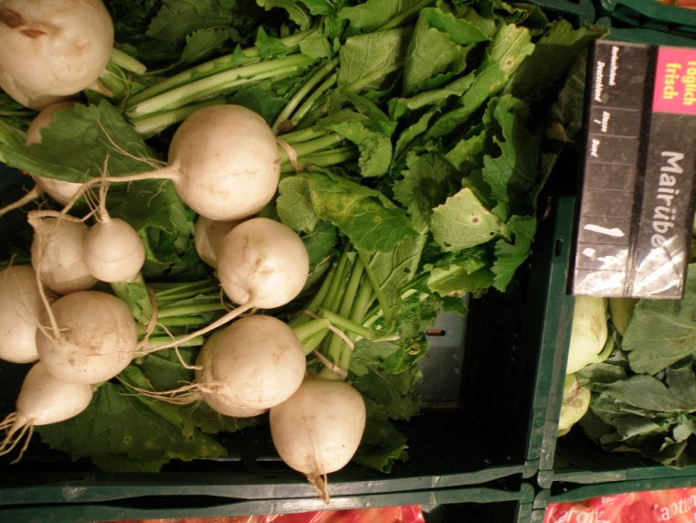
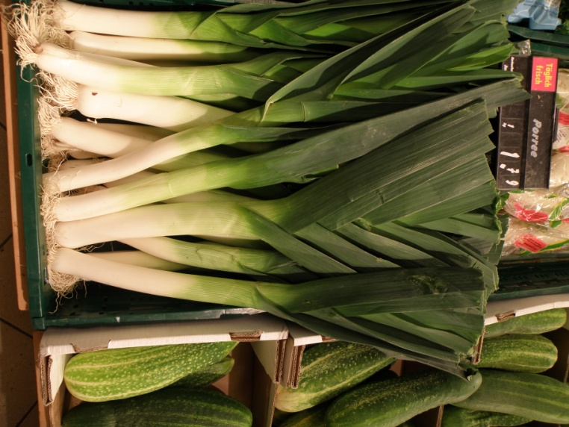
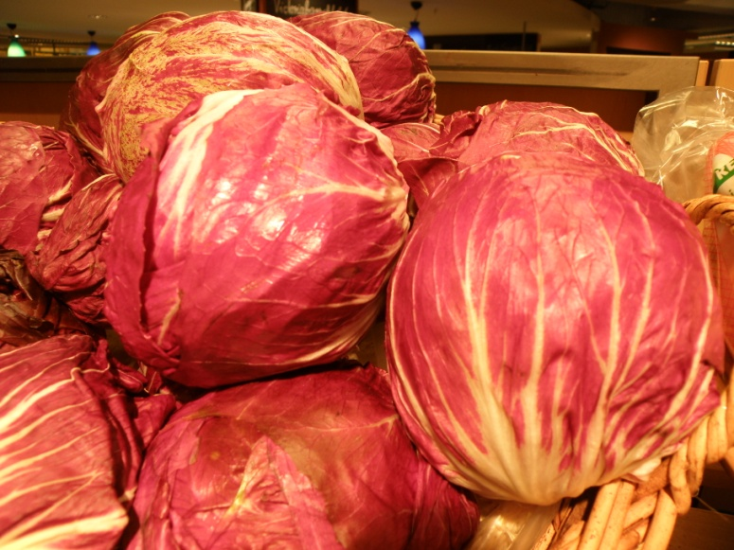
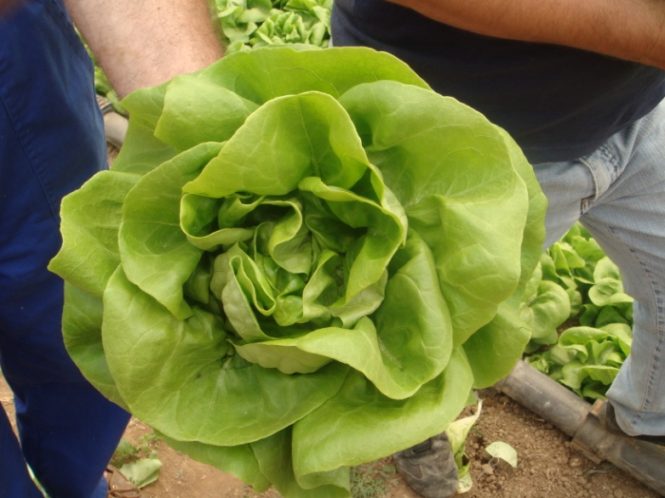
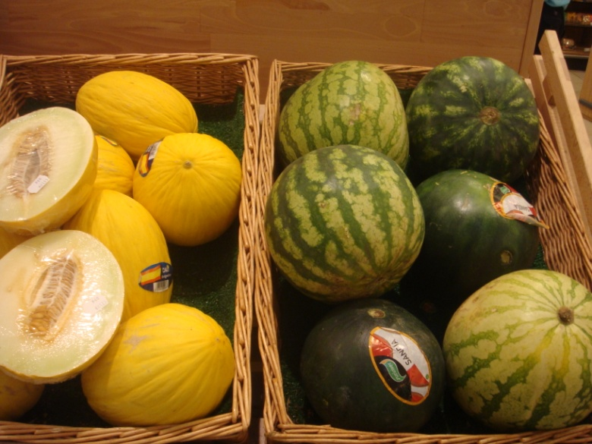
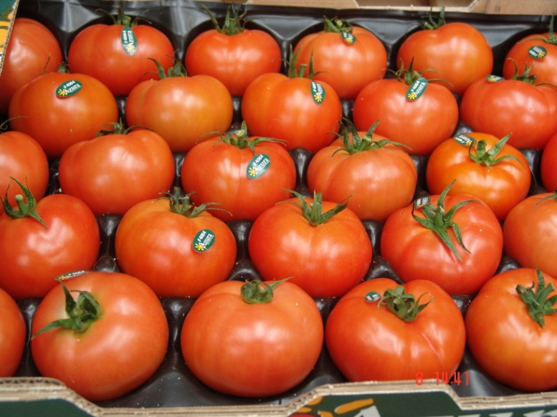
CLASSIFICATION ACCORDING TO THE EDIBLE PART

Slide 14
CLASSIFICATION ACCORDING TO THE EDIBLE PART
The edible part may be:
Underground plant organts
tuber: potato
Root tuber: red beet, carrot
Bulb: onion, garlic
Stem: asparagus, kohlrabi
Leaves: lettuce, endive
Unripe flowers: cauliflower, artichoke
Fruit:
Unripe fruit: cucumber, eggplant
Ripe fruit: tomato, watermelon

Slide 15
Table 4: Classification of vegetables according to their temperature requirements
Cold season vegetables |  | Warm season vegetables
Cold-resistant Opt. T: 15 - 18 ºC, Max >24 ºC | Cold tolerant | Moderately cold-sensitive | Strongly cold-sensitive
Kohlrabi | Artichoke | Sweet corn | Cucumber
Onion * | Endive | Green cowpea | Pepper
Cabbage | Carrot | Tomato | Sweet potato
Brussel sprouts | Cauliflower | Green bean | Watermelon
Parsley | Chinese cabbage |  | Zucchini
Iceberg lettuce | Lettuce (Head) |  | Squash
Pea | Red beet |  | Eggplant
Leek * | Potato |  | Okra
Broccoli | Celery |  | Melon
Chicory | Swiss chard
Radish
Garlic *
Spinach
Asparagus *

Slide 16
Table 5: Vegetables requiring vernalization through exposure to cold temperatures to form reproductive organs
Kohlrabi | Fennel
Carrot | Red beet
Onion | Leek
Cabbage | Radish
Brussel sprouts | Celery
Parsley | Swiss chard

Slide 17
Table 6A: Classification of vegetables according to their pollination needs
Insect-pollinated | Wind-pollinated | Self-pollinated
Artichoke | Sweet corn | Endive
Cucumber | Red beet | Faba bean
Dill | Swiss chard | Lettuce
Sweet potato | Spinach | Eggplant
Kohlrabi |  | Carrot
Pea |  | Potato
Watermelon |  | Pepper
Zucchini squash |  | Chicory
Onion |  | Tomato
Cauliflower |  | Common bean
Cabbage
Brussels sprouts
Chinese cabbage
Parsley
Fennel
Eggplant
Okra
Melon
Leek
Broccoli
Radish
Asparagus

Slide 18
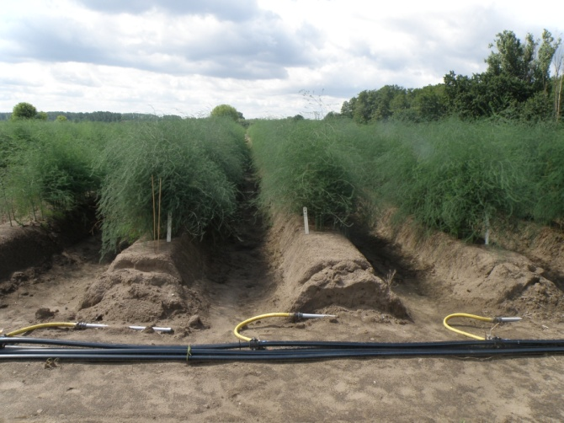
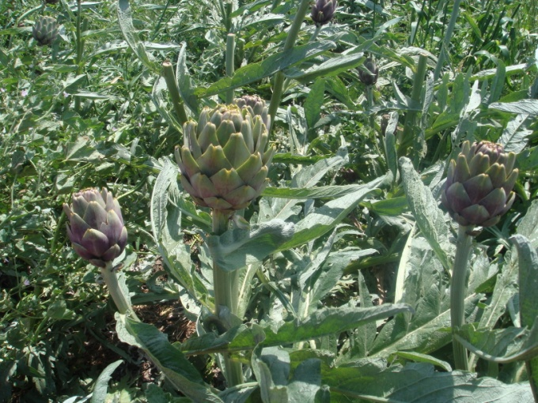
Classification of vegetables according to the cultivation cycle
Perennial
Asparagus
Artichoke
Annual
All other vegetables cultivated in temperate climates

Slide 19
Current trends in the market of fresh vegetables
The percentage of fresh vegetables distributed trough large super markets is increasing
Consumer demand for safe and high quality food has dramatically increased
Quality certification of fresh vegetables and fruits is becoming compulsory

Slide 20
The importance of quality
Product quality is a complex characteristic that depends on several factors and includes both objective, measurable quality traits as well as subjective, sensory characteristics.
Nowadays, most vegetables prescribed for the market are subjected to quality grading based on standards set by EU and other international or national authorities.

Slide 21
The importance of quality
The application of quality standards to fresh vegetables has increased the uniformity in size, maturity and presentation of produce.
However, the vegetable quality characteristics related to flavour and aroma are not affected by such standards.
Flavour and aroma are important in the market to gain reputation (e.g. a brand name) and get a premium price .

Slide 22
The importance of quality
Furthermore, the quality characteristics linked with food safe, i.e. the residuals of agrochemicals, are in most cases not taken into consideration when grading into classes according to quality standards.
Therefore, many state authorities as well as the European Union have established maximum residual limits (MRL) for specific agrochemicals and horticultural products.

Slide 23
The need for certification
The increasing concern of consumers with the safe and quality of fresh vegetables and other food products originating from agriculture forced the large super market chains in Europe to establish a comprehensive system of certification.
GLOBALG.A.P. (www.globalgap.org) (formerly EUREPGAP)
Certification is based on a standard protocol of Good Agricultural Practices (GAP)
GLOBALG.A.P. Fruit and Vegetables Standard

Slide 24
Certification and Market
The application of good agricultural practices is aimed at minimising detrimental environmental impacts of farming operations, reducing the use of chemical inputs and ensuring a responsible approach to worker health & safety.

Slide 25
Certification and Market
Certification of the production procedure according to the GLOBALGAP standard is a prerequisite for the product to be marketed by the joined retailers.
In Greece and other Mediterranean countries, the introduction of the GLOBALGAP certification system had serious consequences on vegetable production, since it became a prerequisite for growers to export their products to the large fresh vegetable markets of Europe.

