Slide 1
GENERAL VEGETABLE PRODUCTION
Lecture 2:
Brief presentation of vegetables

Slide 2
Solanaceae
Tomato (Solanum lycopersicum L.)
Pepper (Capsicum annuum L.)
Eggplant (Solanum melongena L.)
Potato (Solanum tuberosum L.)

Slide 3
Tomato

Slide 4
Field tomato crop

Slide 5
Pepper

Slide 6
Field pepper crop

Slide 7
Eggplant

Slide 8
Field eggplant crop

Slide 9
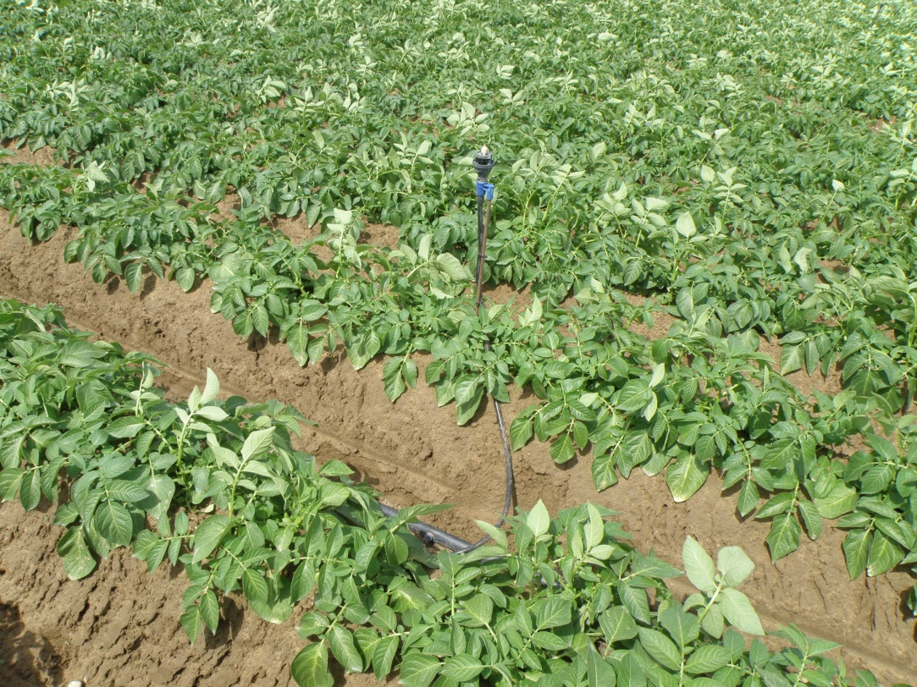
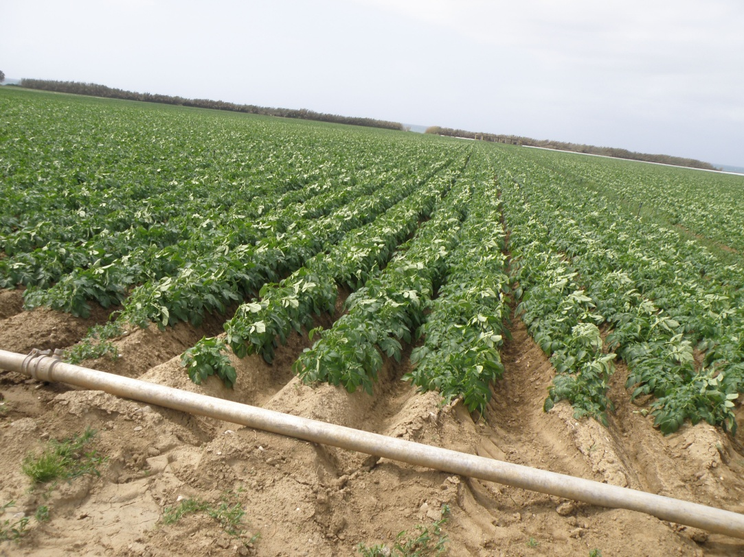
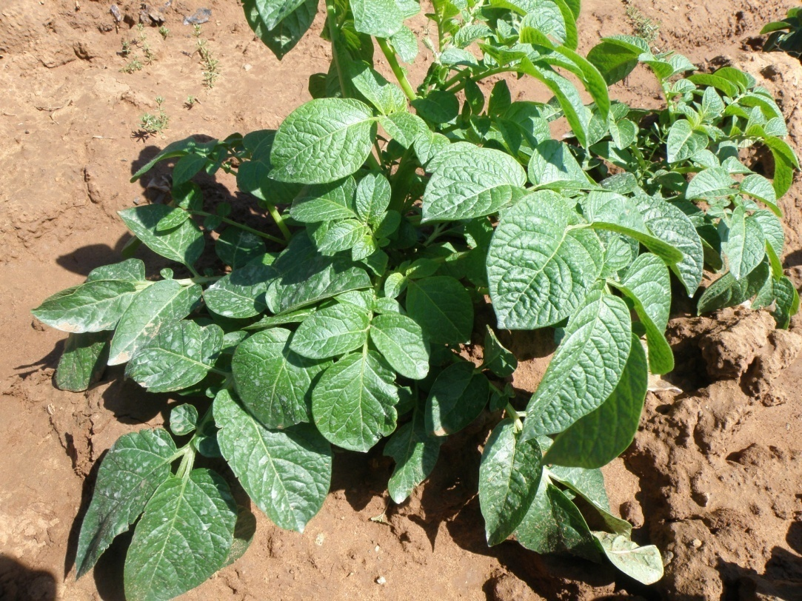
Potato

Slide 10
Cucurbitaceae
Cucumber (Cucumis sativus L.).
Melon (Cucumis melo L.).
Watermelon (Citrullus lanatus).
Zucchini squash(Cucurbita pepo L.).

Slide 11
Cucumber

Slide 12
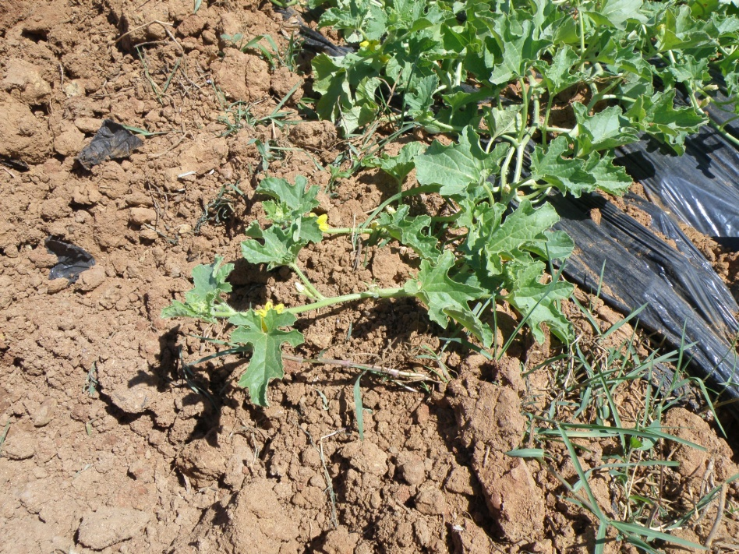
Melon

Slide 13
Watermelon

Slide 14
Zucchini Squash

Slide 15
Fabaceae
French bean (Phaseolus vulgaris L.).
Cowpea (Vigna unguiculata)
Pea (Pisum sativum)

Slide 16
French bean

Slide 17
Cowpea

Slide 18
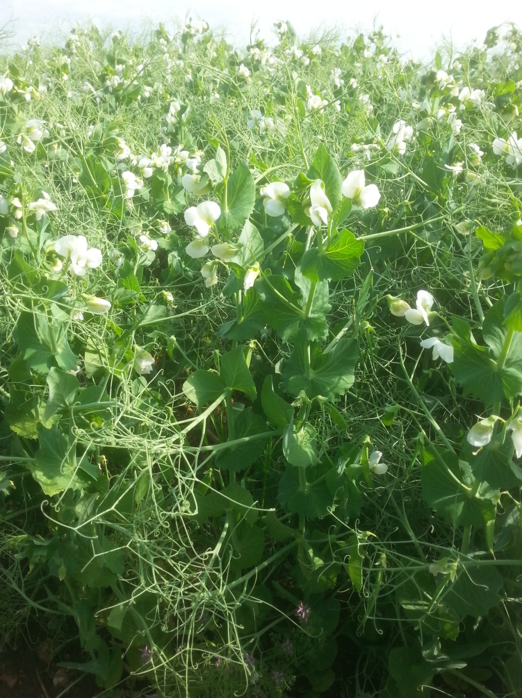
Pea

Slide 19
Compositae
Lettuce (Lactuca sativa L.).
Endivia (Cichorium endivia L.).
Chicory (Cichorium intybus L.).
Artichoke (Cynara scolymus L.).

Slide 20
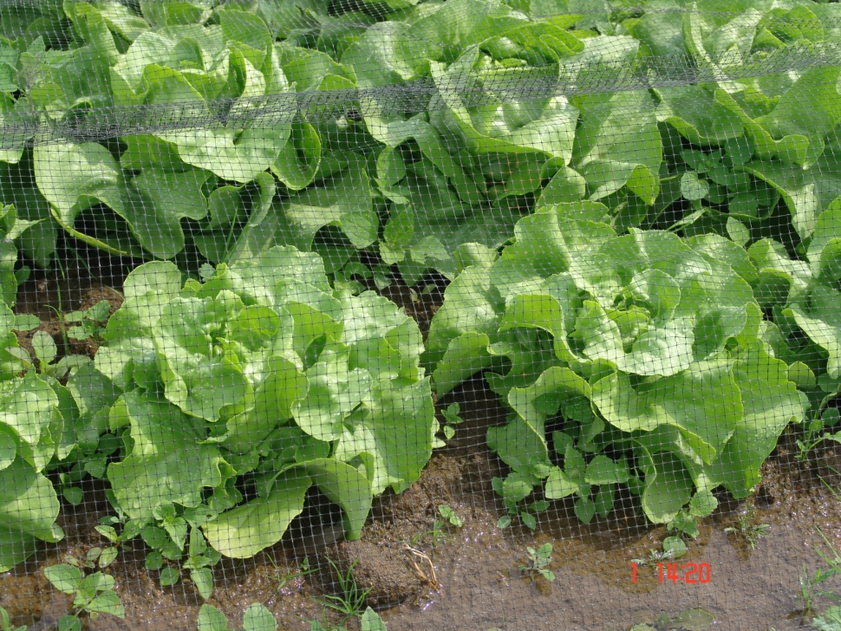
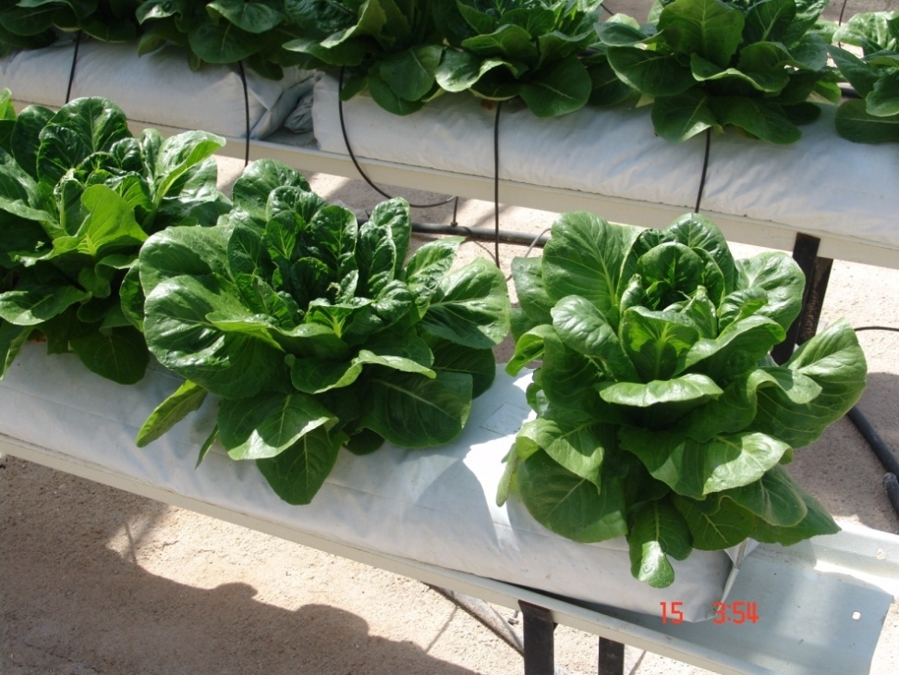
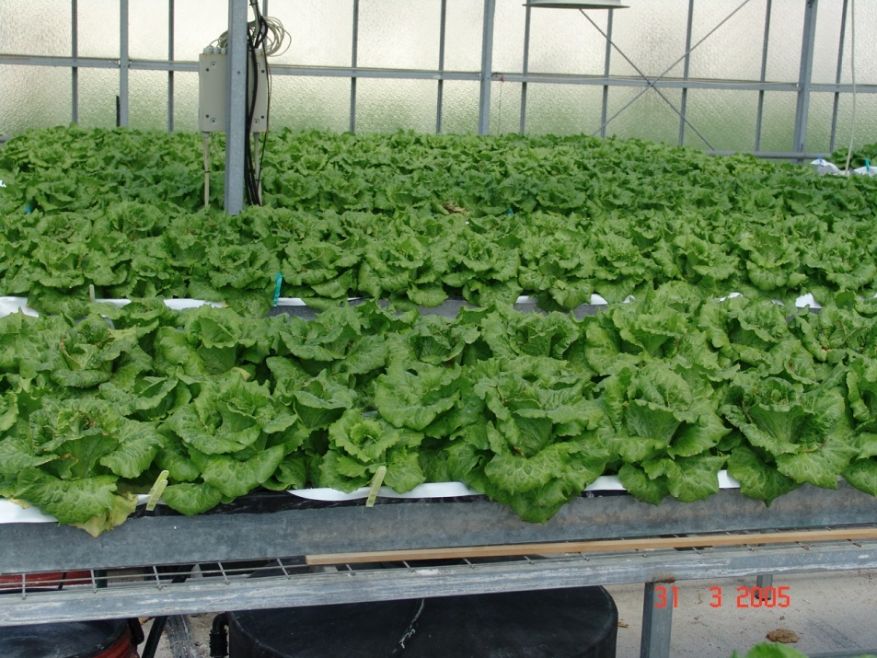
Lettuce

Slide 21
Greenhouse lettuce crop

Slide 22
Endivie

Slide 23
Chicory

Slide 24
Artichoke

Slide 25
Brassicaceae
Cabbage(Brassica oleracea, var. capitata)
Kohlrabi (Brassica oleracea, var. gongylodes L.)
Cauliflower (Brassica oleracea, var. botrytis)
Broccoli (Brassica oleracea, var. italica)
Brussels sprouts (B. oleracea, var. gemmifera)
Chinese cabbage (Brassica pekinensis).
Radish (Raphanus sativus L.).
Rocket (Eruca sativa)

Slide 26
Cabbage

Slide 27
Kohlrabi

Slide 28
Cauliflower

Slide 29
Broccoli

Slide 30
Broussel sprouts

Slide 31
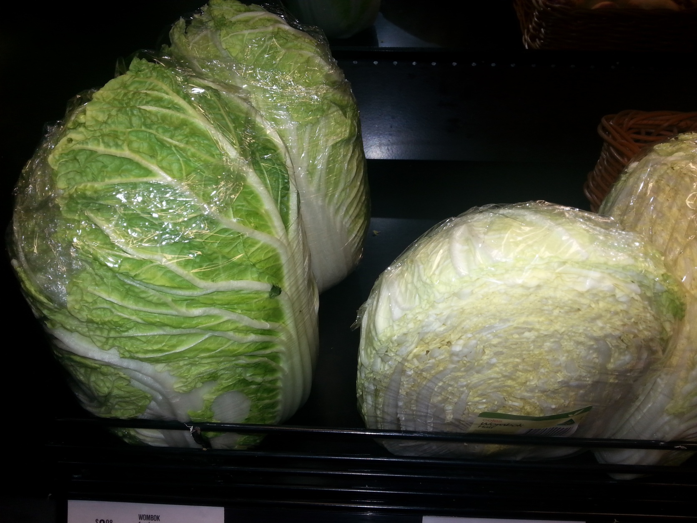
Chinese cabbage

Slide 32
Radish

Slide 33
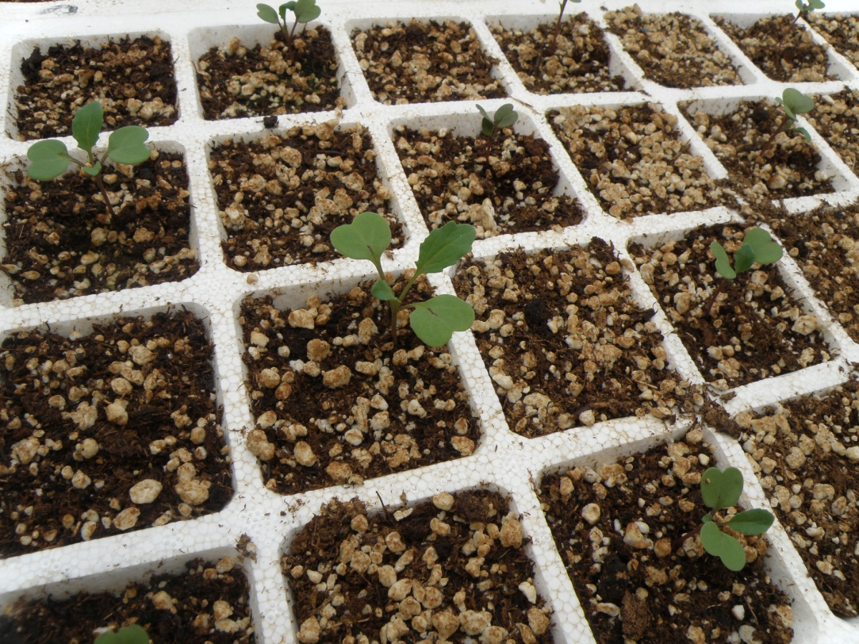
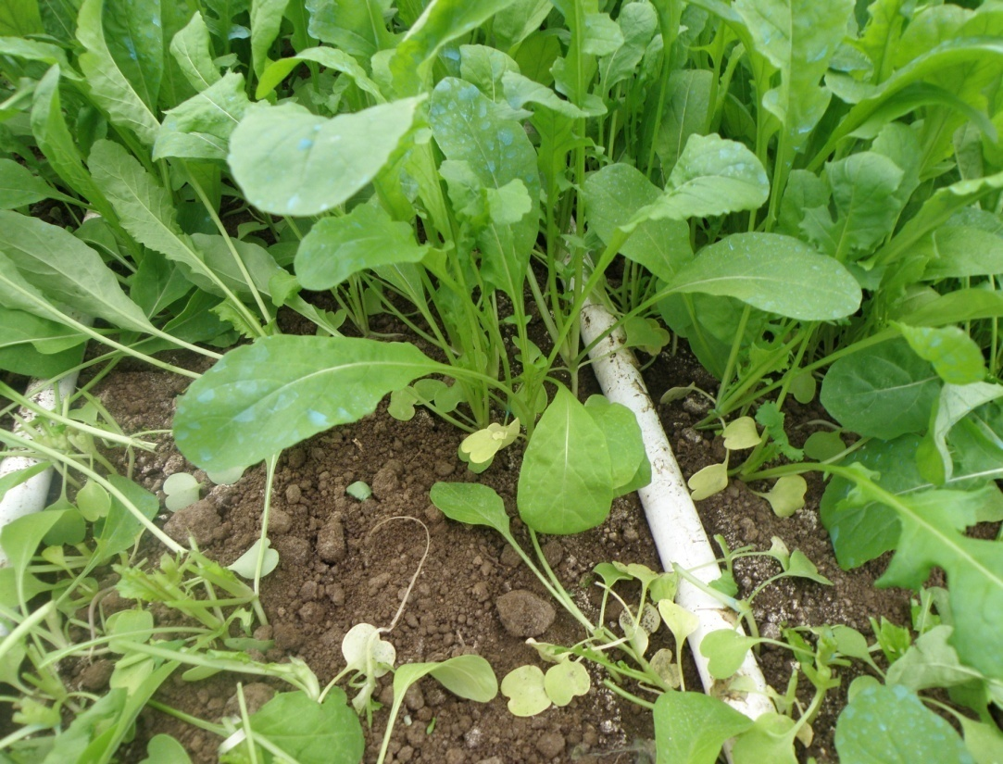
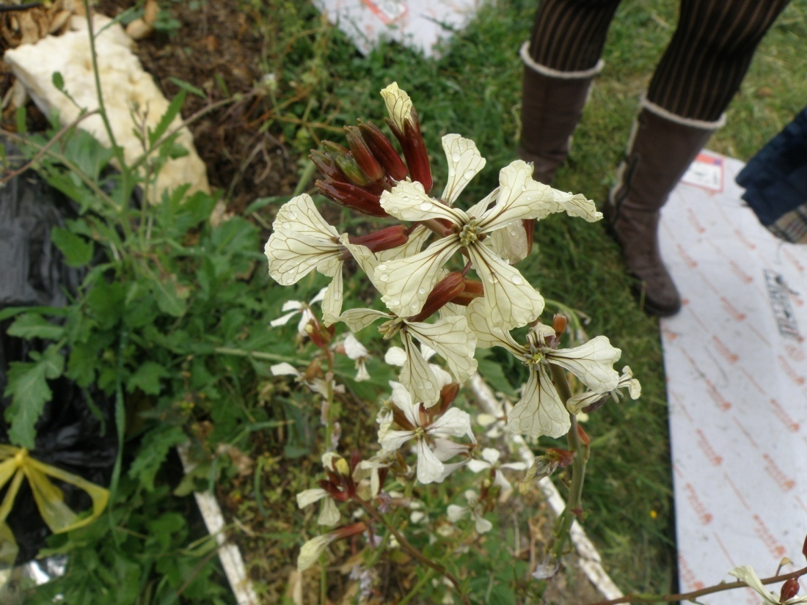
Rocket

Slide 34
Chenopodiaceae
Spinach (Spinacia oleracea L.)
Red beet (Beta vulgaris L. var. conditiva)
Swiss chard (Beta vulgaris L. var. sicla)

Slide 35
Spinach

Slide 36
Red beet

Slide 37
Swiss chard

Slide 38
Apiaceae
Celery (Apium graveolens L.).
Parsley (Petroselinum crispum Mill.).
Carrot (Daucus carota L. ).
Dill (Anethum graveolens L. var. hortorum).
Fennel (Foeniculum vulgare Mill.).

Slide 39
Celery

Slide 40
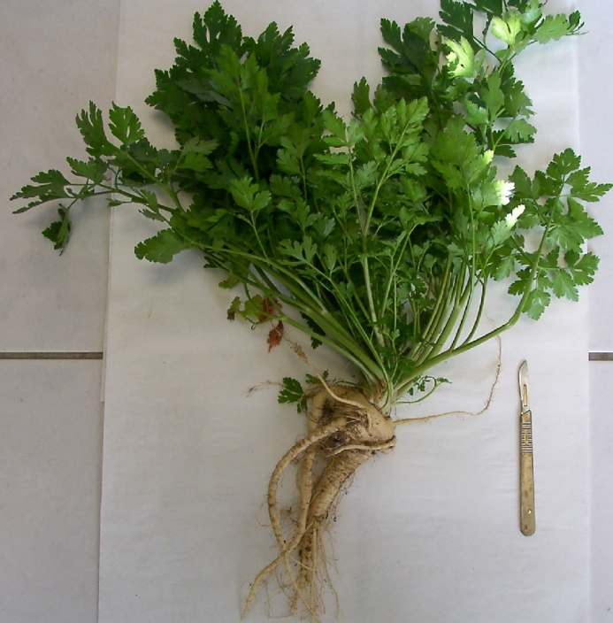
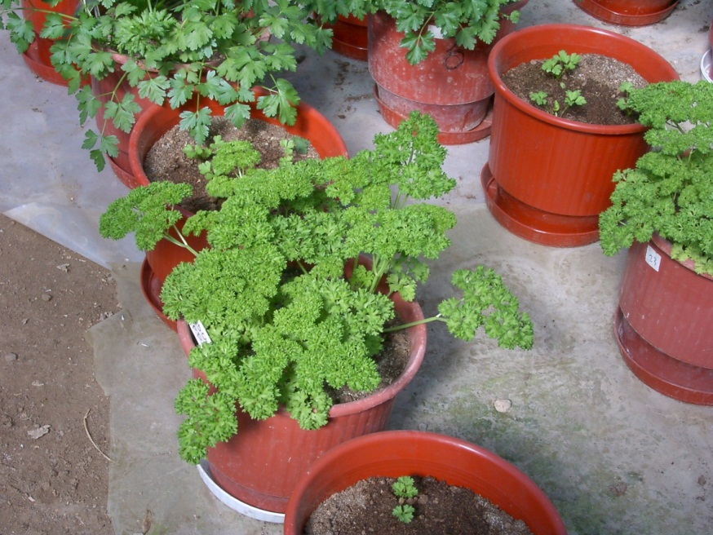
Parsley

Slide 41
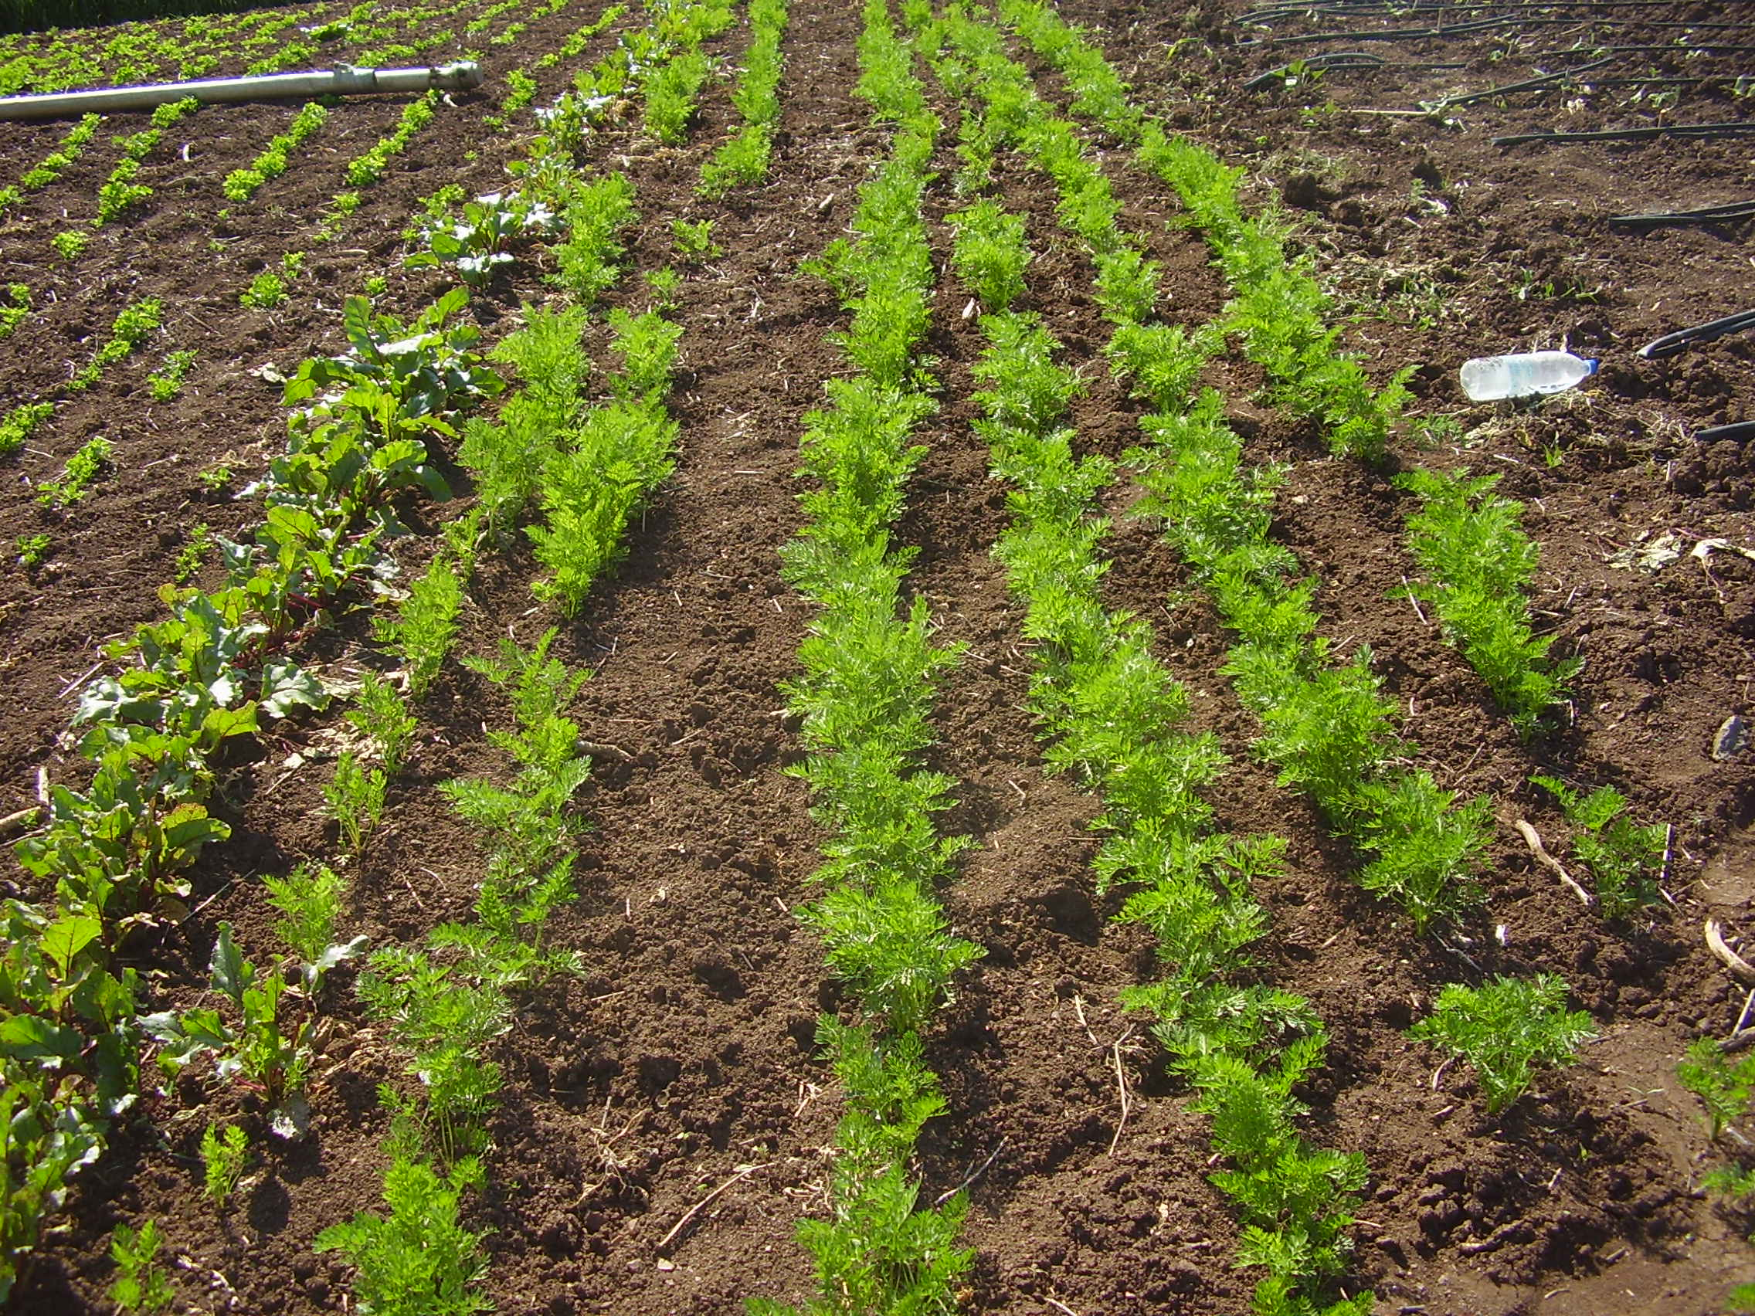
Carrot

Slide 42
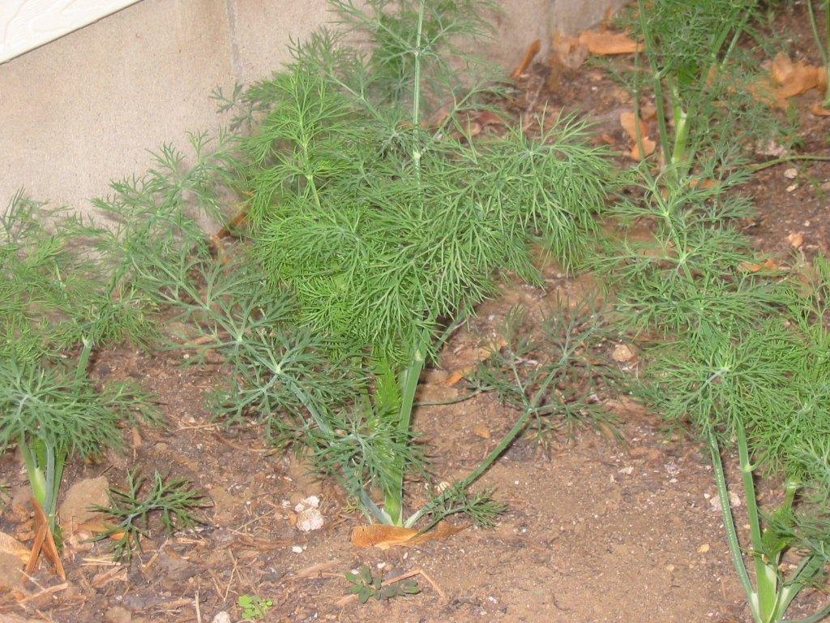
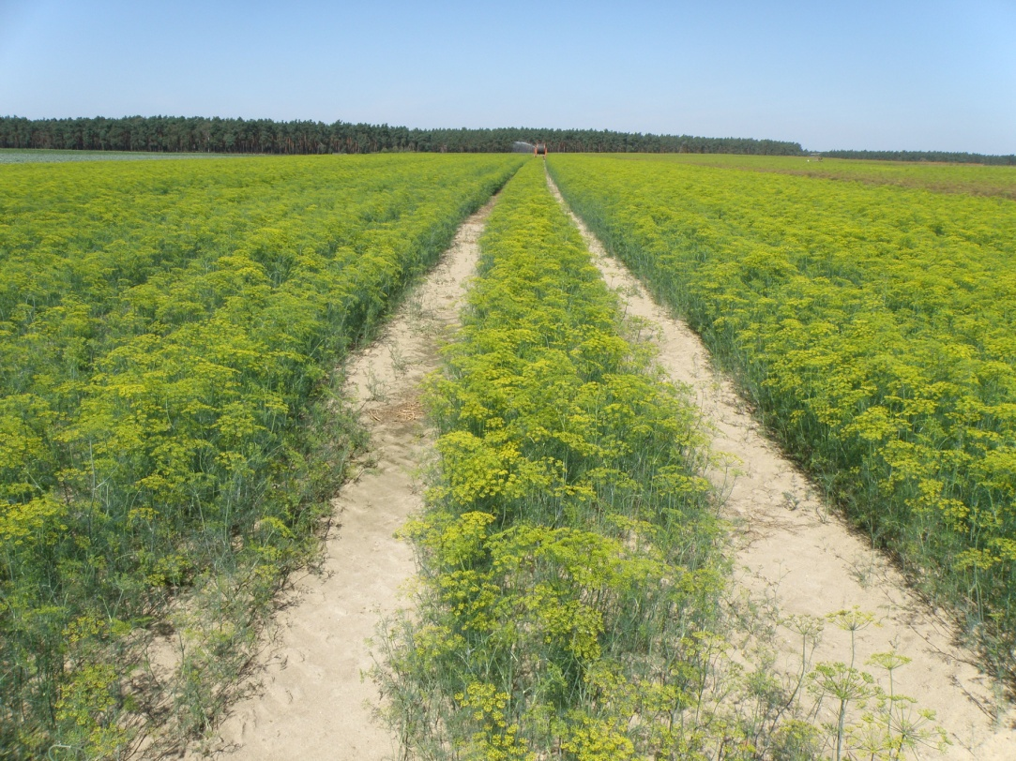
Dill

Slide 43
Fennel

Slide 44
Malvaceae
Okra
(Abelmoschus esculentus)

Slide 45
Alliaceae
Leek (Allium porrum L.).
Onion (Allium cepa L.).
Garlic (Allium sativum L.).

Slide 46
Leek

Slide 47
Onion

Slide 48
Garlic

Slide 49
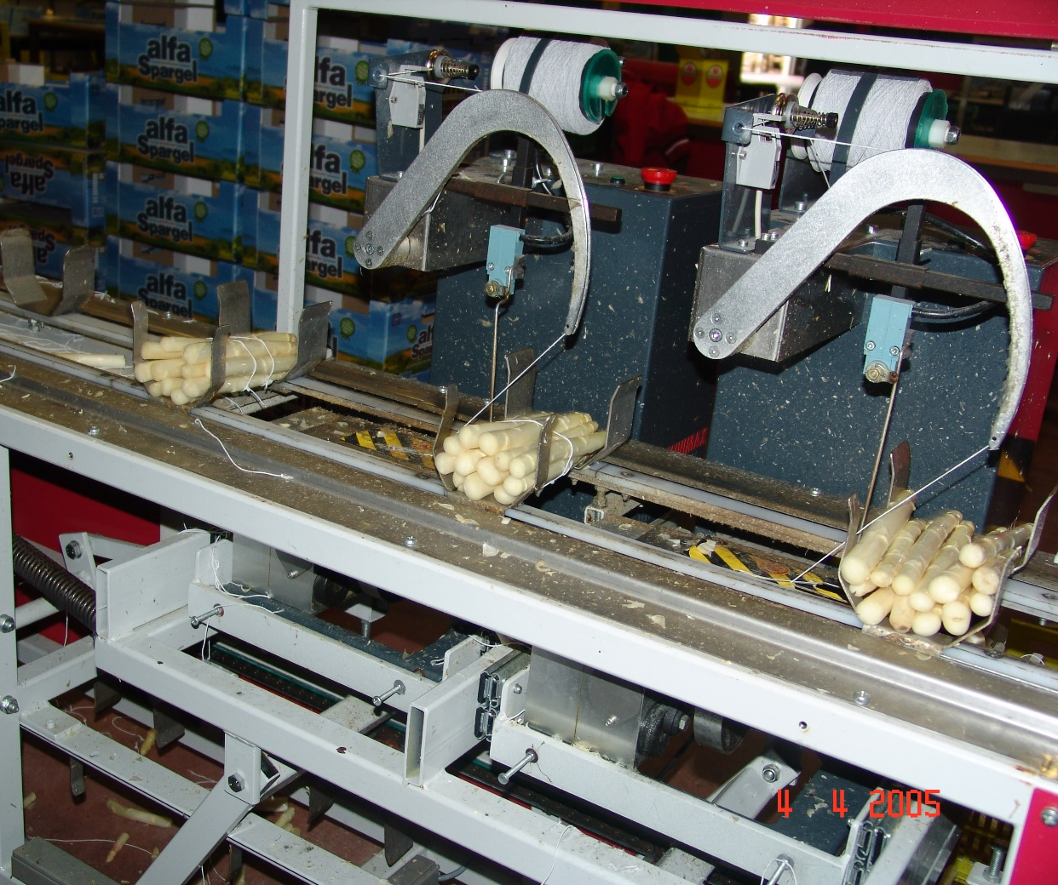
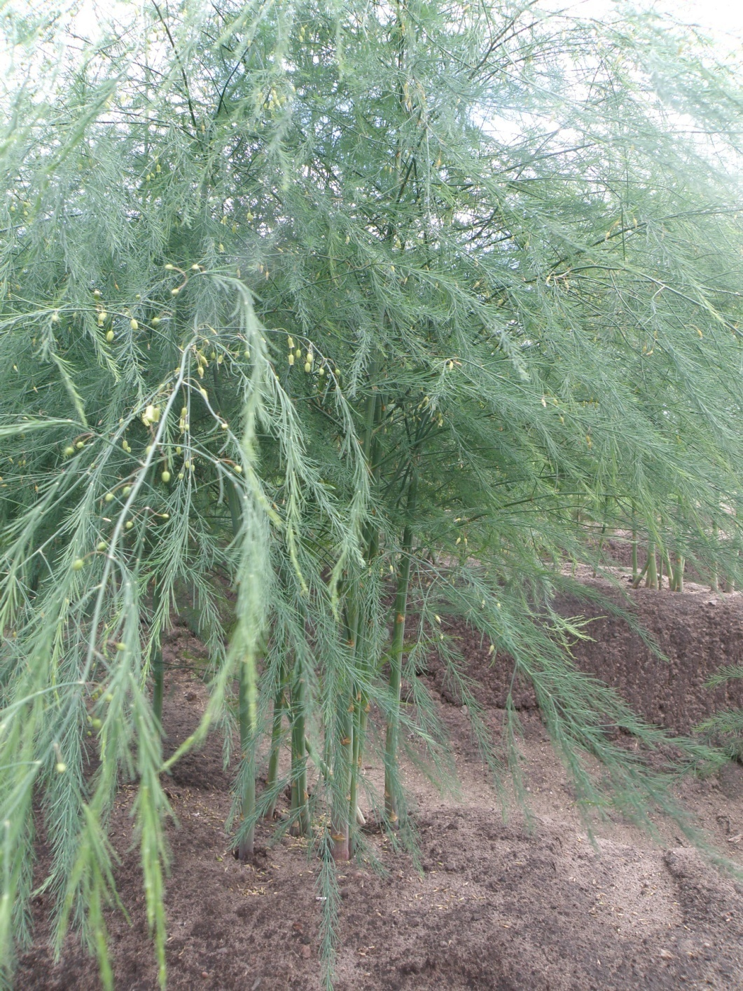
Asparagaceae
Asparagus (Asparagus officinalis L.).

Slide 50
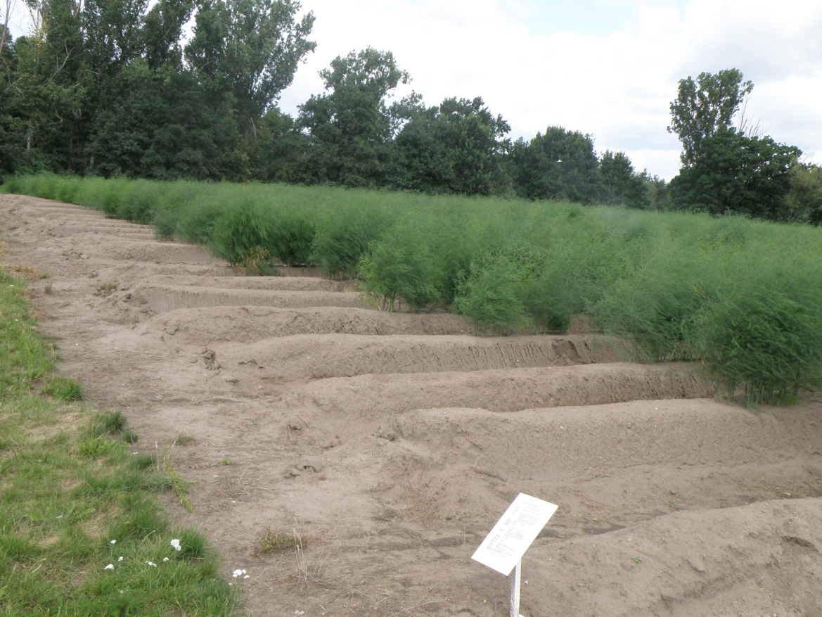
Asparagus

