Slide 1
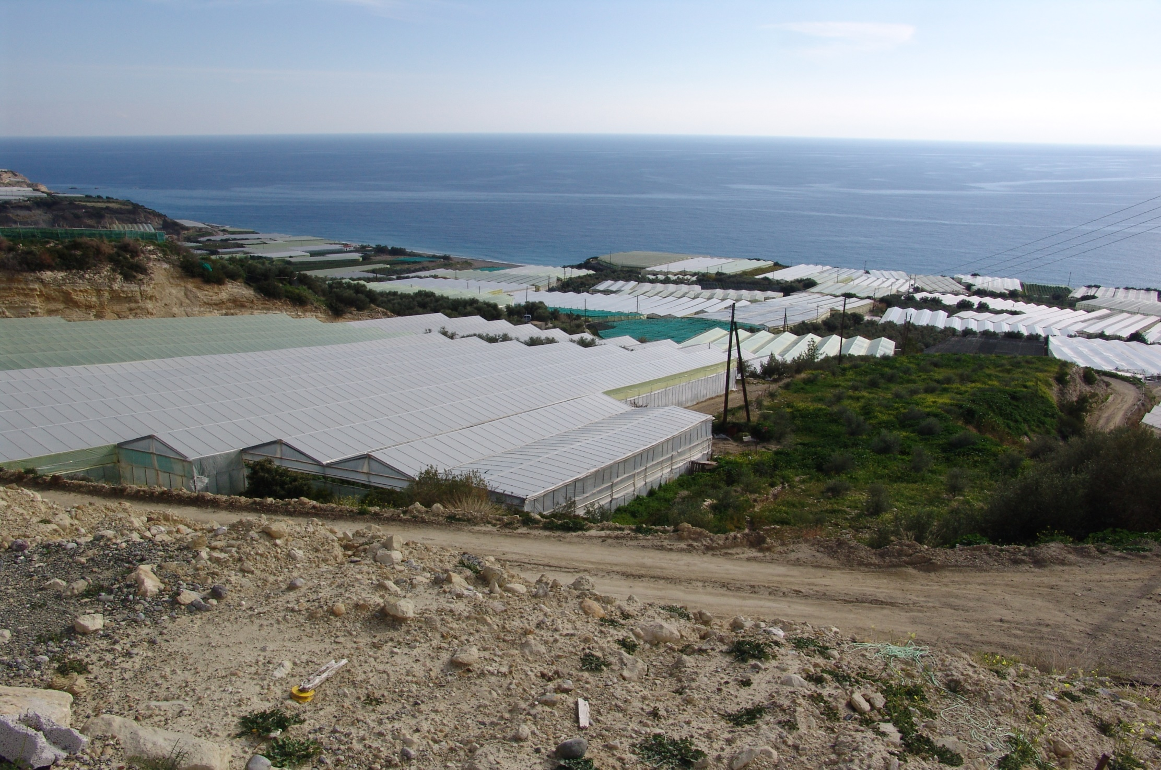
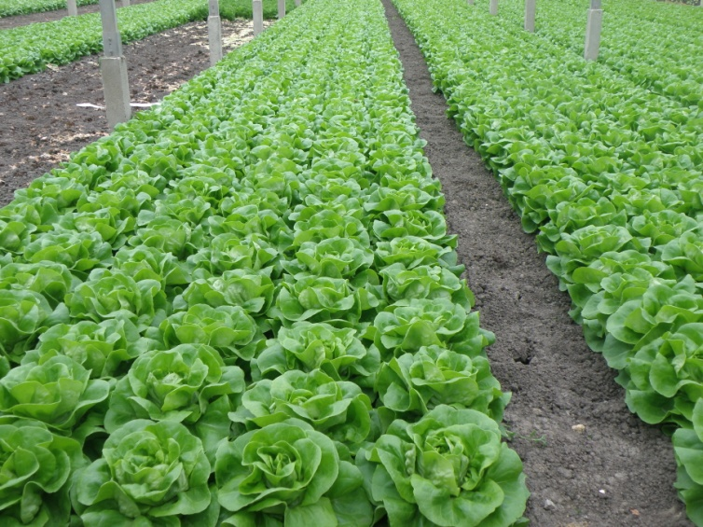
CULTURAL PRACTICES IN VEGETABLE PRODUCTION

Slide 2
SOIL PREPARATION
Soil tillage
Increase of organic matter content to improve soil texture and related characteristics, soil chemical properties and cation exchange capacity
Control of salinity and alkalinity
Provision of adequate and balanced nutrient supply

Slide 3
Soil tillage
The seedbed must be well prepared, usually following ploughing.
Soil compaction significantly reduces plant growth and yield.

Slide 4
ROTATION
Crop rotation is a planned order of specific dissimilar types of crops planted on the same field for a number of subsequent years (commonly 2 to 4).
Crop rotation mitigates the build-up of pathogens and pests that often occurs when one species is continuously cropped.
Crop rotation can improve soil structure and fertility by alternating deep-rooted and shallow-rooted plants.

Slide 5
Objectives
Crop rotation has several agronomic objectives including:
maintaining or increasing yield by helping to control weeds, pests and crop diseases and increasing plants' resilience to adverse weather effects;
improving soil fertility and structure and ensuring nutrient management by balancing the fertility demands of different crops.

Slide 6
Vegetable crop establishment
Sowing (placement of seed directly to the field)
Transplanting of seedlings produced in nurseries

Slide 7
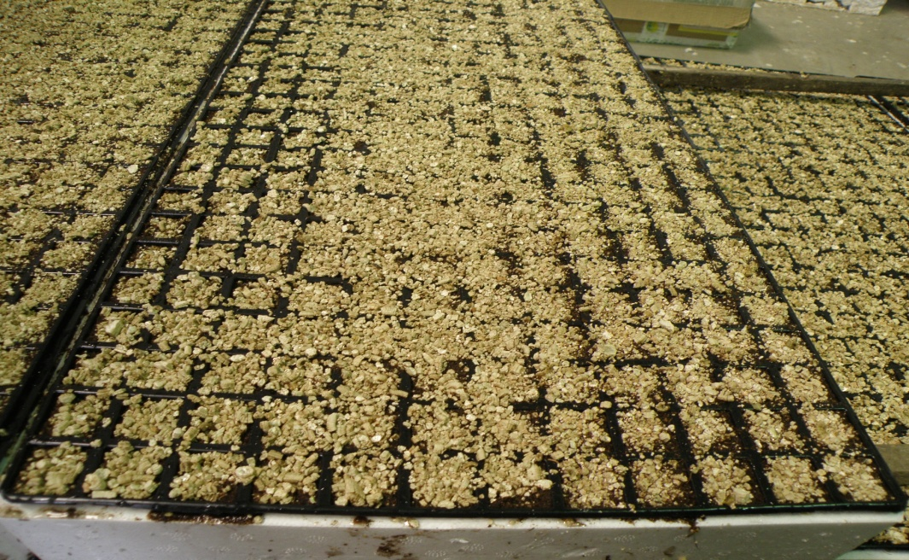
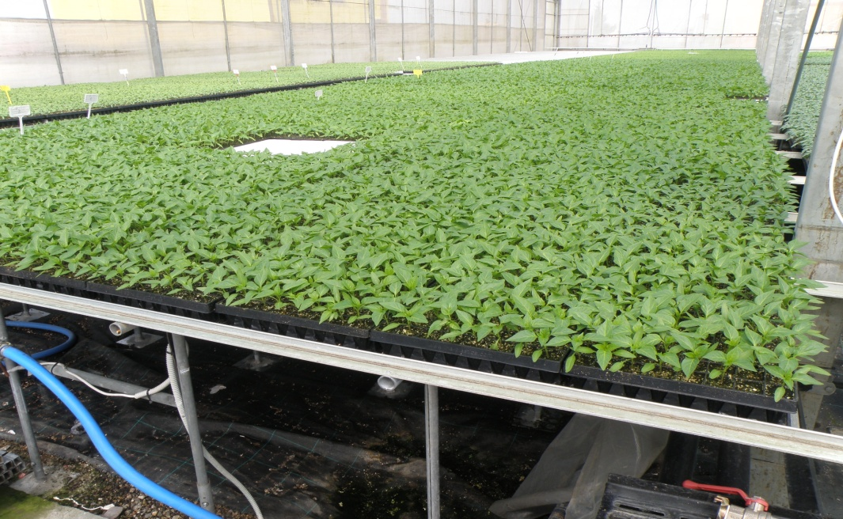
Sowing in nurseries
Sowing in polystyrene trays
Pepper seedlings ready for transplanting
Sowing in plastic trays
Seedling trays placed on benches in a nursery

Slide 8
A small nursery

Slide 9
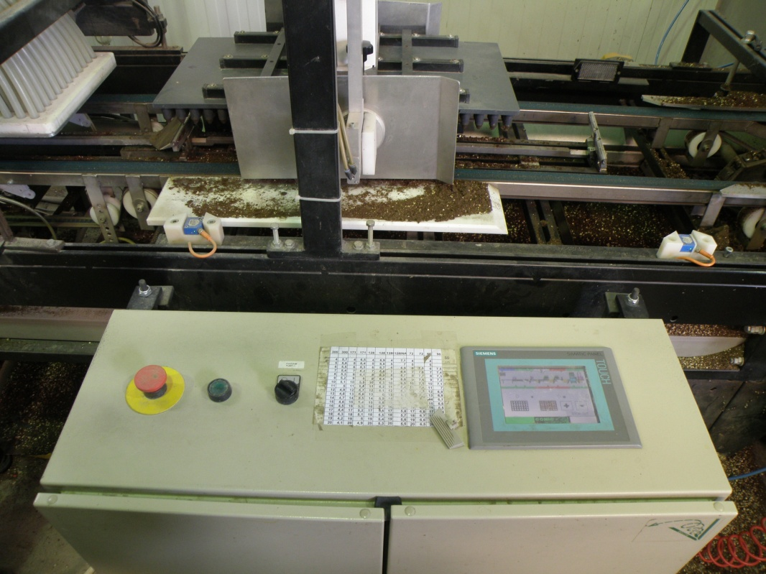
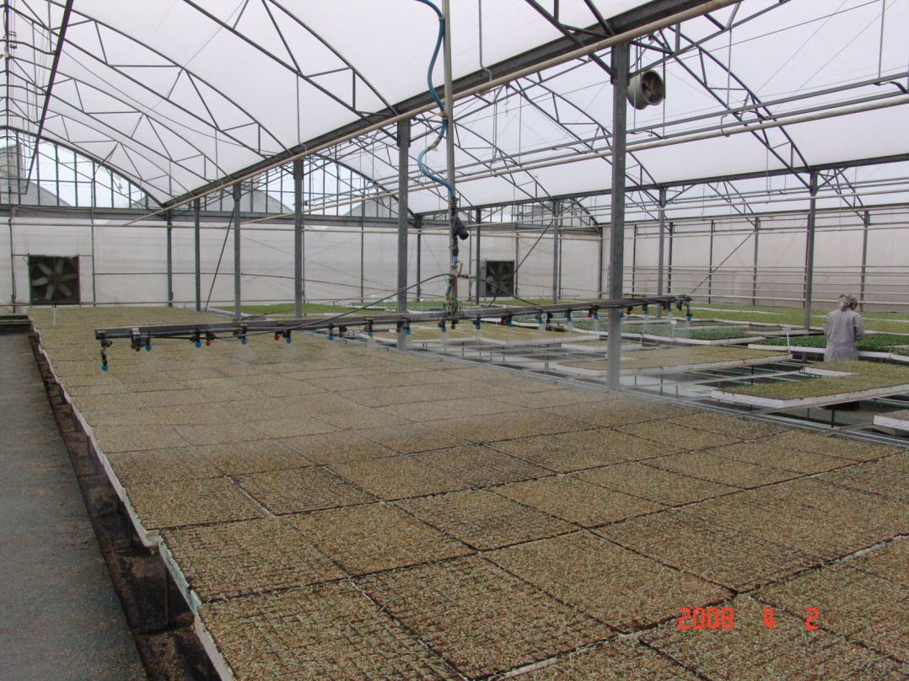
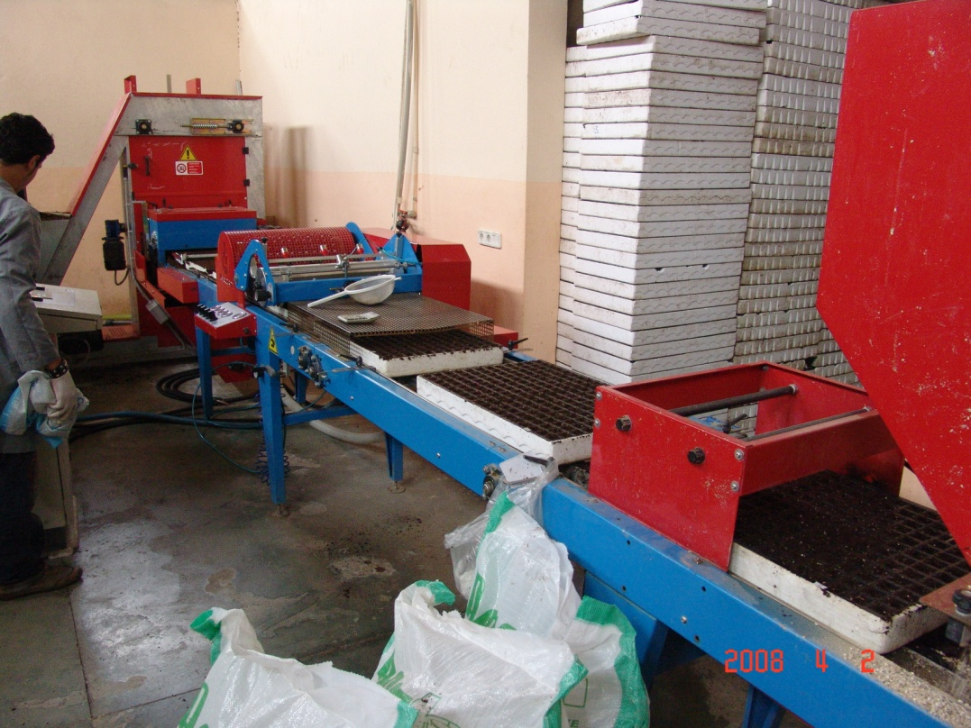
Automated control of a sowing machine
Irrigation of seedlings in a nursery
Seedlings on benches
Machinery for automated sowing in seedling trays

Slide 10
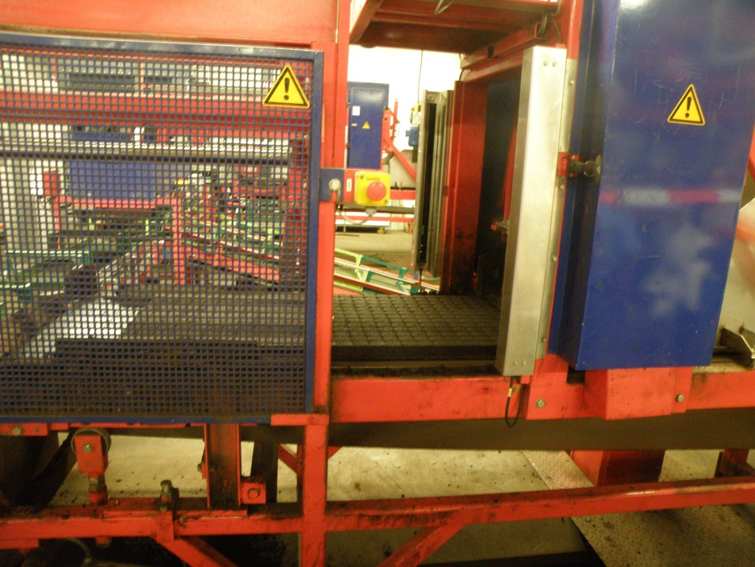
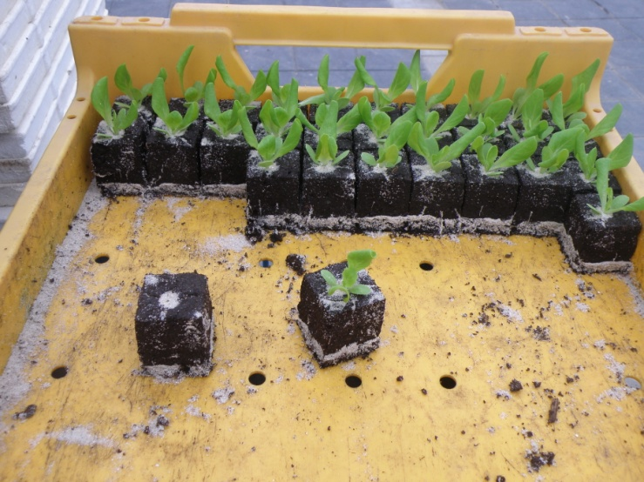
Automated equipment for production of substrate cubes and sowing in a nursery.

Slide 11
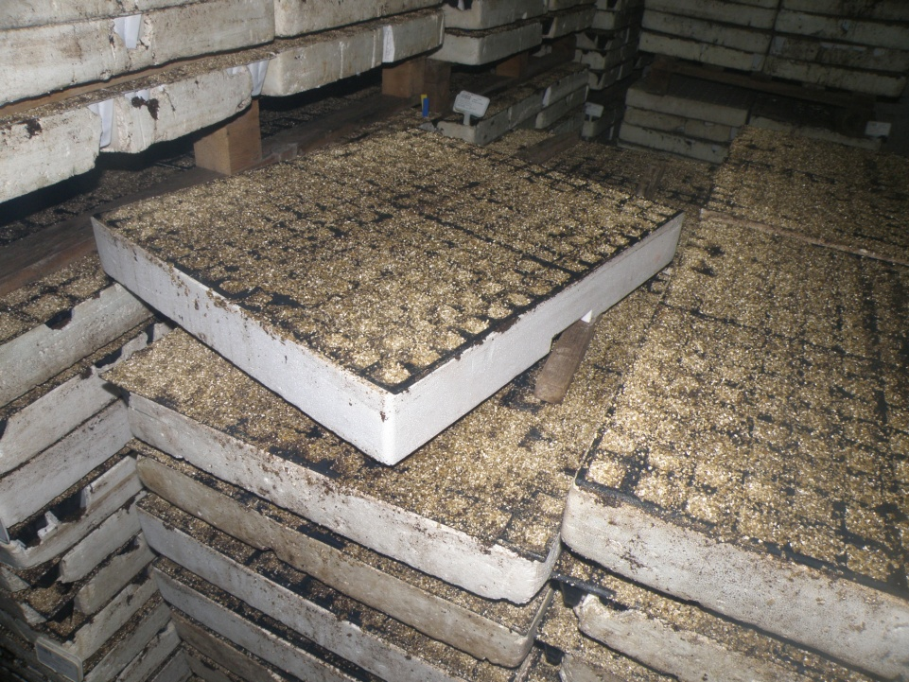
Germination chamber in a nursery

Slide 12
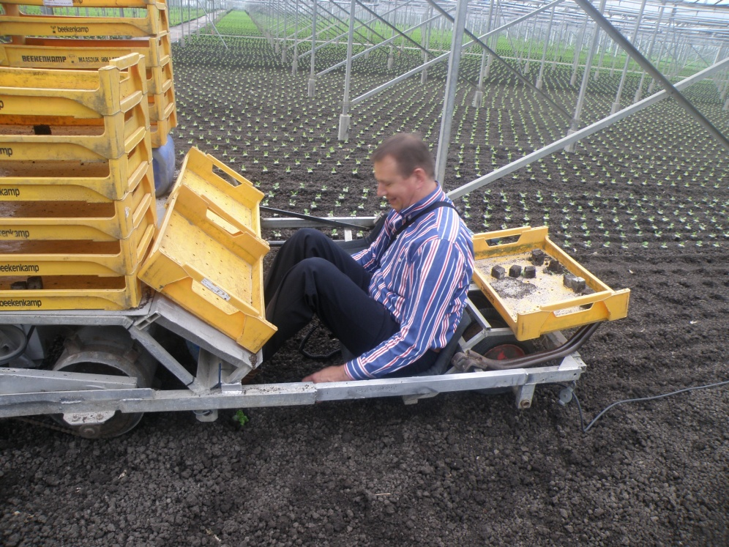
Transplanting
Transplanting of leek in an open field
Transplanting of lettuce in the greenhouse

Slide 13
Soil mulching

Slide 14
Objectives
Increase soil temperature to achieve earliness
Weed control
Preserve soil moisture
Prevent soil errosion

Slide 15
Mulching materials
Plastic sheet
Straw
Sawdust
Tree bark
Plant residues

Slide 16
Mulching in potato and watermelon crops

Slide 17
Cultivation of vegetables in low tunnels
The main objective is earliness
This technique is based on trapping thermal ratiation emmitted by the soil
Low tunnels are applied in combination with soil mulching

Slide 18
Melon in low tunnel

Slide 19
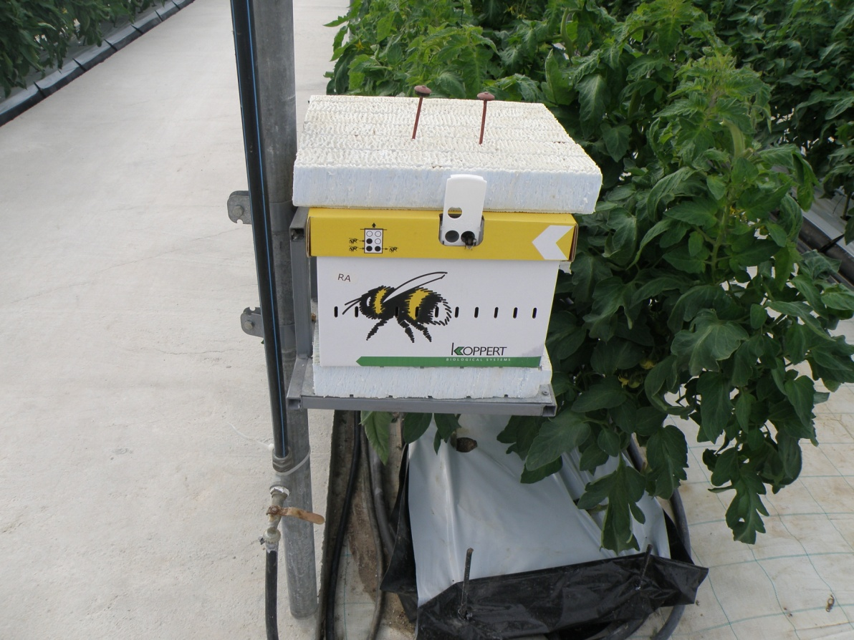
Use of bumble bees for pollination in greenhouses

Slide 20
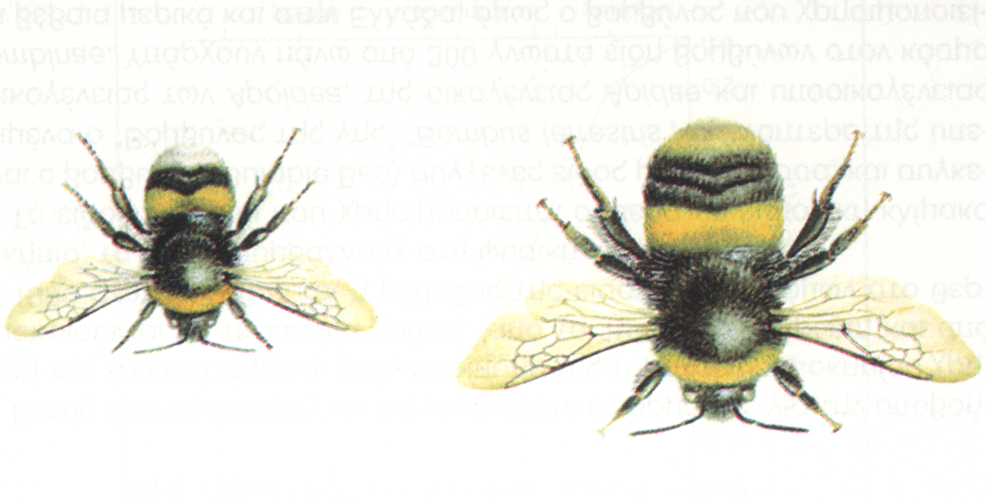
Α. Worker Β. Queen
Α
Β

Slide 21
Irrigation of vegetables

Slide 22
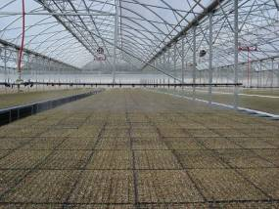
Sprinkler irrigation
Waste of water
Wet foliage (disease risk)
Suitable mainly for nurseries
Suitable mainly for low crops

Slide 23
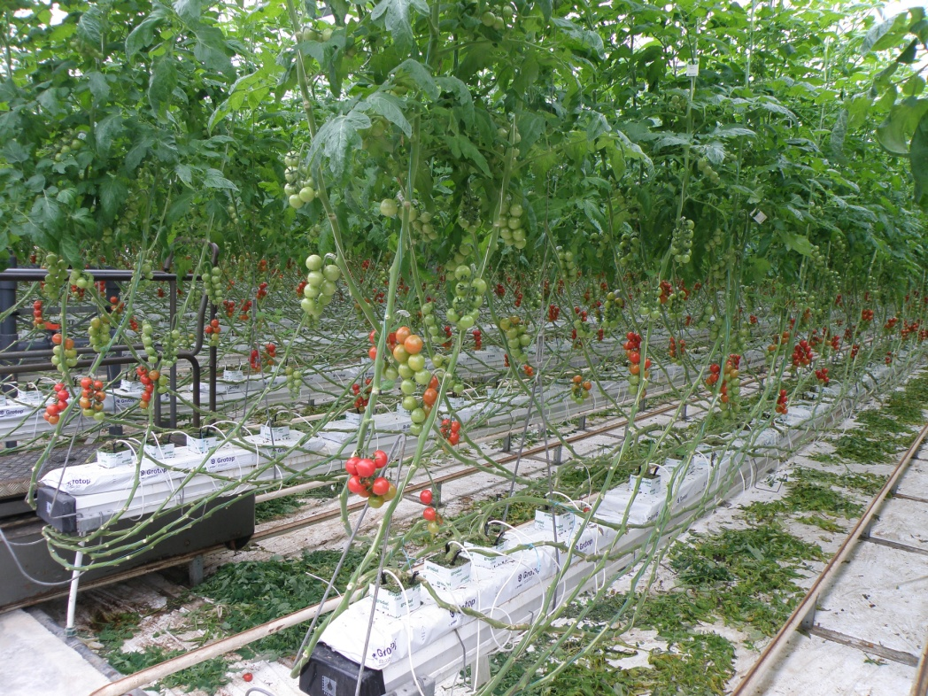
Drip irrigation
Most widely used method
Saves water
Maximum water use efficiency
Minimum labor
Uniformity in water supply

