Slide 1
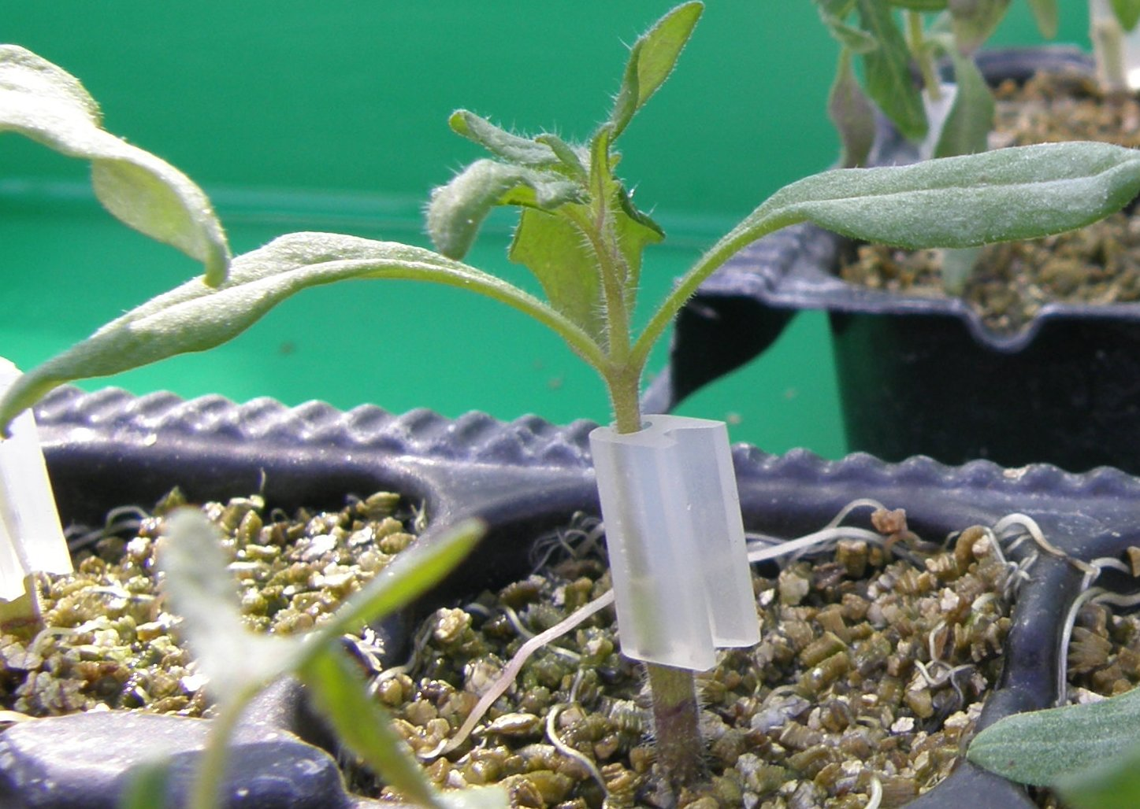


Vegetable grafting
Georgia Ntatsi
Laboratory of Vegetable Production
Agricultural University of Athens

Slide 2
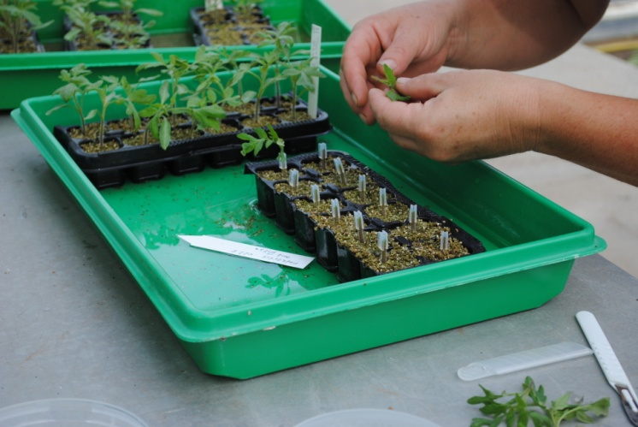
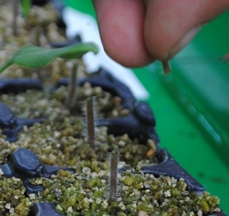
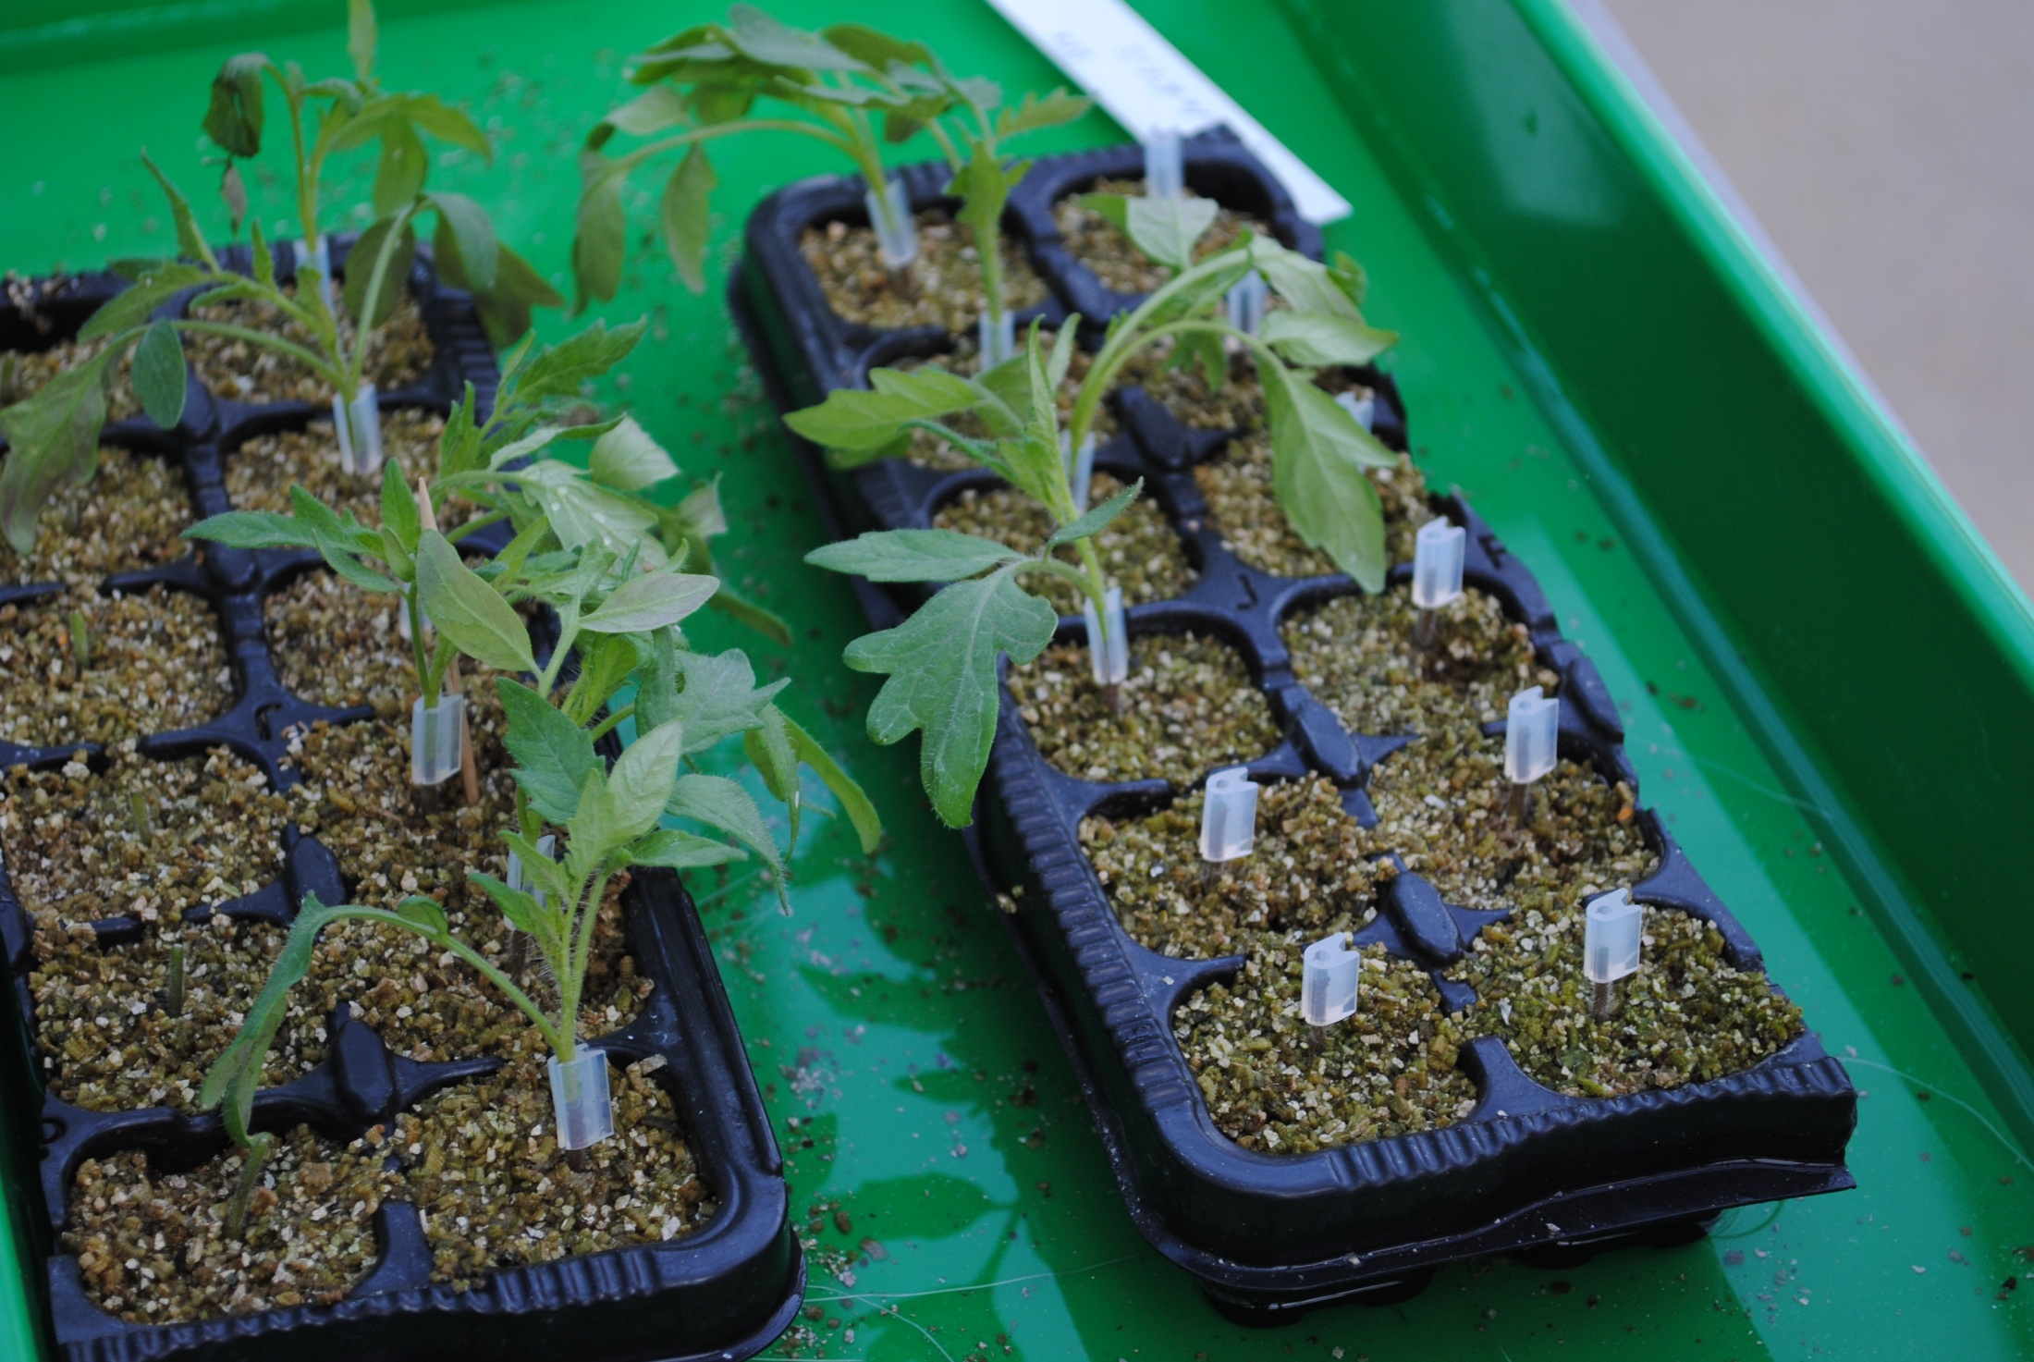
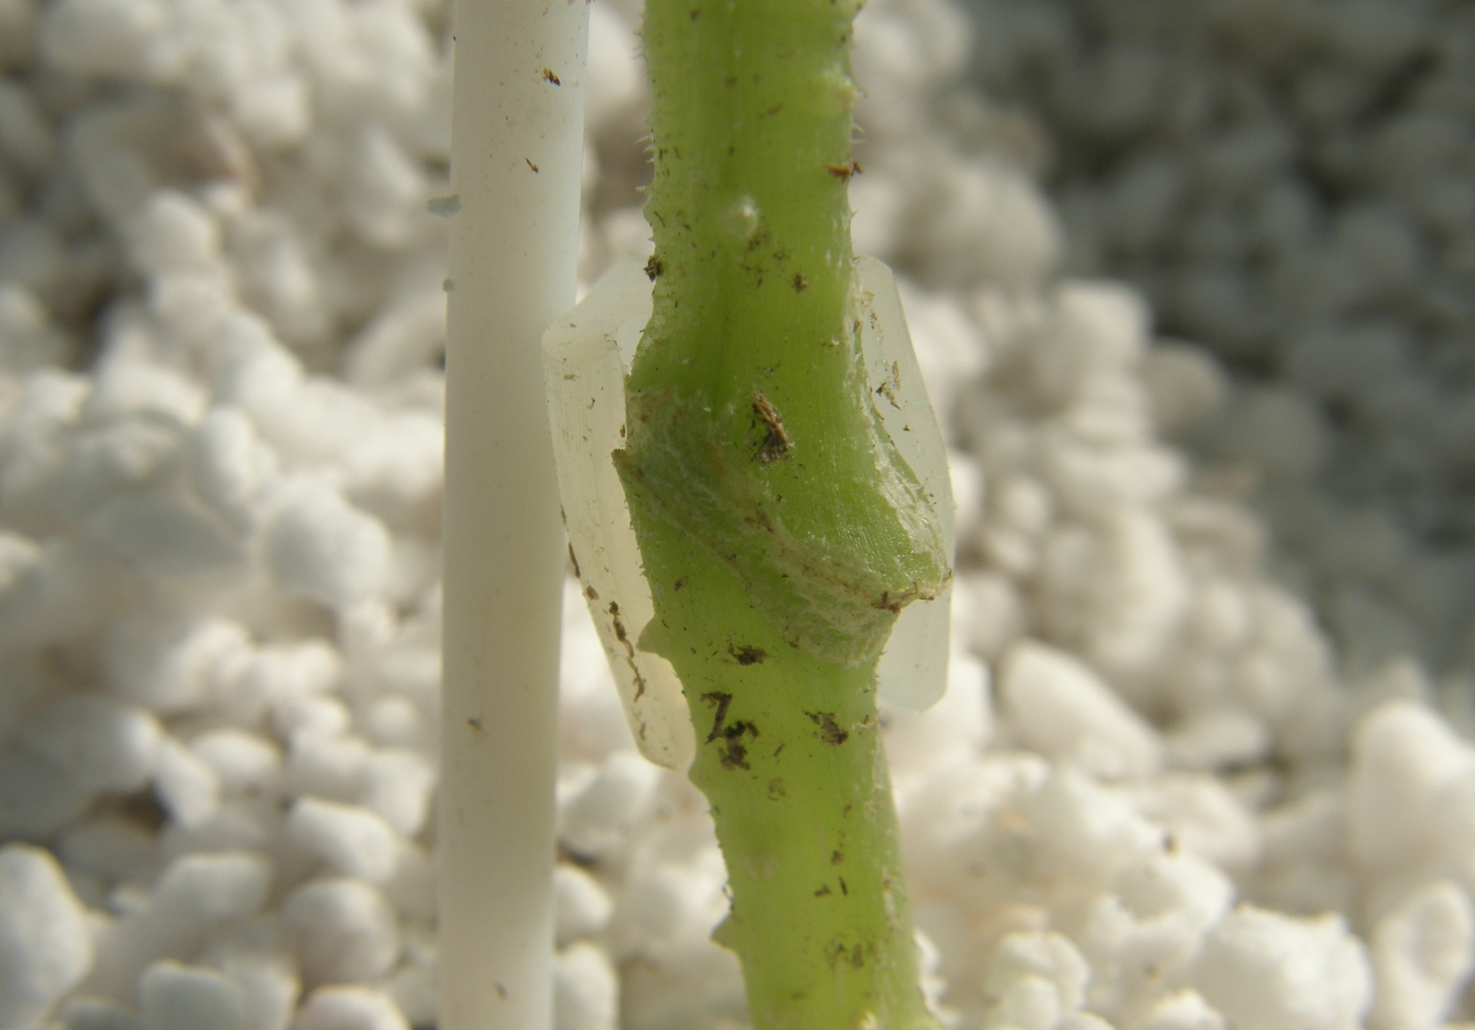
What is grafting?
The union of two or more pieces of living plant tissue, which are forced to develop vascular connection and grow as a single
Savvas, et al.2010 Sci. Hort

Slide 3
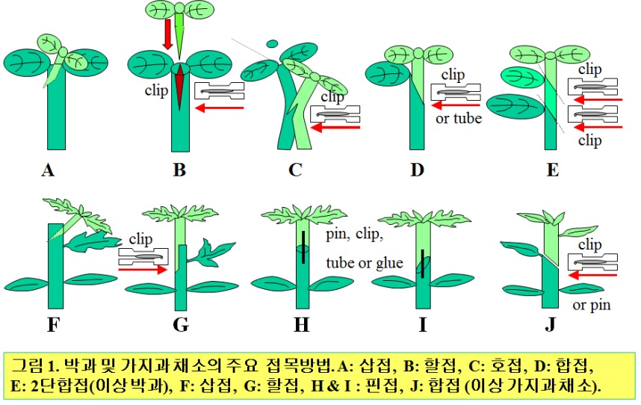
Grafting methods applicable for herbaceous grafting
Grafting methods commonly practiced
Cucurbits (up)-A: hole insertion TAG), B: cleft (CG), C: tongue approach(TAG), D: splice SP), and E:double splice grafting)DSG)
Solanaceous Crops(down)- F: hole insertion(TAG), G: cleft(CG), H & I: pin (PG), and J:splice grafting(SG)

Slide 4
Major grafting methods
Cut line
Splice
Hole Insertion
Tongue Approach

Slide 5
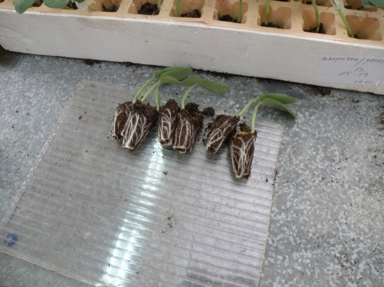
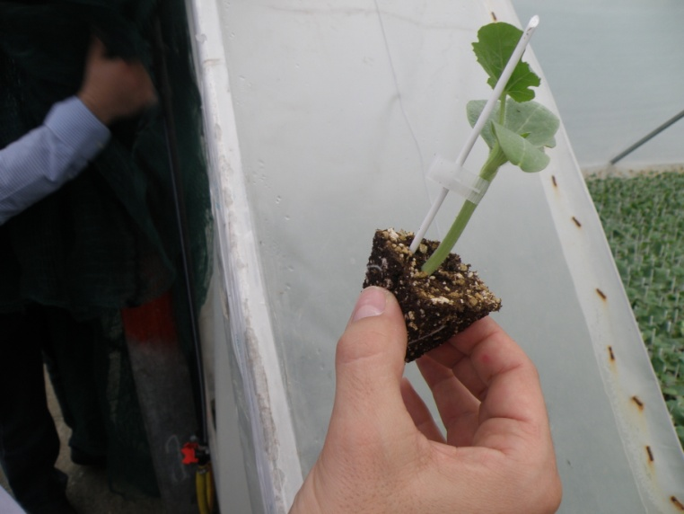
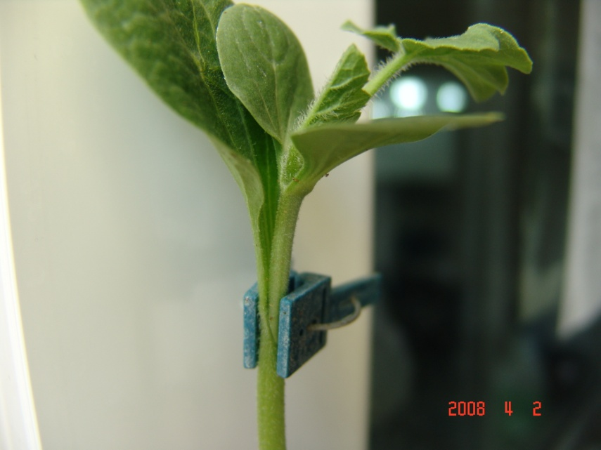
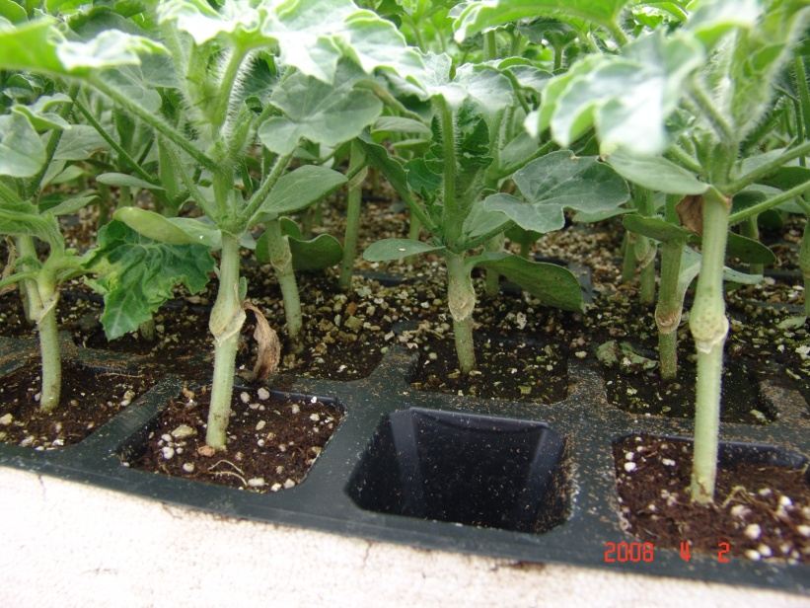
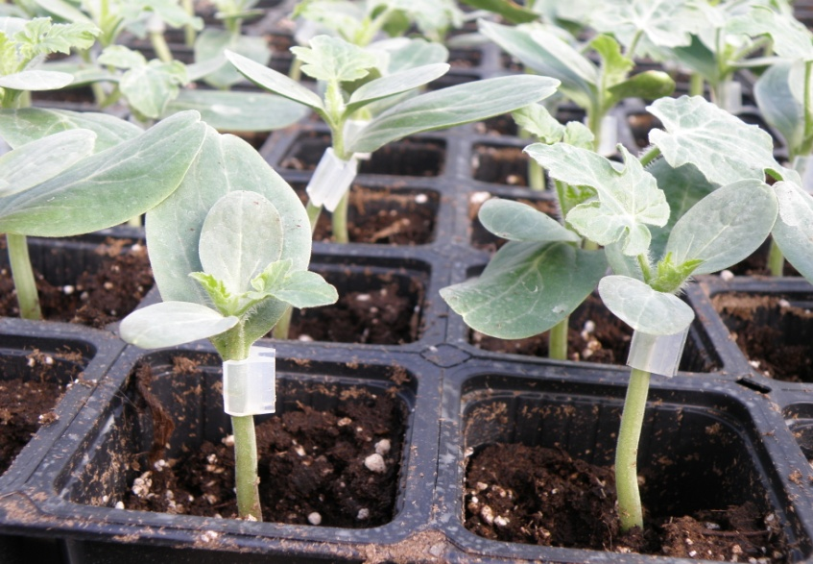
  Grafting of Cucurbitaceae
.
.
.
.
.
.
.
.
.
.
.
.
.
.
.
.
.
6.3γ
6.3δ

Slide 6
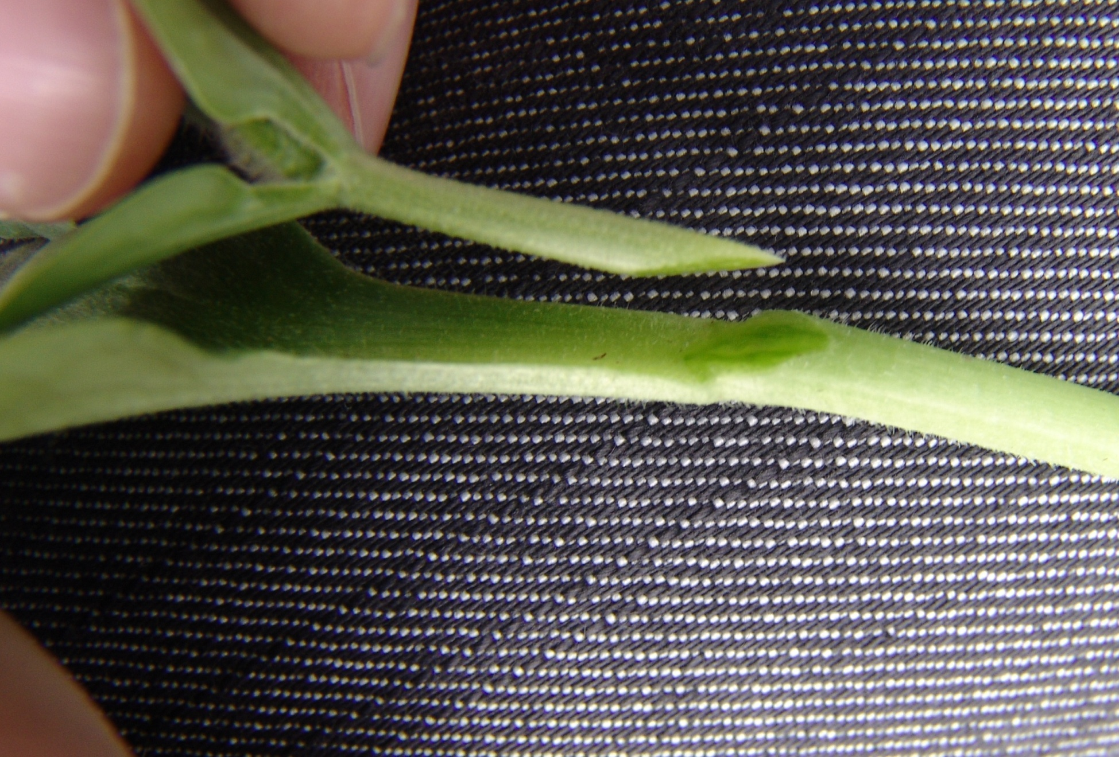
Splice grafting in Cucurbitaceae

Slide 7
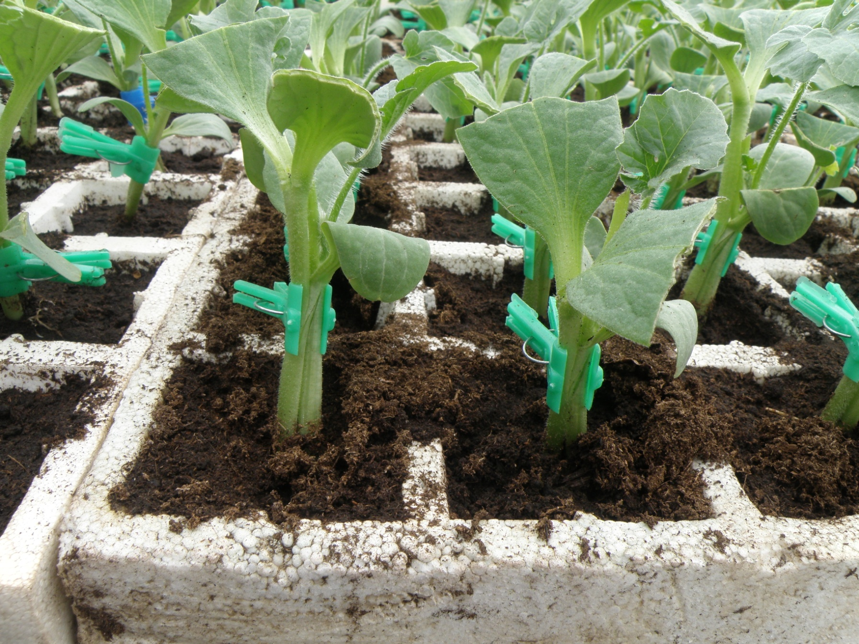
Tongue approach grafting in Cucurbitaceae

Slide 8
Hole insertion grafting in Cucurbitaceae

Slide 9
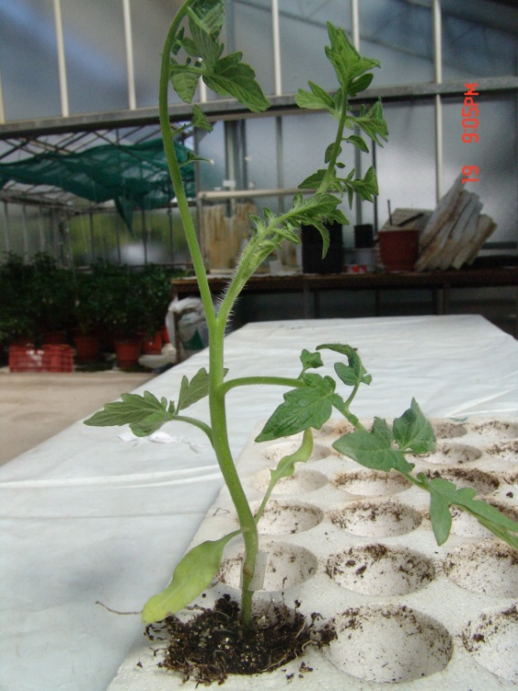
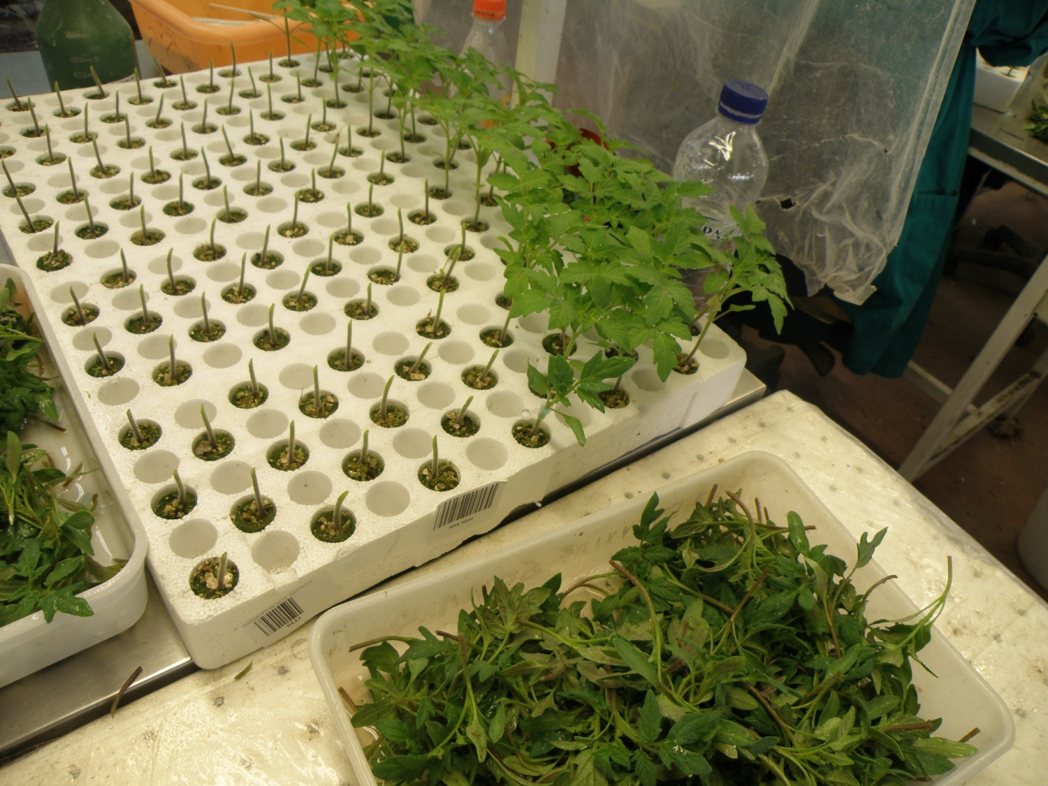
  Grafting of Solanaceae
  (splice grafting)
.
.
.
.
6.3γ
6.3δ

Slide 10
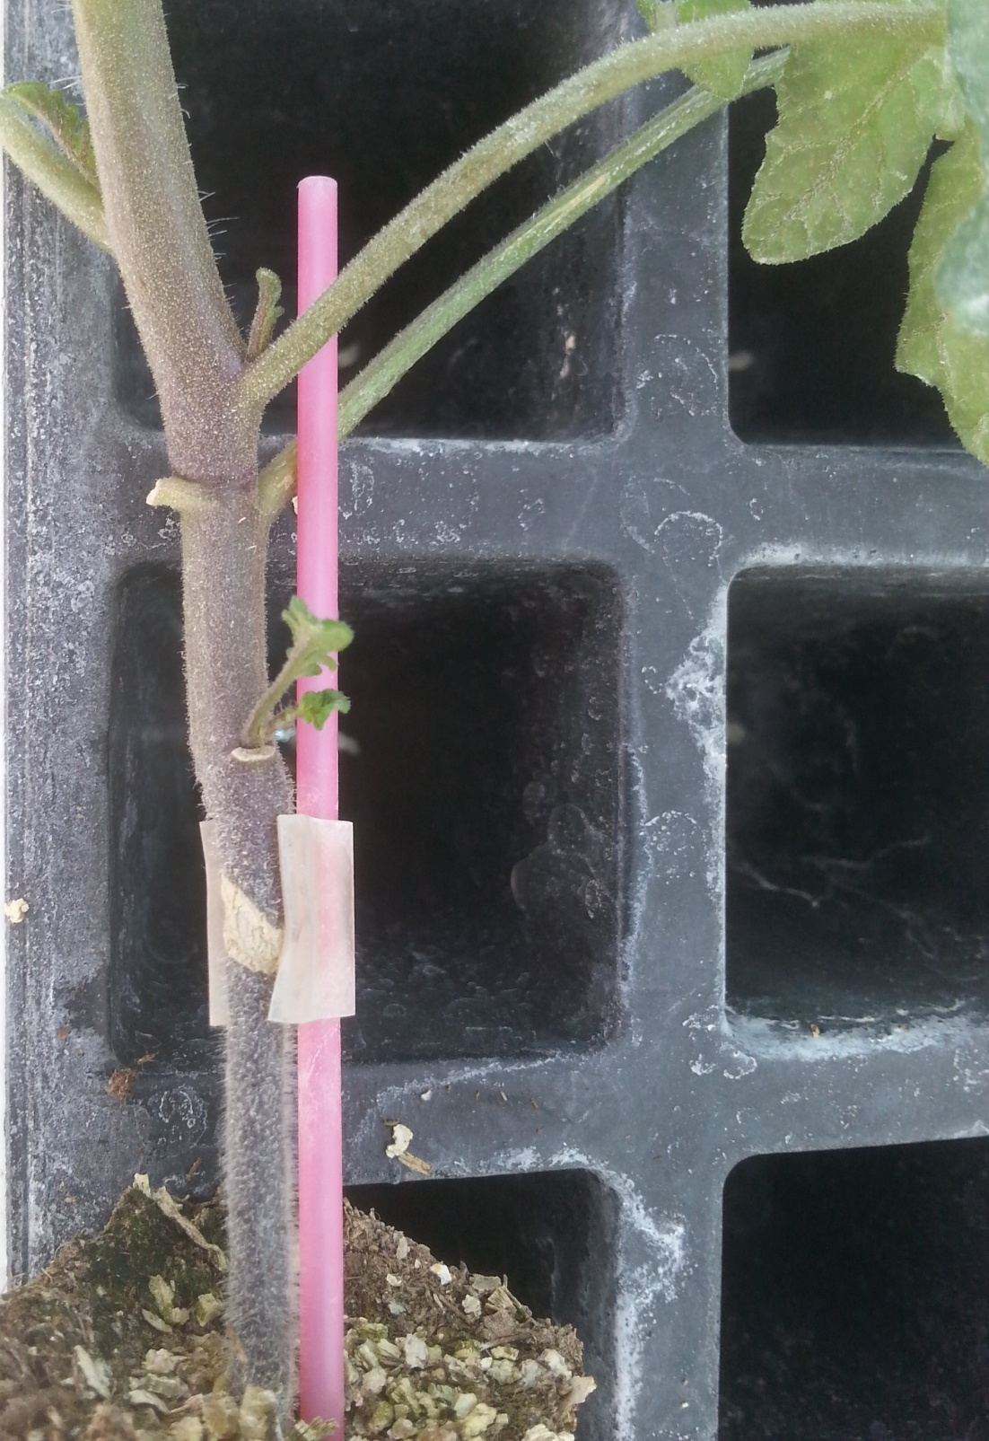
Tomato plant grafted following the splice grafting method

Slide 11
Cleft grafting

Slide 12
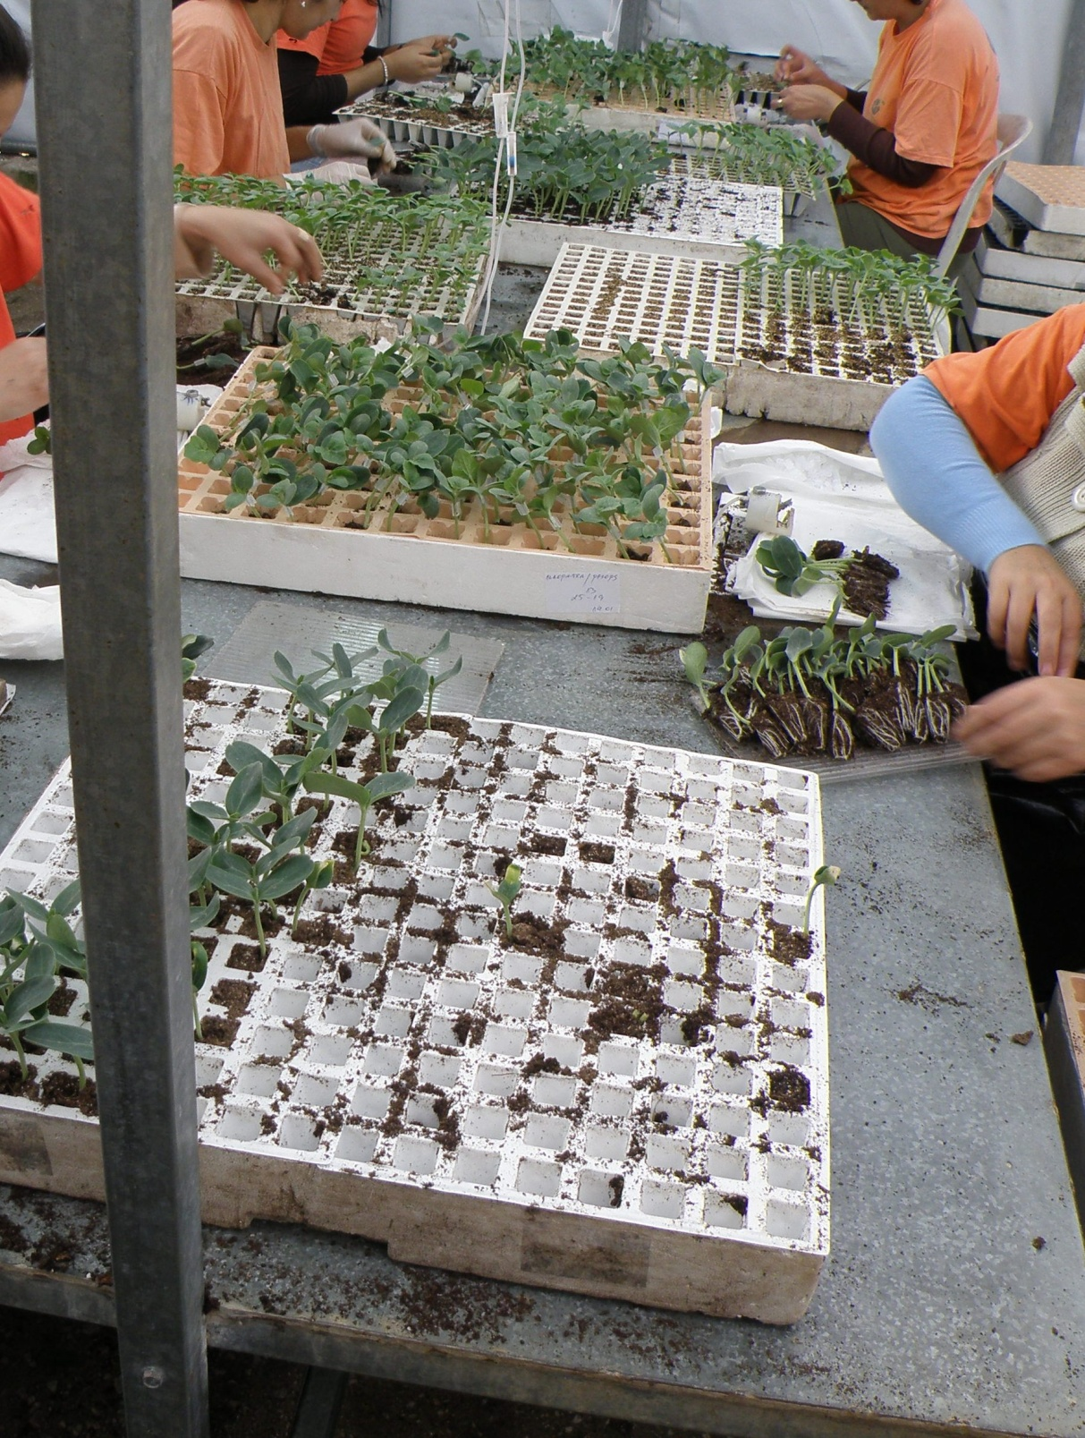
Manual grafting

Slide 13
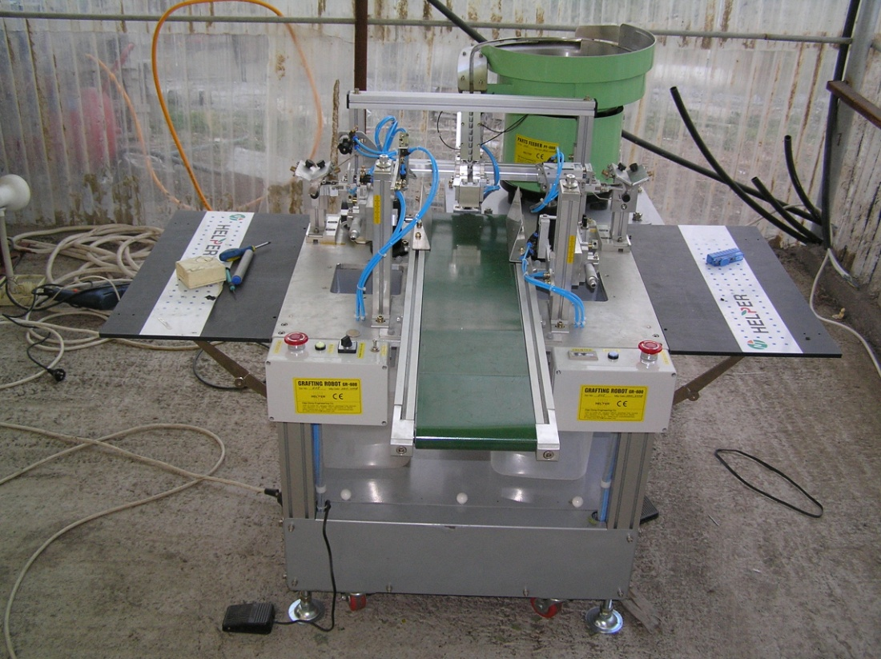
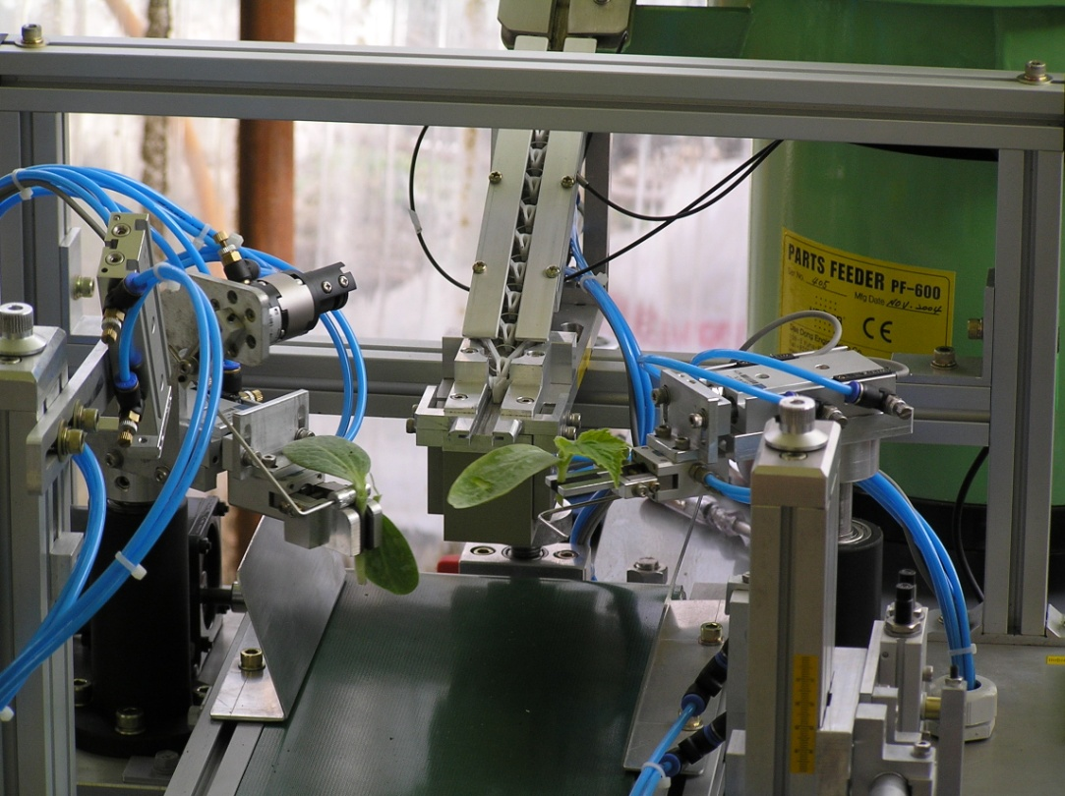
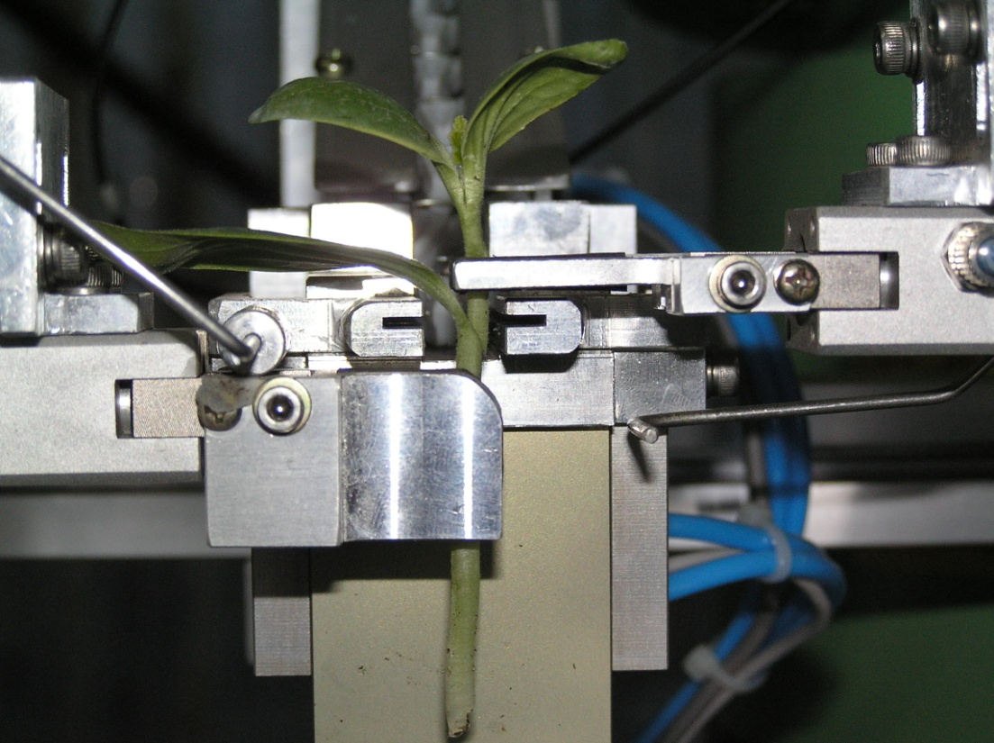
Grafting machine

Slide 14
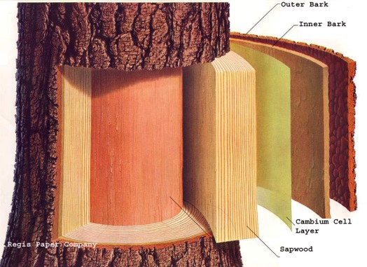
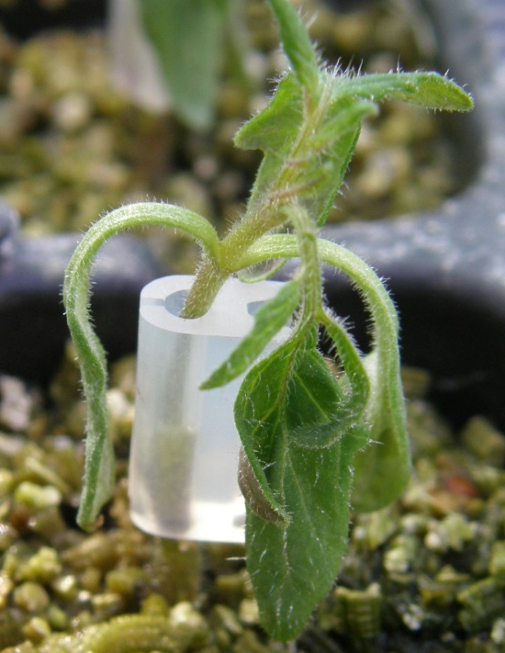
Grafting Union Formation
What happens?
callus proliferation (from both the rootstock and the scion),
callus bridge formation,
differentiation of new vascular tissue from callus cells and
production of secondary xylem and phloem
A low or incorrect callus formation between the rootstock and scion could lead to
defoliation
reduction of scion growth
low survival of grafted plants
Martínez-Ballesta, et al.2010 Sci. Hort. 127, 112-118

Slide 15
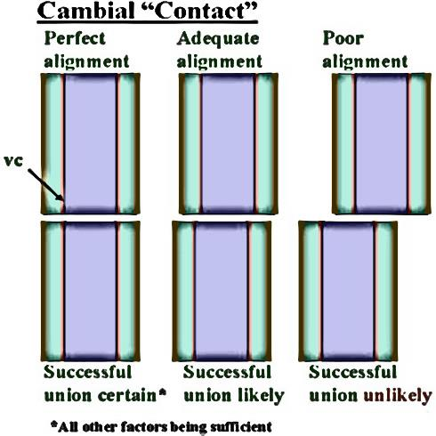
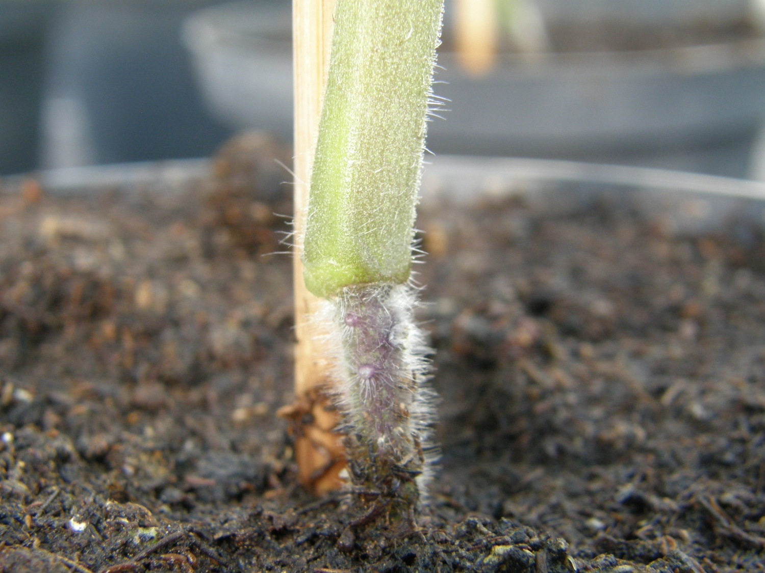
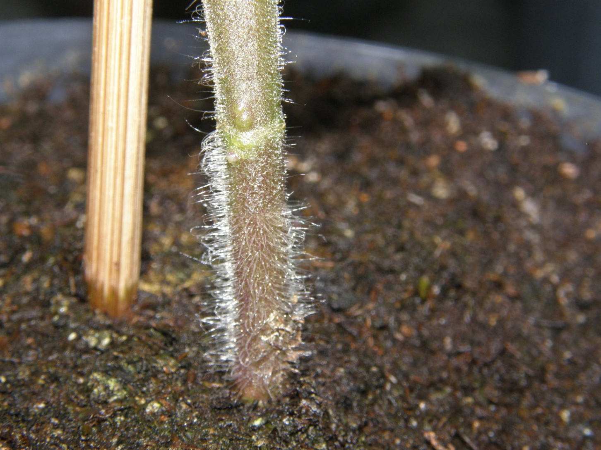
What makes grafting successful?
Compatibility
Cambial "contact" (alignment)
CO/LA 1777
CO/MM

Slide 16
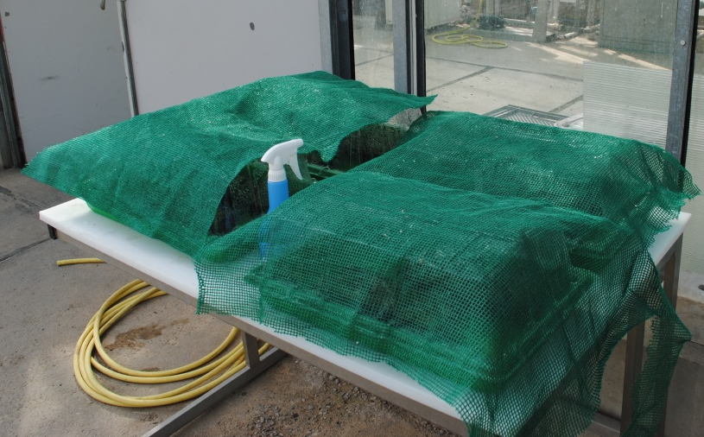
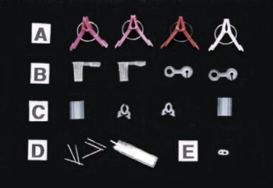
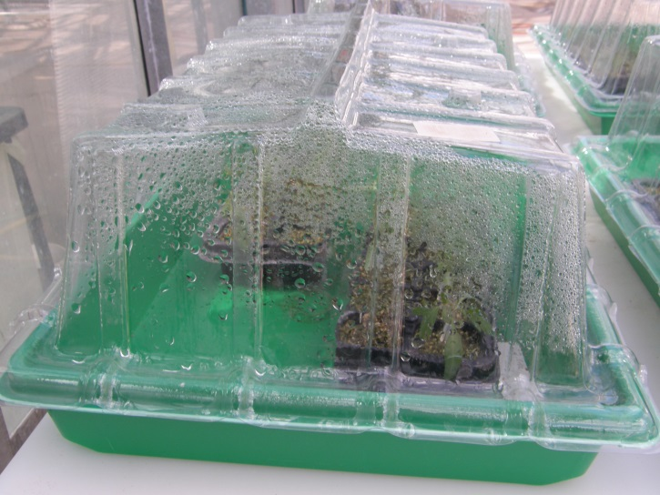
What makes grafting successful?
C. Pressure (To form a continuous bridge of callus, across which a new vascular cambium and then xylem and phloem)
D. Avoid tissue desiccation (mechanical barriers to water vapor loss are important)
Promotion of cell division from the graft union is optimum under environmental conditions of 25-30°C and 95% or higher relative humidity, which protect the wounded tissues from desiccation

Slide 17
Percentages of non-grafted, self-grafted and hetero-grafted tomato plants infected by: a) Fusarium oxysporum f. sp. lycopersici and b) bacterial wilt (Ralstonia solanacearum).

Slide 18
Impact of grafting and rootstock genotype (‘Beaufort’, He-man’ ‘Resistar’) on leaf Na concentration in tomato grown at low (0.3 mM), moderate (22 mM) or high (45 mM) salinity.
Leaf Na concentration (mg g⁻¹ D.W.)

Slide 19
Mechanisms involved in rootstock performance at stress conditions
Root growth and architecture
Root functioning
Nutrient absorption
Absorption and translocation of water
Lipid peroxidation and antioxidants
Sink-source relations (photosynthesis)
Production, (upward) transport and signaling of phytohormones

Slide 20
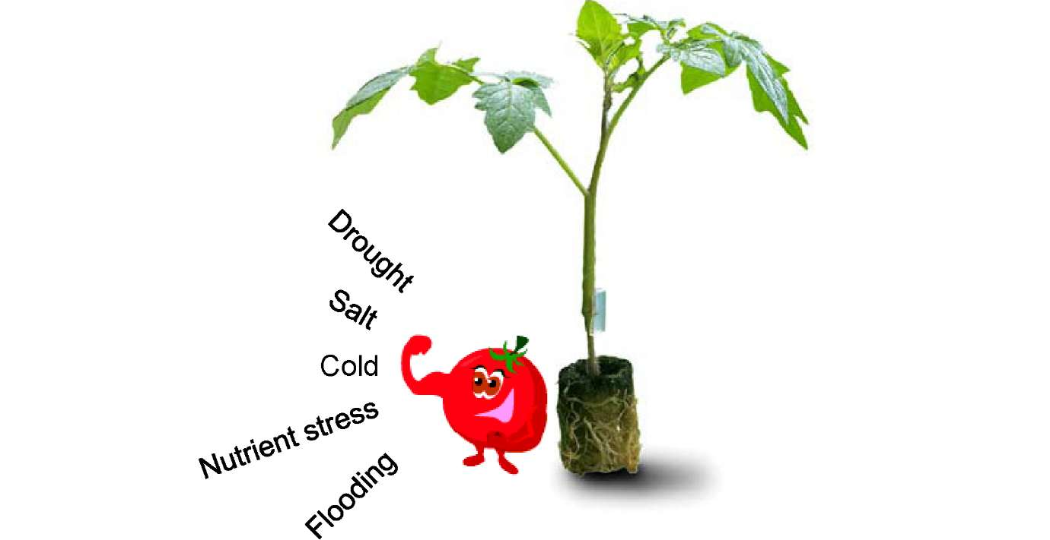
Grafting and abiotic stress
Grafting has a potential to alleviate abiotic stress conditions
Advantages depend on:
    species, e.g.
    results on cucurbitaceae are
    not the same for solanaceae
    the rootstock/scion combination
    (assimilate distribution)
    not one combination for all conditions
    interactions with other conditions
    (climate and nutrition)
effects on taste and
health related
characteristics are
interesting but not
always clear and need
further research

Slide 21
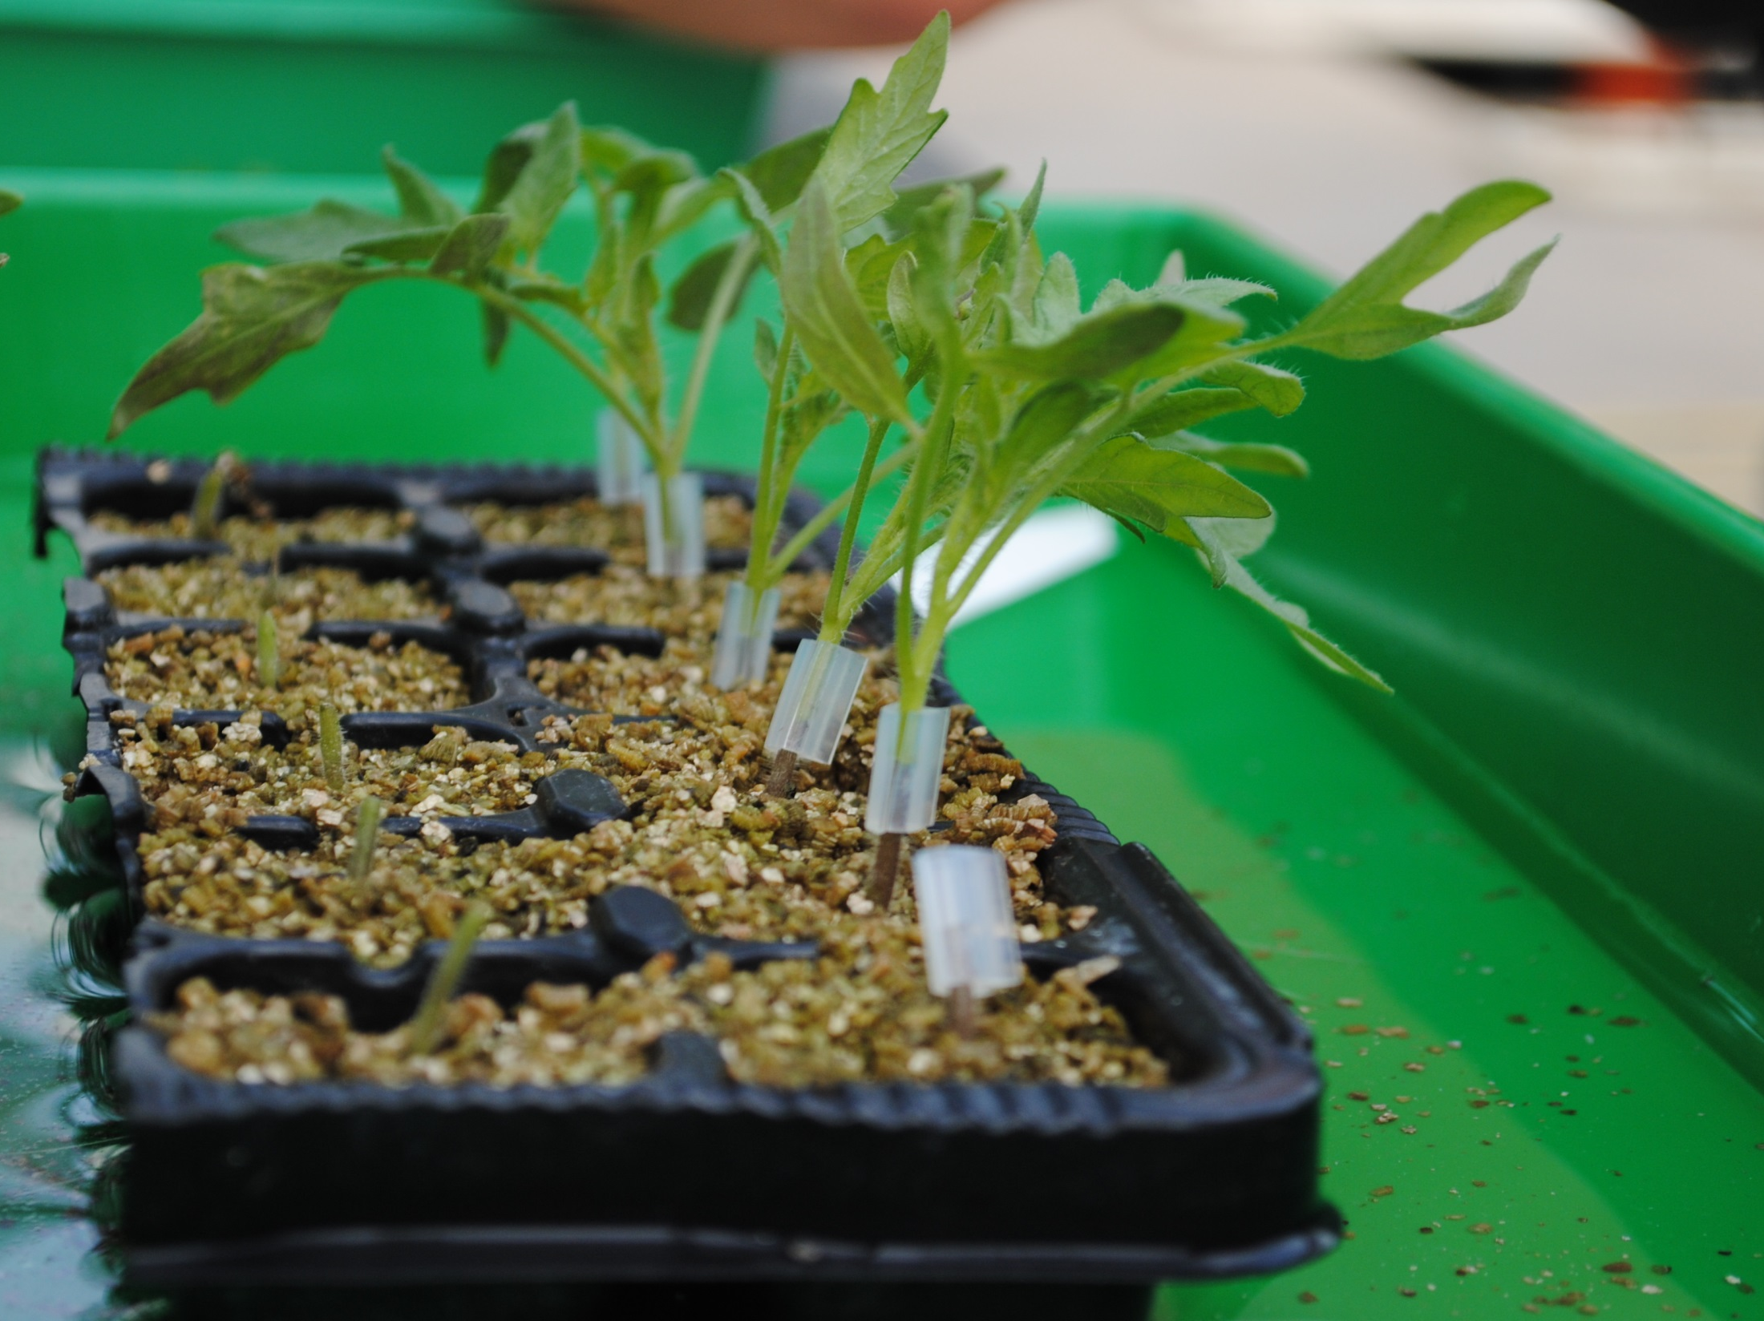

Thank you for your attention!

