Slide 1
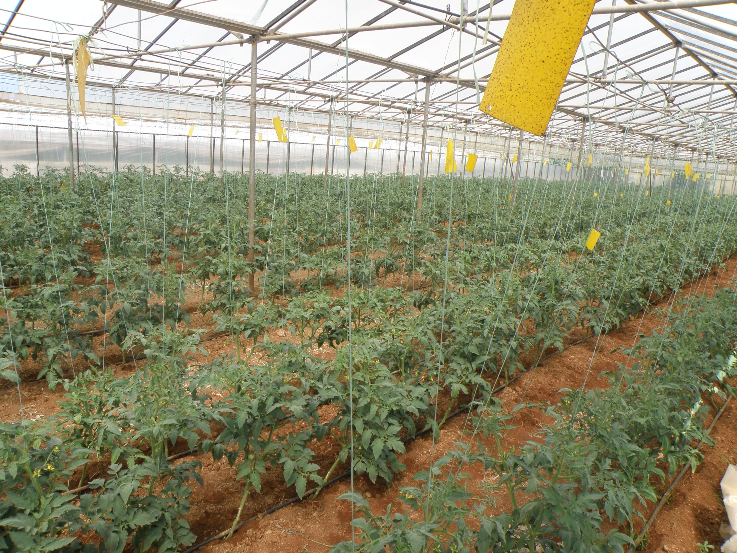
VEGETABLE PRODUCTION IN GREENHOUSES

Slide 2
Greenhouse
A greenhouse is a closed construction with the following characteristics:
It is covered with a material which is transparen to the photosynthetically active radiation,
Its height is sufficient for a human to enter in standing position,
It aims at modifying the inside microclimate with reference to the external environment,
It is used to enable plant cultivation, irrespective of the external climatic conditions.

Slide 3
Greenhouse effect owing to the closed construction.
I. Selective transmittance of the covering material
The transparent covering material is permeable to the ultraviolet, (>400 nm) visible (PAR: 400-720), far-red (720-780) and infra-red radiation (740-2.500 nm)
However the permeability of the transparent covering materials to thermal radiation higher than 2.500 nm is very low or even zero .

Slide 4
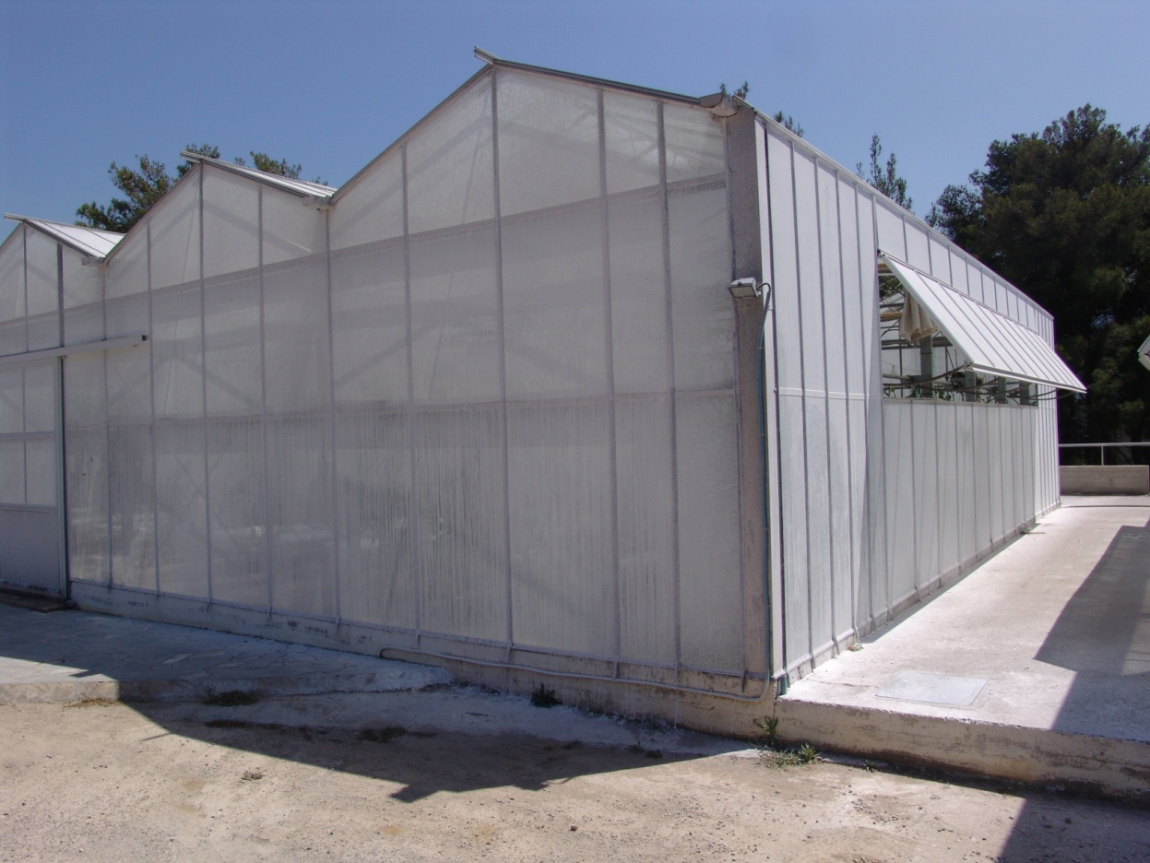
Greenhouse effect owing to the closed construction.
II. Obstruction of air exchange
ΙΙ. Temperature, air humidity, and air composition inside the greenhouse are modified because the air exchange with the external environment is drastically restricted.

Slide 5
Area and production of greenhouse vegetables in Greece (2012)
Crop species | Tall greenhouses |  |  |  |  |  |  |  |  |  | 2nd crop
 | Heated greenhouses |  |  |  | Unheated greenhouses |  |  |  | Total (tall greenhouses)
 | Glasshouses |  | Plastic-covered greenhouses |  | Glasshouses |  | Plastic-covered greenhouses
 | area (ha) | prod. (ton) | area (ha) | prod. (ton) | area (ha) | prod. (ton) | area (ha) | prod. (ton) | area (ha) | prod. (ton) | area (ha) | prod. (ton)
Tomato | 62.2 | 11,203 | 425.2 | 41,165 | 23.9 | 2,510 | 1,393.0 | 164,161 | 1,904.3 | 219,039 | 710.9 | 71,059
Cucumber | 11.5 | 1,405 | 188.3 | 28,578 | 25.4 | 5,280 | 895.5 | 93,178 | 1,120.6 | 128,441 | 317.9 | 38,582
Zucchini | 0.9 | 41 | 15.0 | 729 | 3.0 | 240 | 57.4 | 2,137 | 76.3 | 3,147 | 31.8 | 866
Eggplant | 0.7 | 56 | 16.0 | 968 | 3.0 | 220 | 155.8 | 16,884 | 175.6 | 18,128 | 12.3 | 754
Pepper | 11.9 | 1,570 | 78.9 | 4,935 | 8.3 | 716 | 626.9 | 71,132 | 725.9 | 78,353 | 52.8 | 3,411
Bean | 2.0 | 50 | 62.2 | 1,978 | 7.5 | 260 | 104.4 | 2,167 | 176.1 | 4,455 | 125.9 | 3,378
Lettuce | 1.8 | 63 | 22.4 | 634 | 3.0 | 120 | 115.8 | 2,489 | 143.0 | 3,306 | 237.8 | 4,704
Melon | 0.1 | 0 | 2.1 | 85 | 1.0 | 20 | 2.0 | 100 | 5.2 | 205 | 118.0 | 8,400
Watermelon | 0.2 | 0 | 1.6 | 96 | 6.0 | 420 | 14.5 | 620 | 22.3 | 1,136 | 685.0 | 39,150
Strawberry | 0.0 | 0 | 0.0 | 0 | 0.0 | 0 | 1,163.0 | 43,927 | 1,163.0 | 43,927 | 2.0 | 60
Miscellaneous | 2.0 | 0 | 16.9 | 1,135 | 1.0 | 15 | 42.1 | 772 | 62.1 | 1,922 | 50.9 | 1,005
Total | 93.3 | 14,388 | 828.6 | 80,301 | 82.1 | 9,801 | 4,570.4 | 397,568 | 5,574.3 | 502,058 | 2,345.2 | 171,368

Slide 6
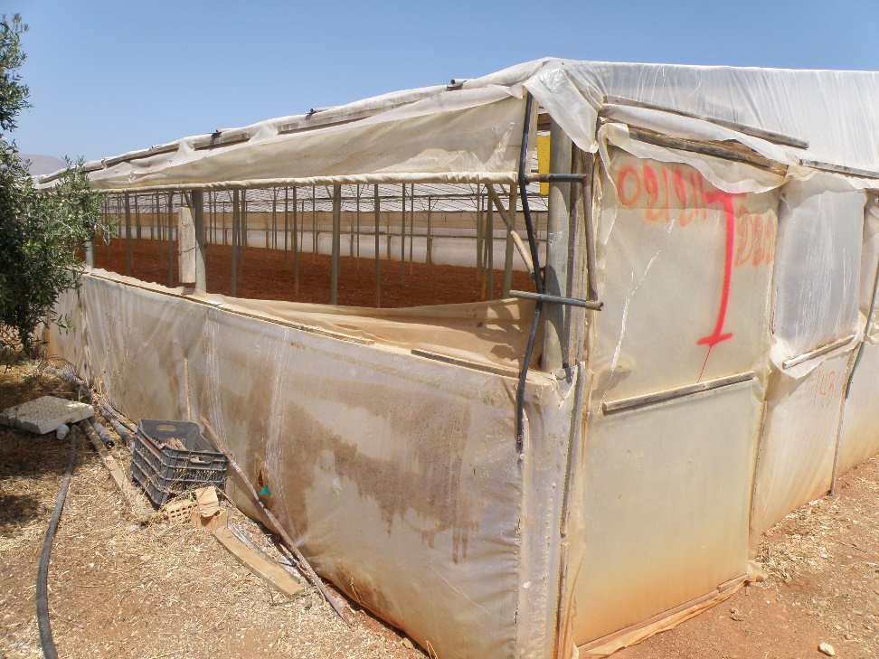
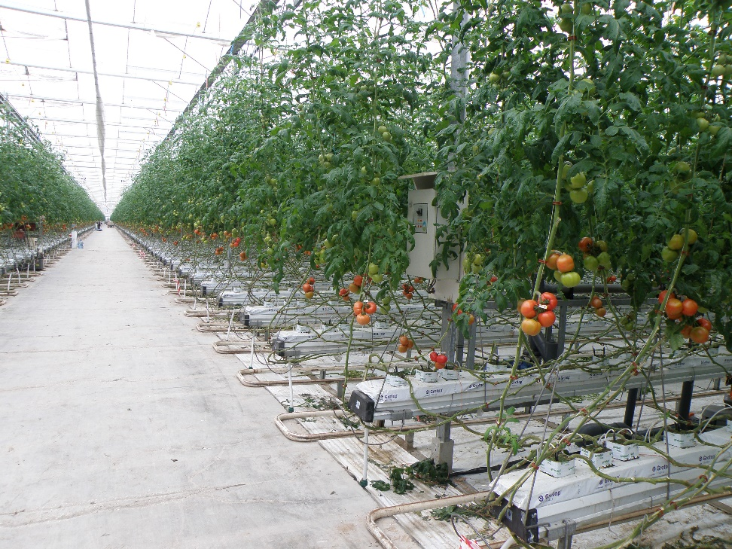
Types of greenhouses
Simple construction: Low cost resulting in low yield. Very common GH type in Mediterranean countries.
Modern greenhouse combined with hydroponics, resulting in high yields, which requires a high investment.

Slide 7
Construction characteristics of greenhouses
Greenhouse shape
Greenhouse width
Greenhouse height
Greenhouse structure
Greenhouse covering materials

Slide 8
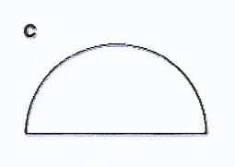
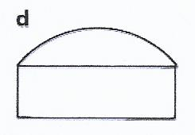
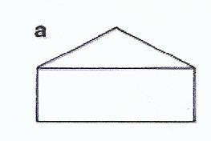
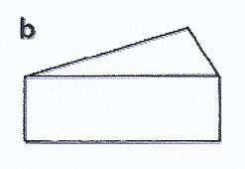
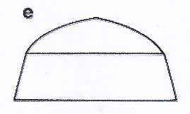
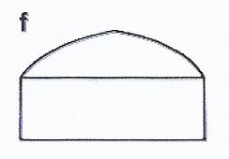
Greenhouse shapes
α
β
γ
Round arched tunnel
Round arch with vertical side wall
Saddle roof
δ
ε
στ
Shed roof
Pointed arch with sloping side wall
Pointed arch with vertical side wall

Slide 9
Structure of a greenhouse

Slide 10
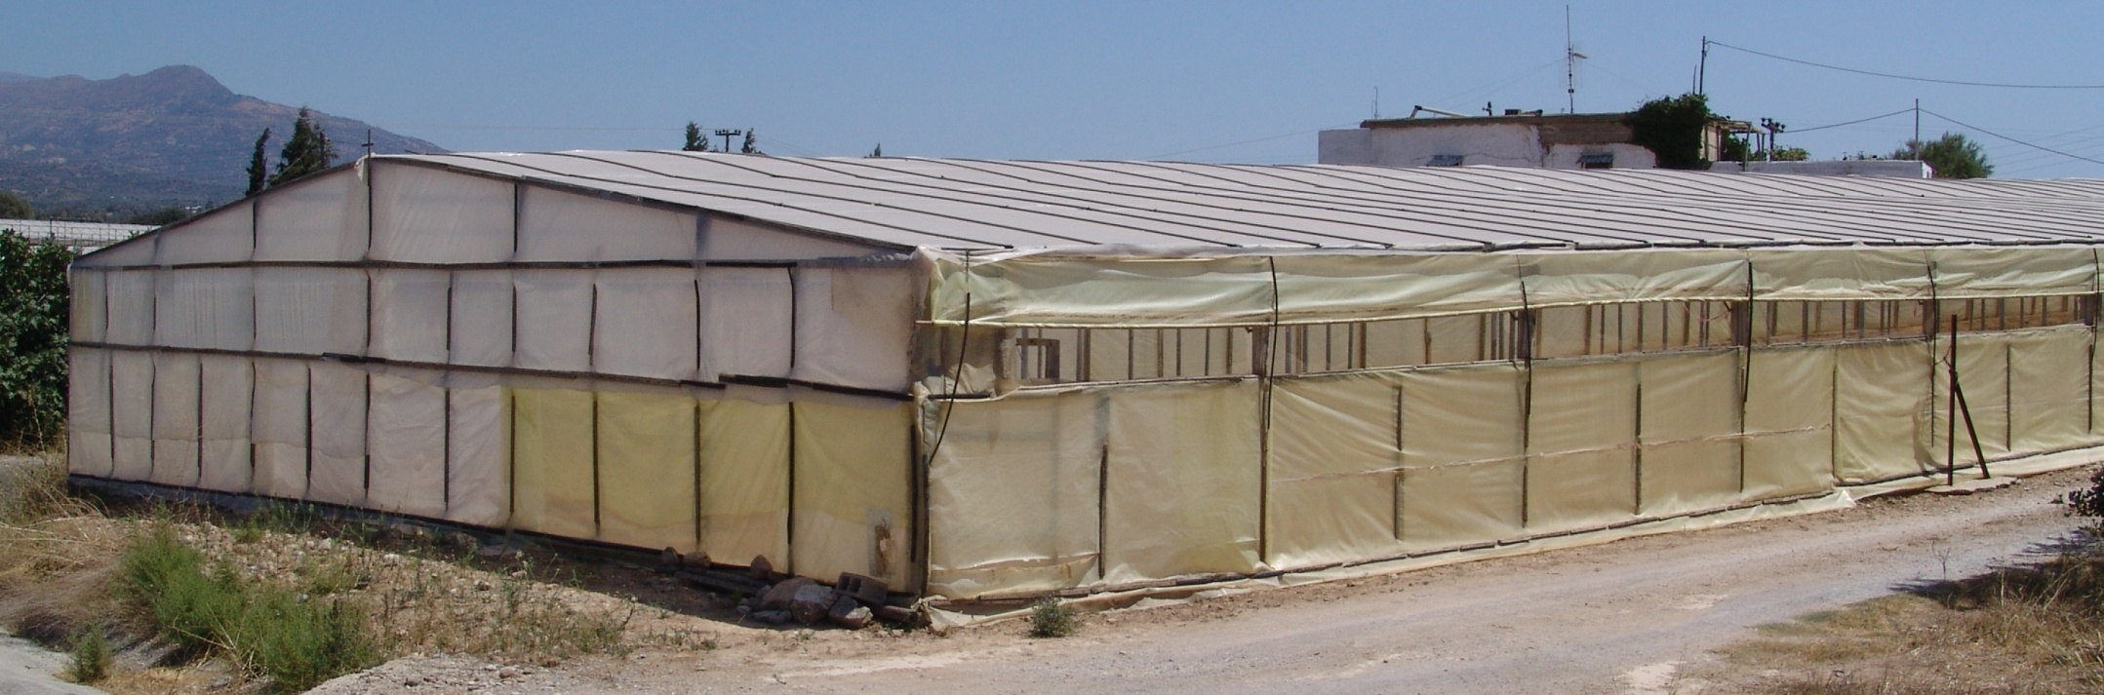
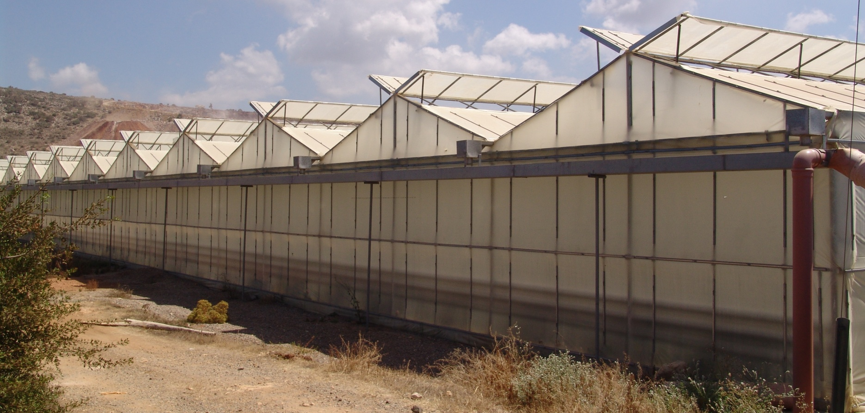
Single-line greenhouse
Multiple-line greenhouse

Slide 11
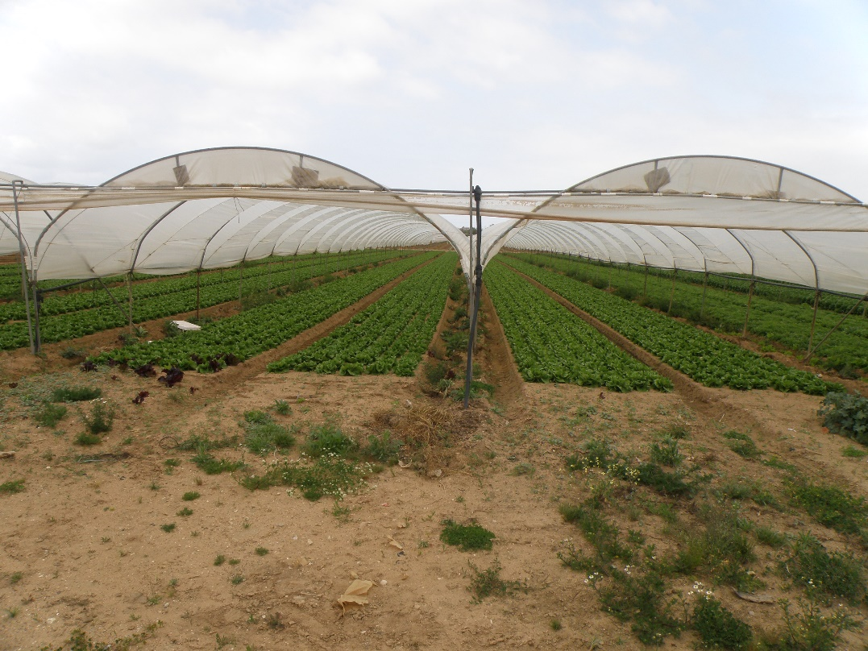
Round arched tunnel

Slide 12
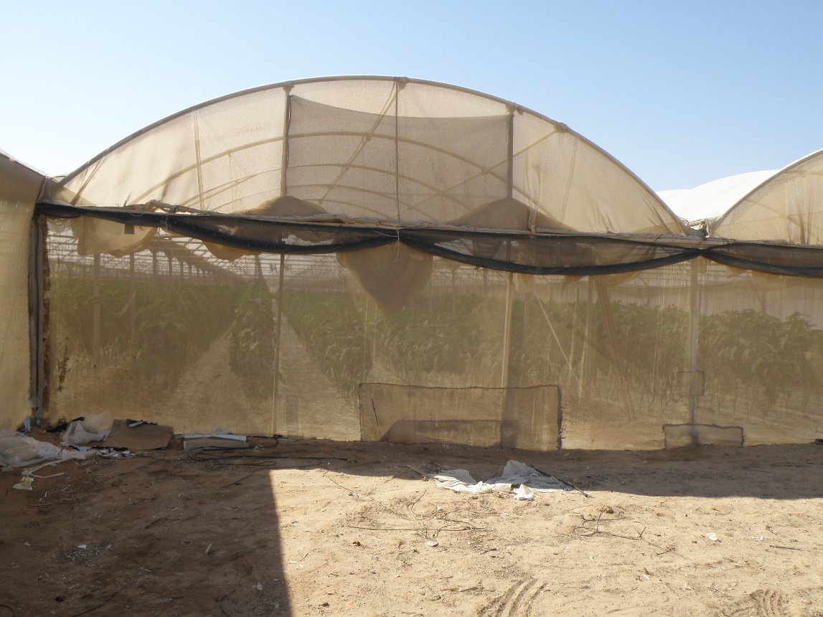
Round arch with vertical side wall

Slide 13
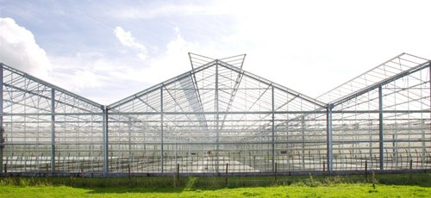
Saddle roof with one roof per construction unit
(wide-span type)

Slide 14
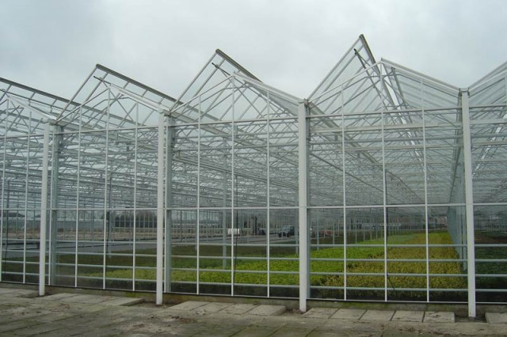
Saddle roof with two roofs per construction unit (Venlo type)

Slide 15
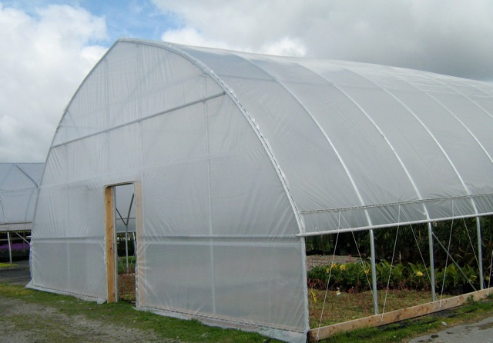
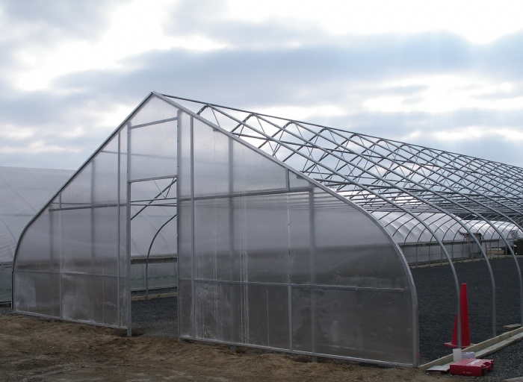
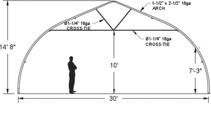
Pointed-arched (gothic-arched) structures with sloping side wall

Slide 16
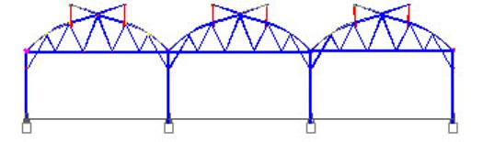
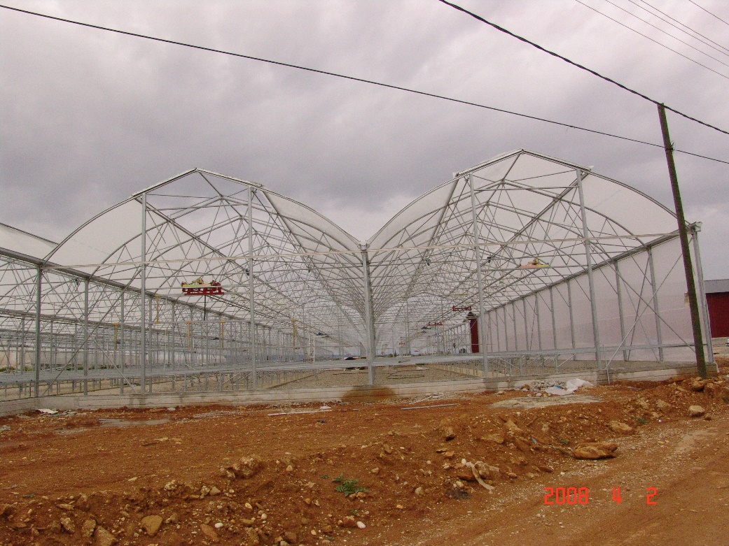
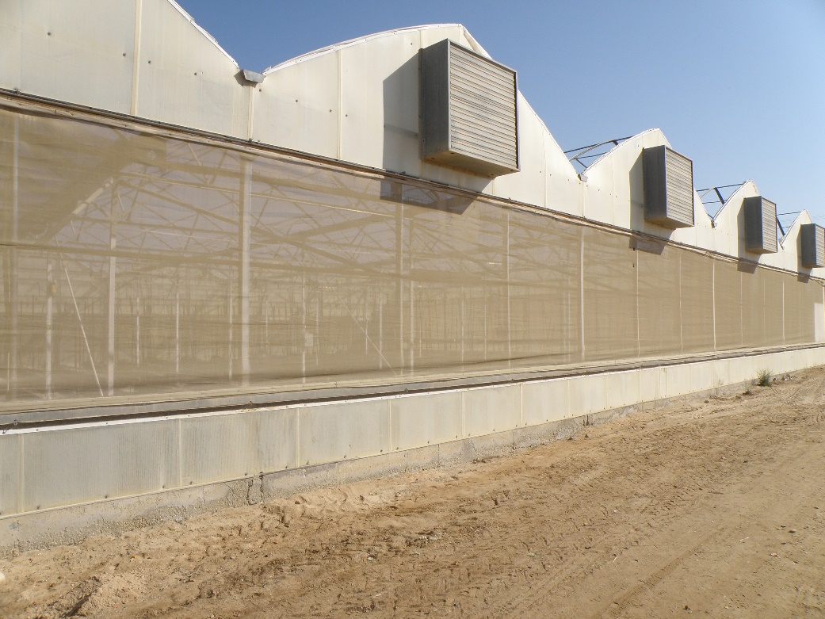
Pointed arched (gothic-arched) with vertical side walls

Slide 17
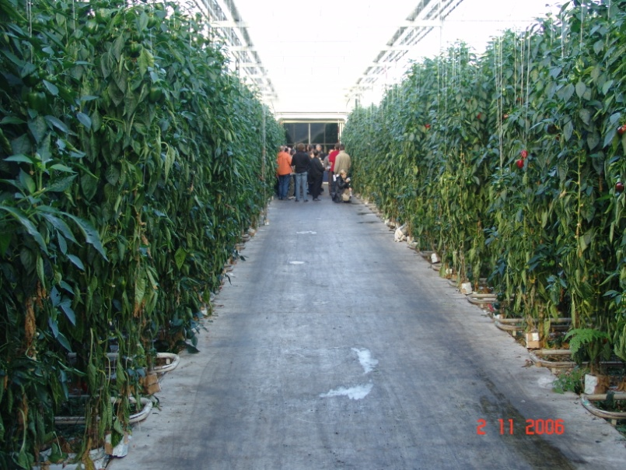
Greenhouse height
High constructions (7-7.5 m) are suggested
Advantages:
Larger volume per area unit and thus a higher buffering to temperature changes during the 24-hours cycle.
A lower fluctuation in CO₂ concentrations during the 24-hours cycle.
More vertical space for the development of high plants

Slide 18
Greenhouse orientation
.
PAR transmittance through two similar greenhouses at the same location differing in the orientation
Transmittance to PAR (%)
E-W
N-S
21 Dec. 21 Febr. 21 Apr. 21 June
Date | East - West | North - South
January 2 | 379 | 293
January 4 | 426 | 322
February 6 | 578 | 530
March 10 | 1,243 | 1,226
April 14 | 1,955 | 2,104
June 20 | 2,720 | 2,969
Impact of greenhouse orientation on daily PAR interception (Wh m⁻²) in Dutch greenhouses at different dates during the year.

Slide 19
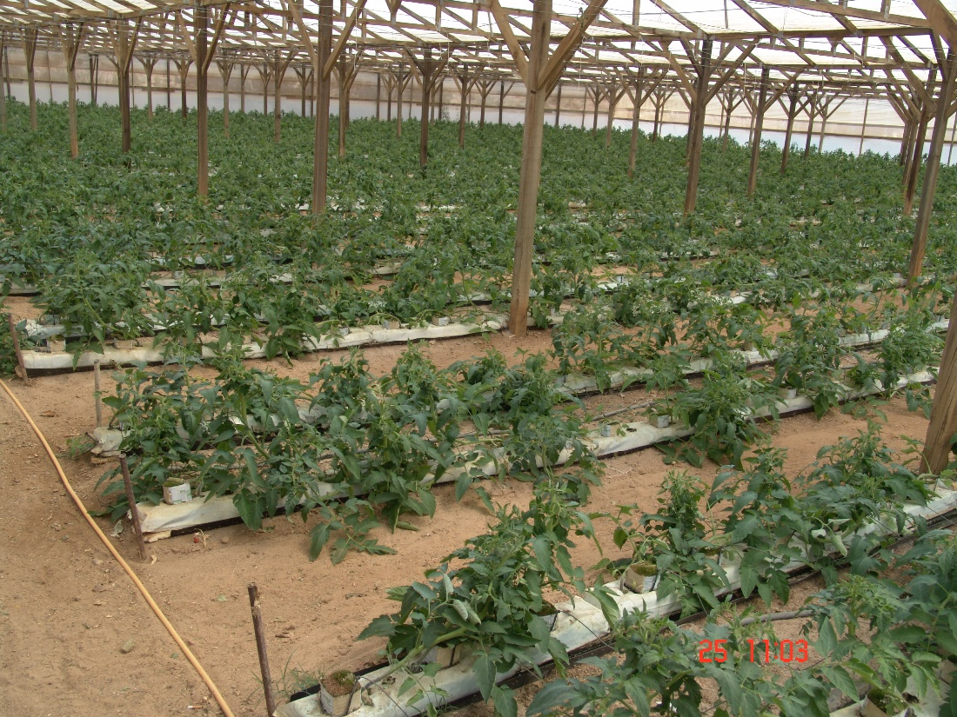
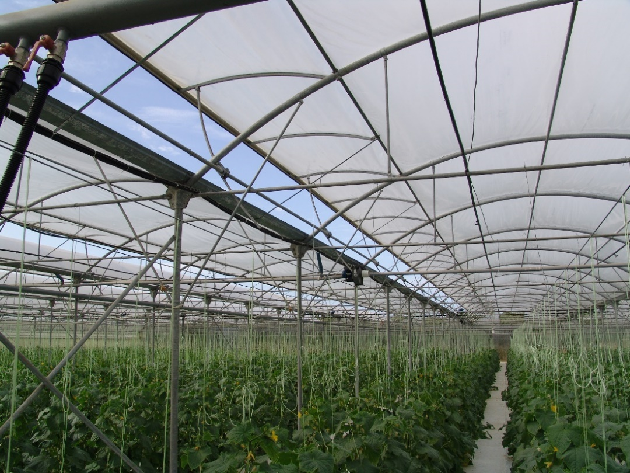
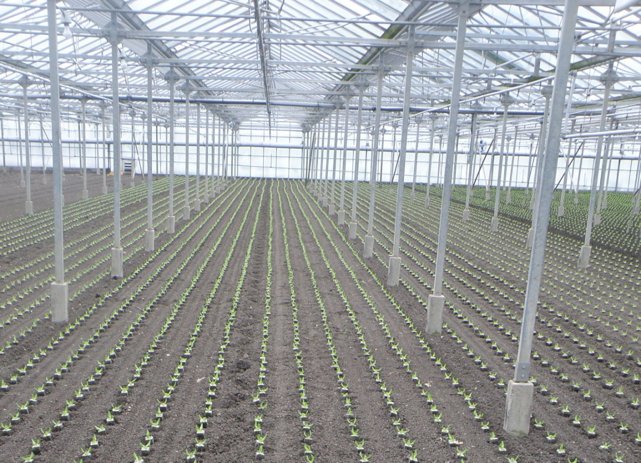
Structure material
Wood
Galvanised steel
Aluminum

Slide 20
Greenhouse covering materials
Three groups of covering materials are used in greenhouse:
soft plastic,
rigid plastic,
glass.

Slide 21
Special types of plastic covering sheets
Stabilized sheets
UV-blocking plastic sheets
IR-radiation blocking plastic films
Plastic films reflecting the NIR radiation
Plastic films increasing the diffusion of the solar radiation
Ant-drop plastic films
Anti-fog plastic films

Slide 22
Increase of light transmittance by using anti-drop films

Slide 23
Greenhouse equipment
Ventilation systems
Heating and energy saving systems
Dehumification systems
Shading systems
Cooling systems
Carbon dioxide (CO₂) enrichment systems
Artificial lighting systems

Slide 24
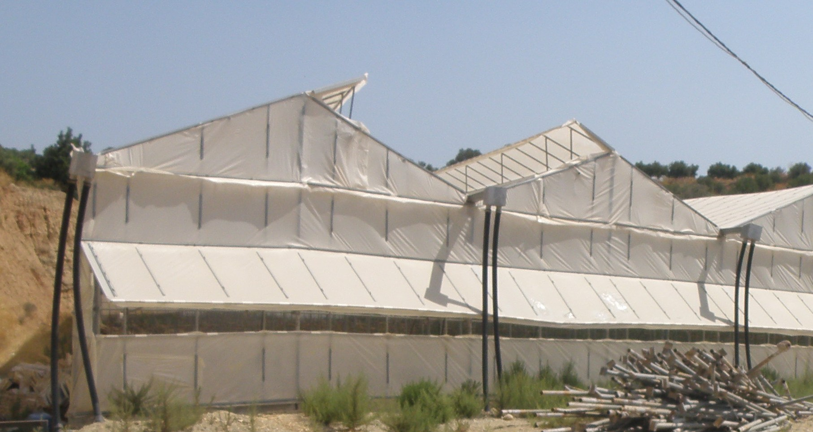
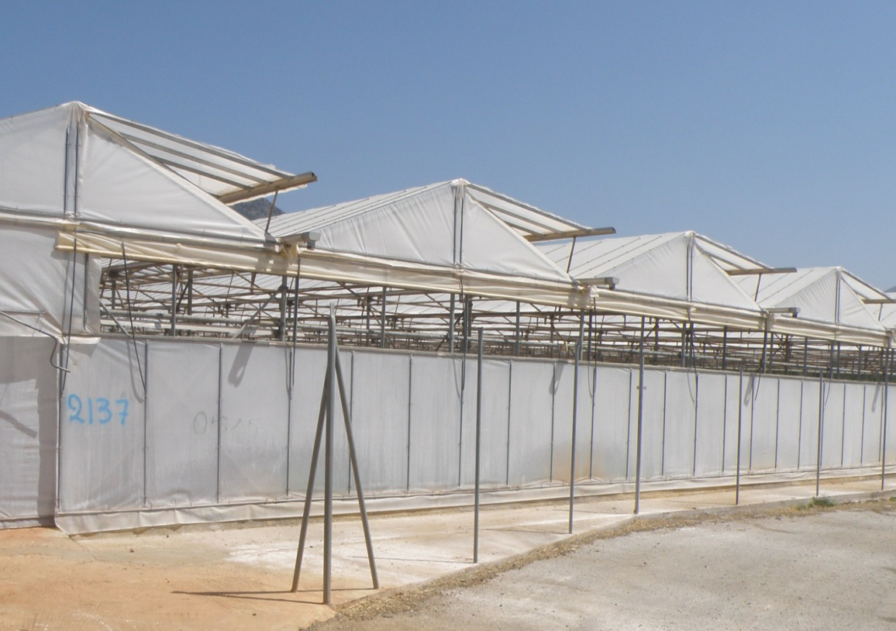
Natural ventilation by opening ventilators at side walls, gables ridge or roof area
Flap ventilators
Roll-up ventilators

Slide 25
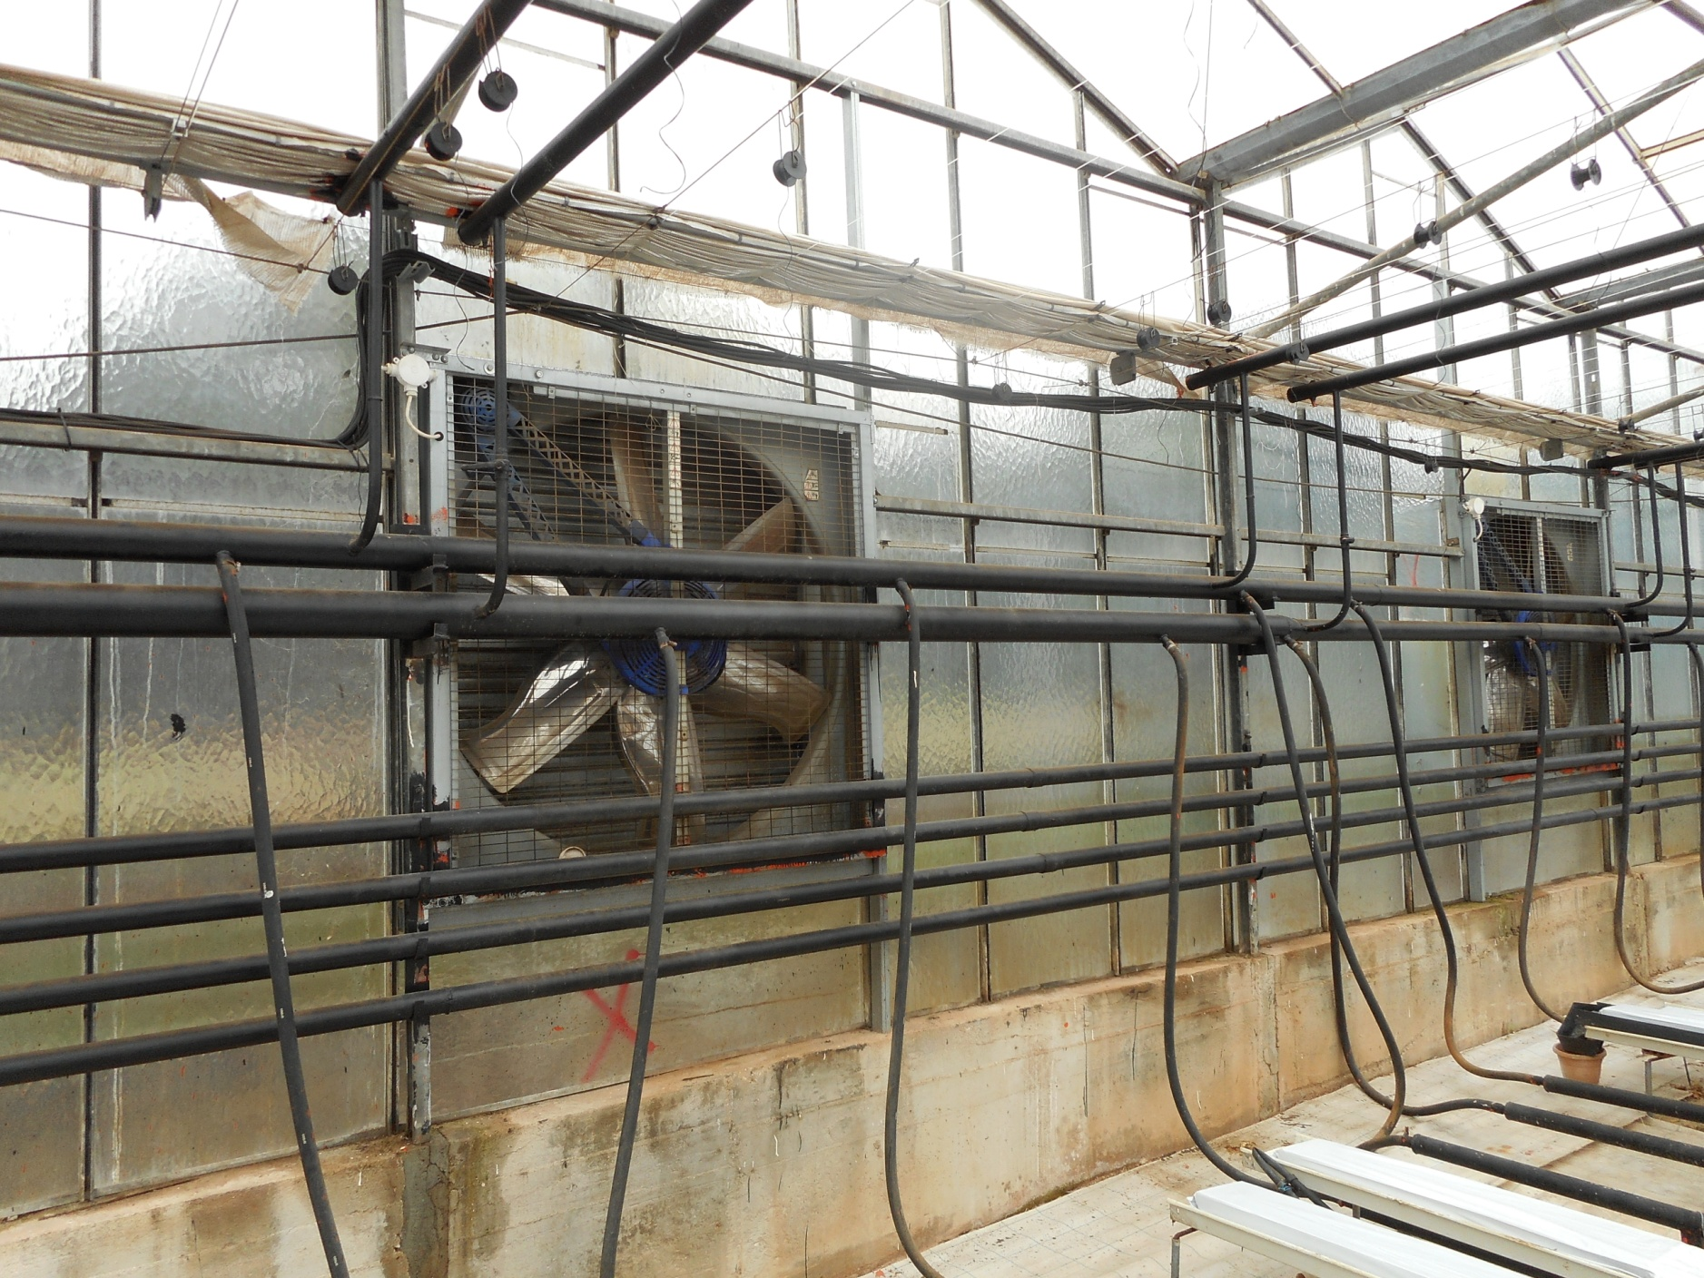
Forced ventilation by fans
Συστήματα δυναμικού εξαερισμού

Slide 26

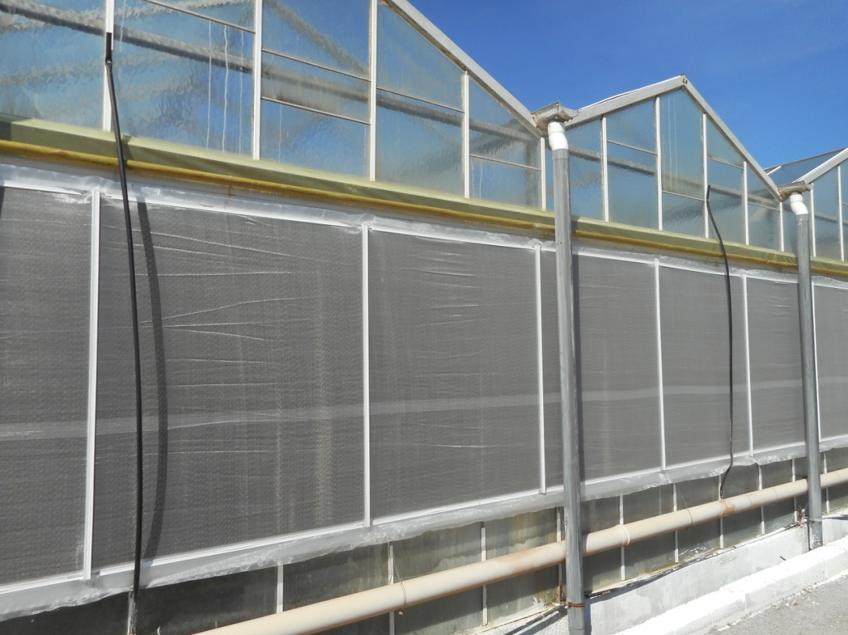
Insect-proof screens
Thrips White fly Aphids

Slide 27
Impact of insect proof screens on greenhouse ventilation

Slide 28
Heating and energy saving systems
They are distinguished according to the following characteristics:
Heat (energy) source
Heat generator (heating system)
Heat distribution system.

Slide 29
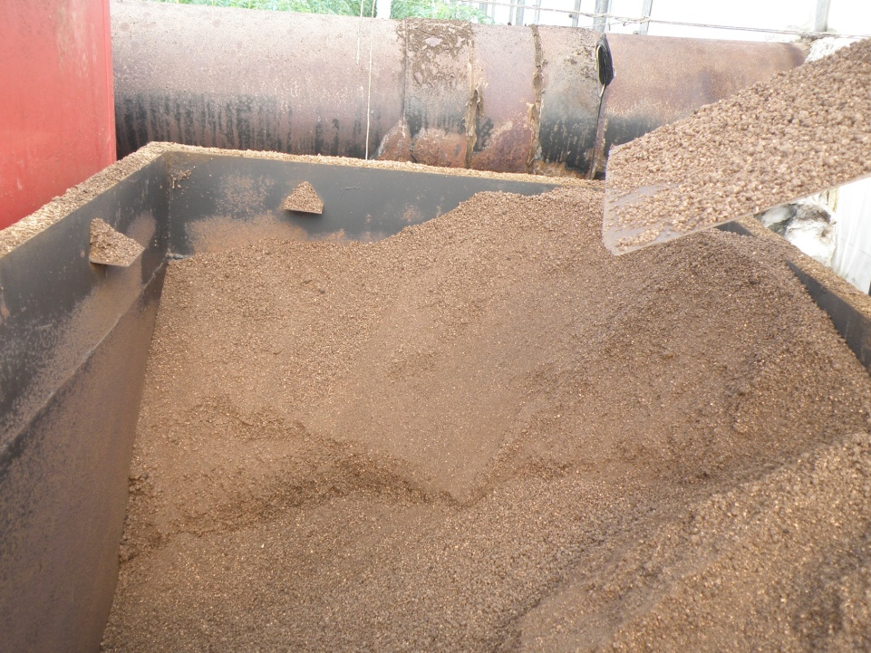
Energy source for heating
Combustion of fossil fuels, oil, gas, coal
Combustion of biomass (wood, straw, husks, etc.)
Geothermal energy
Waste heat from industry
Solar energy

Slide 30
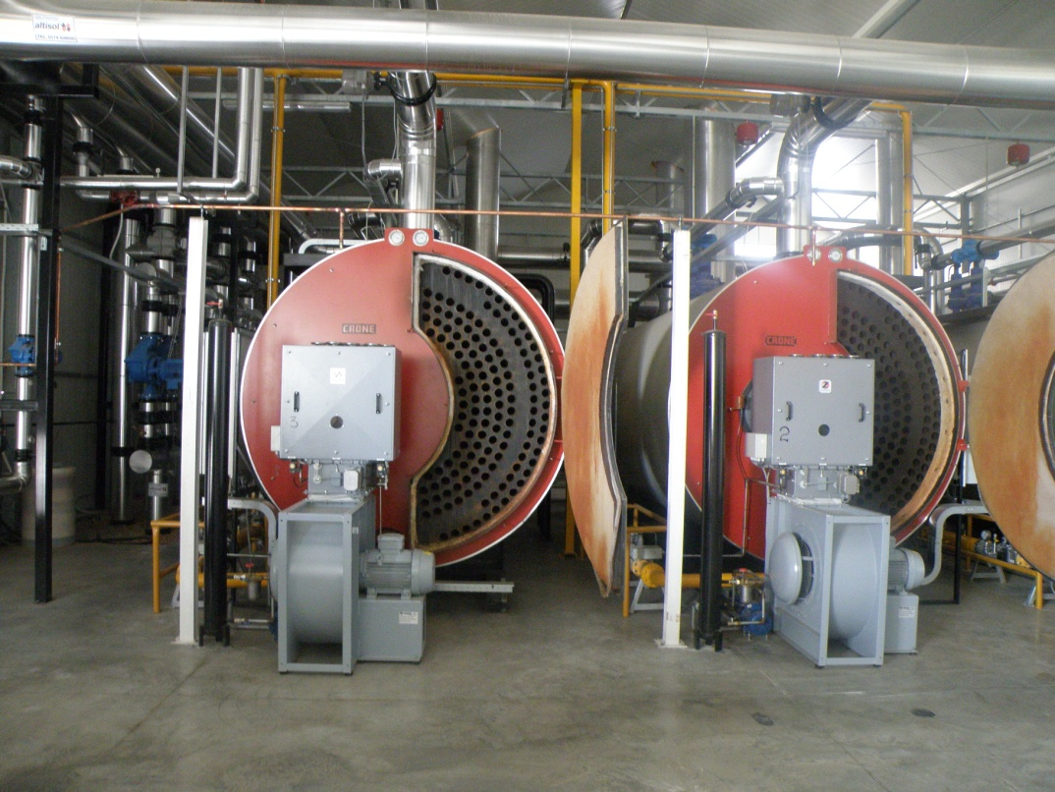
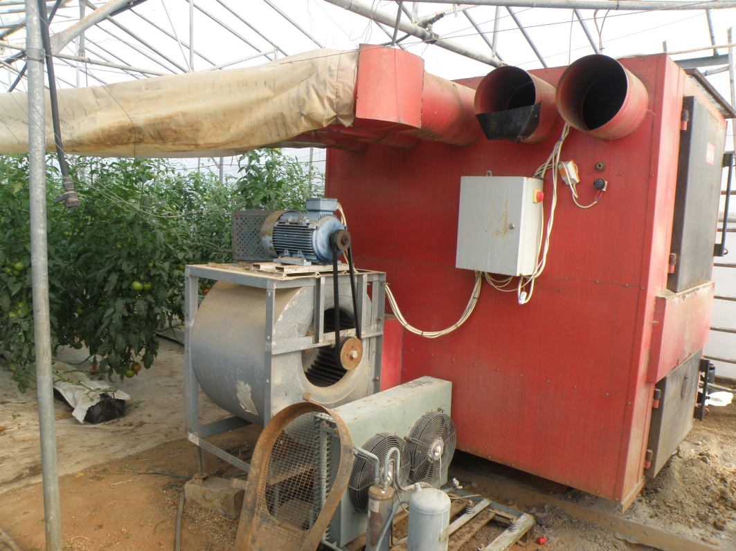
Heating systems
Central warm water boiler
Decentralised warm water boiler
Directly fired air heater
Central warm water boiler
Directly fired air heater

Slide 31
Heat distribution systems
Recirculation of warm water via metallic pipes
Recirculation of vapor via metallic pipes
Corrugated plastic tubes for warm water recirculation
Perforated plastic tubes for air heating systems

Slide 32
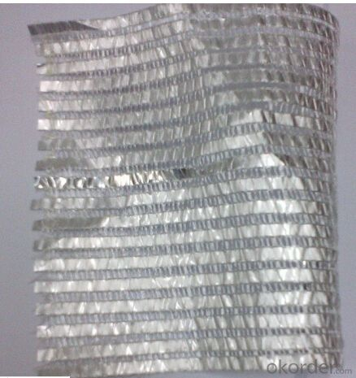
Thermal screens
Thermal screens are capable of reducing the energy consumption for heating by 35-40%.
Thermal screens are made of materials with low heat conductivity which reduce the heat exchange between the inside air and the outside environment

Slide 33
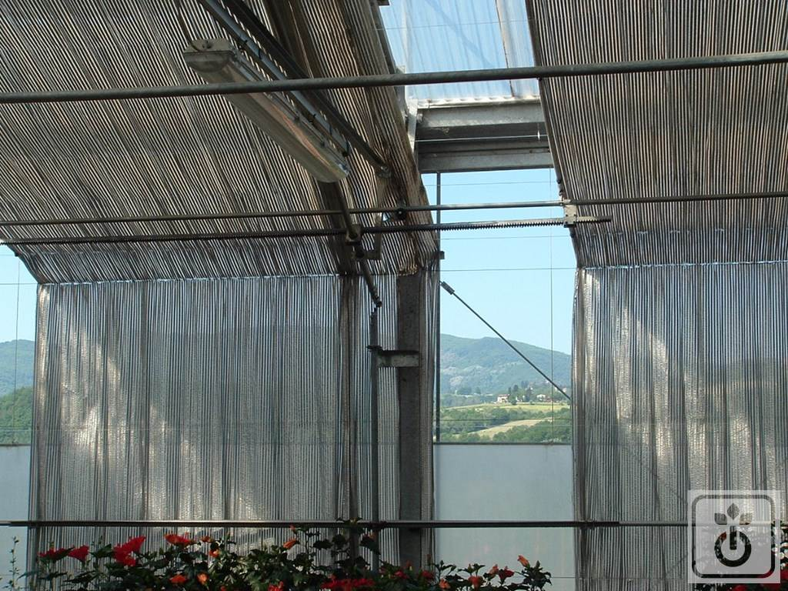
Installation of thermal screens
In most cases they are placed at the top of the greenhouse
In these cases they are used also as shading screens during the summer.
In greenhouse located in cold-climate areas the thermal screens cover also the side walls.

Slide 34
Shading systems
The shading of the greenhouse is aimed at reducing the income of solar radiation, thereby reducing the greenhouse temperature whenever ventilation is not sufficient in reducing the inside air temperature.
On the other hand, shading affects also two other climatic parameters, i.e.:
The relative humidity which increases with increasing shading
The interception of PAR by plants which may result in yield losses.
Methods of greenhouse shading
Whitening of the covering material
Net shading
Shading screens

Slide 35
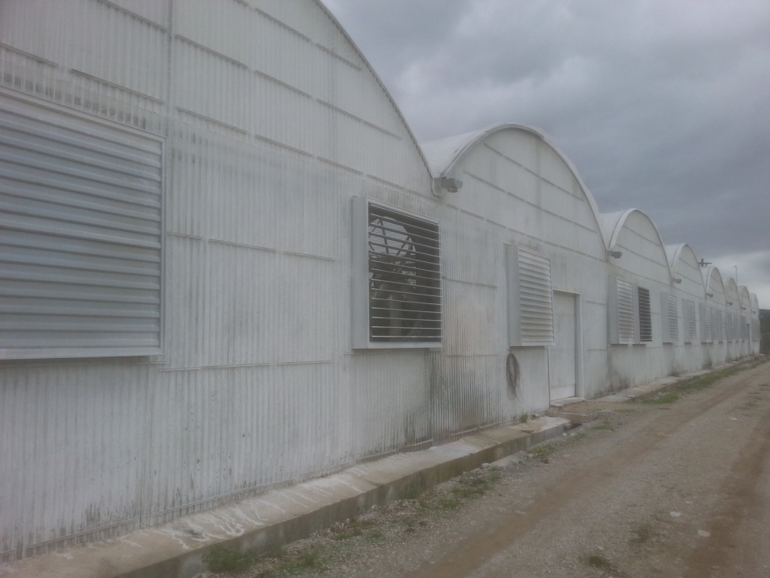
Shading by whitening
Whitening of greenhouses
Impact of whitening on light transmittance
External radiation
Inside radiation before whitening
Solar radiation intensity (W m⁻²)
Inside radiation before whitening
Time (h)

Slide 36
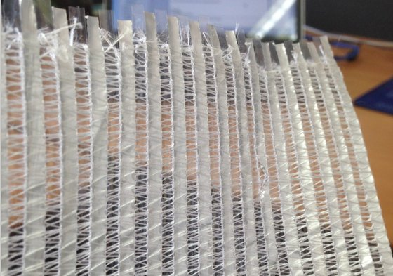
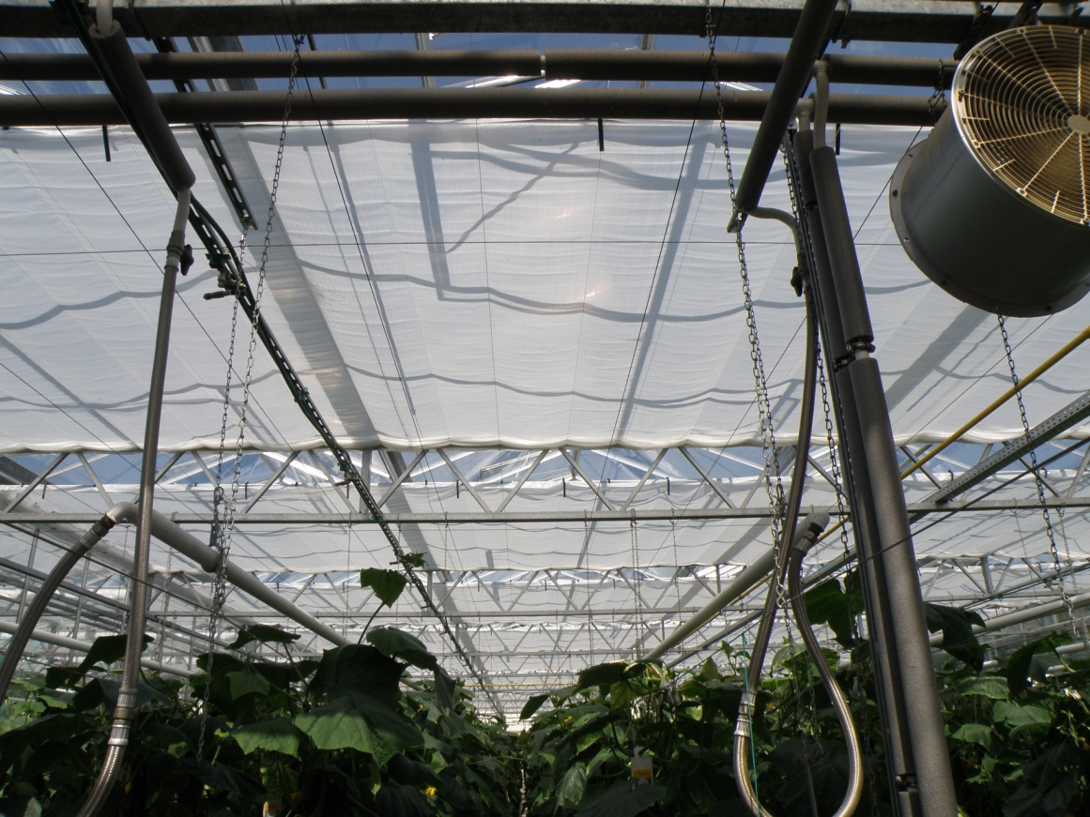
Shading screens

Slide 37
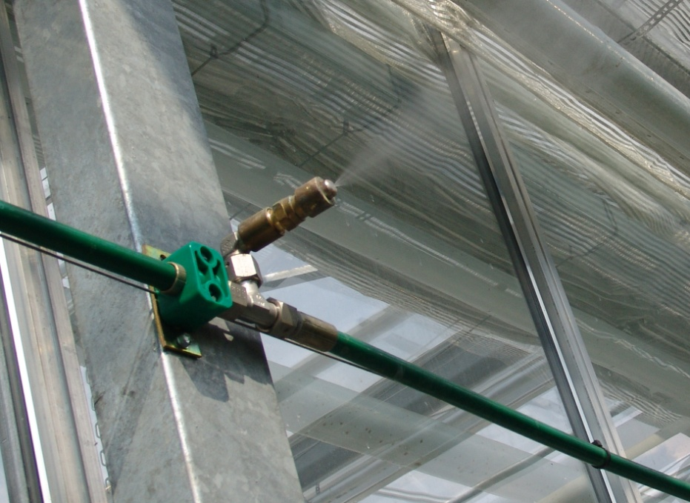
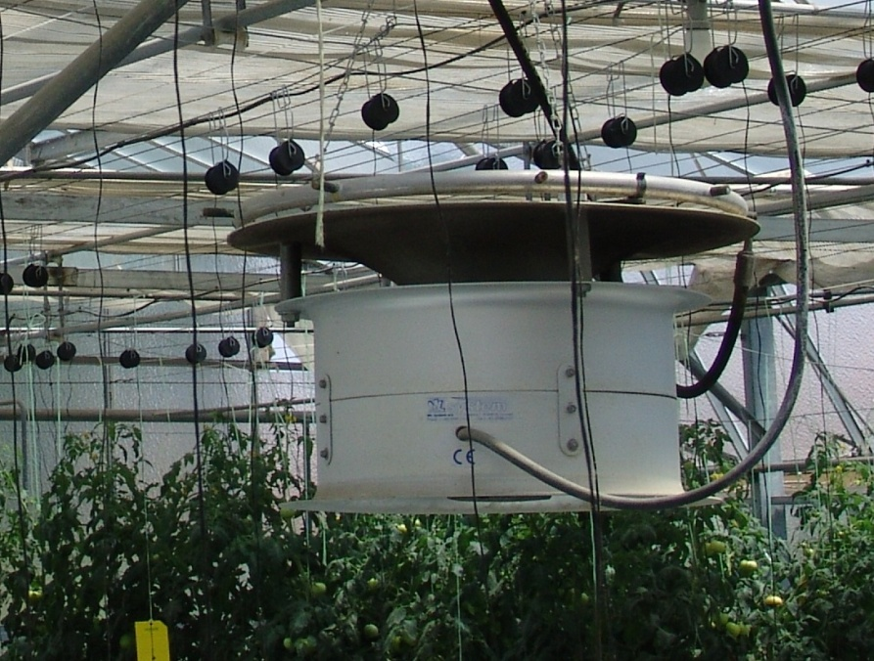
Cooling systems
I. Fog system
A fog cooling system consists of:
a water softener,
good filters to prevent nozzle clogging,
a water reservoir,
pumps,
pressure regulation valves,
tubes with nozzles above the crop.
Prerequisites for high efficiency:
The air must be moving inside the greenhouse,
The air has to be continually renewed through passive ventilators.

Slide 38
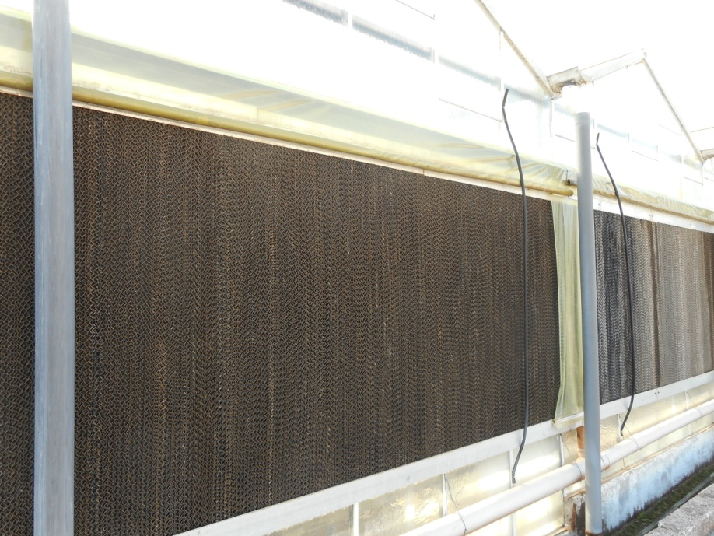
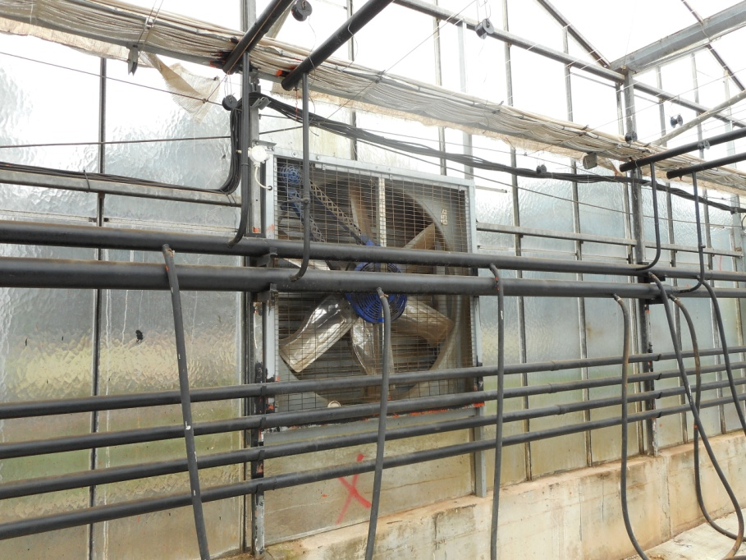
Cooling systems
II. Fan and pad cooling
Air from outside is blown or sucked through pads with a large surface.
The pads are kept permanently wet by sprinkling water that evaporates on the surface of the pad and cools the air down.
The fans suck the air:
either from outside to the inside (positive pressure),
or from inside to the outside of the greenhouse (negative pressure).

Slide 39
Negative versus positive pressure fan and pad systems
Negative pressure fan and pad system
Wet pad
Fan
Positive pressure fan and pad system
Fan
Wet pad
Negative pressure fan and pad system. The fans suck the air through the pad and greenhouse.
Positive pressure fan and pad system. The fans and pads are located on one side and vents on the other side. The fans blow the air through the greenhouse so that an overpressure occurs.

Slide 40
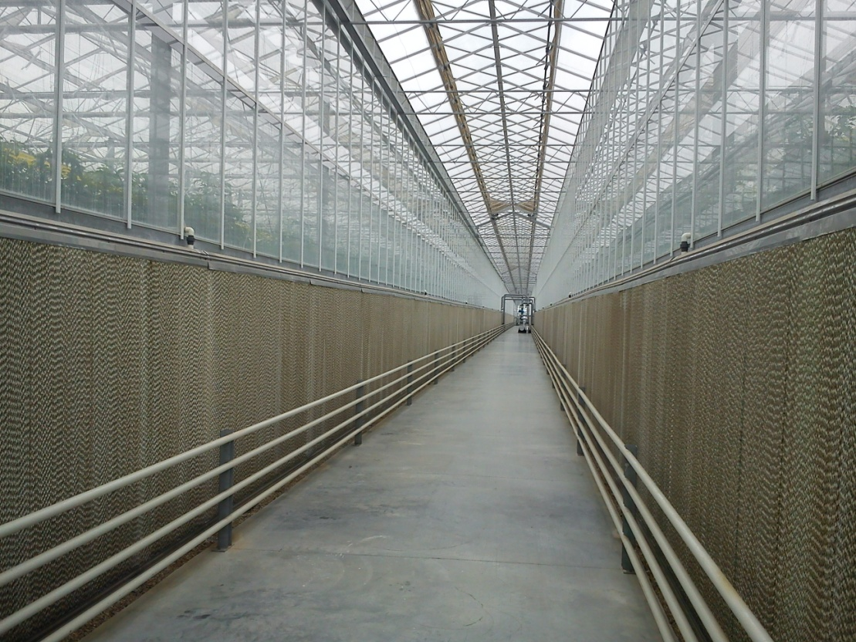
Installation of fans and pads in large greenhouse units
Wet pad
Fans
Wet pad
The distance between the wet pads and the fans or the vents should not exceed 50-60 m but preferably it is advised to be up to 40 m.

Slide 41
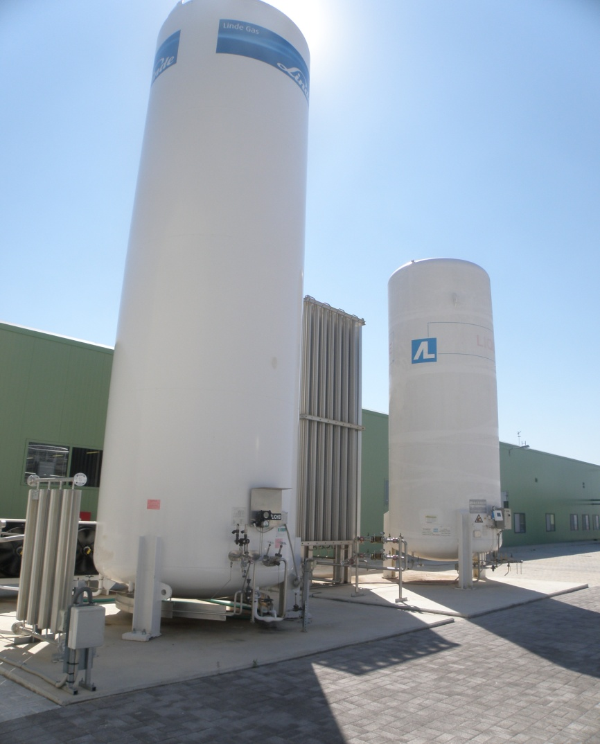
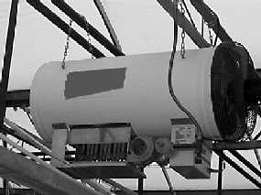
CO₂ enrichment systems
Technical carbon dioxide kept under pressure in liquid form in bottles or tanks
Exhaust gases from:
gas burner or,
directly fired air heater with gas burner.
Simultaneous heat production takes place.

Slide 42
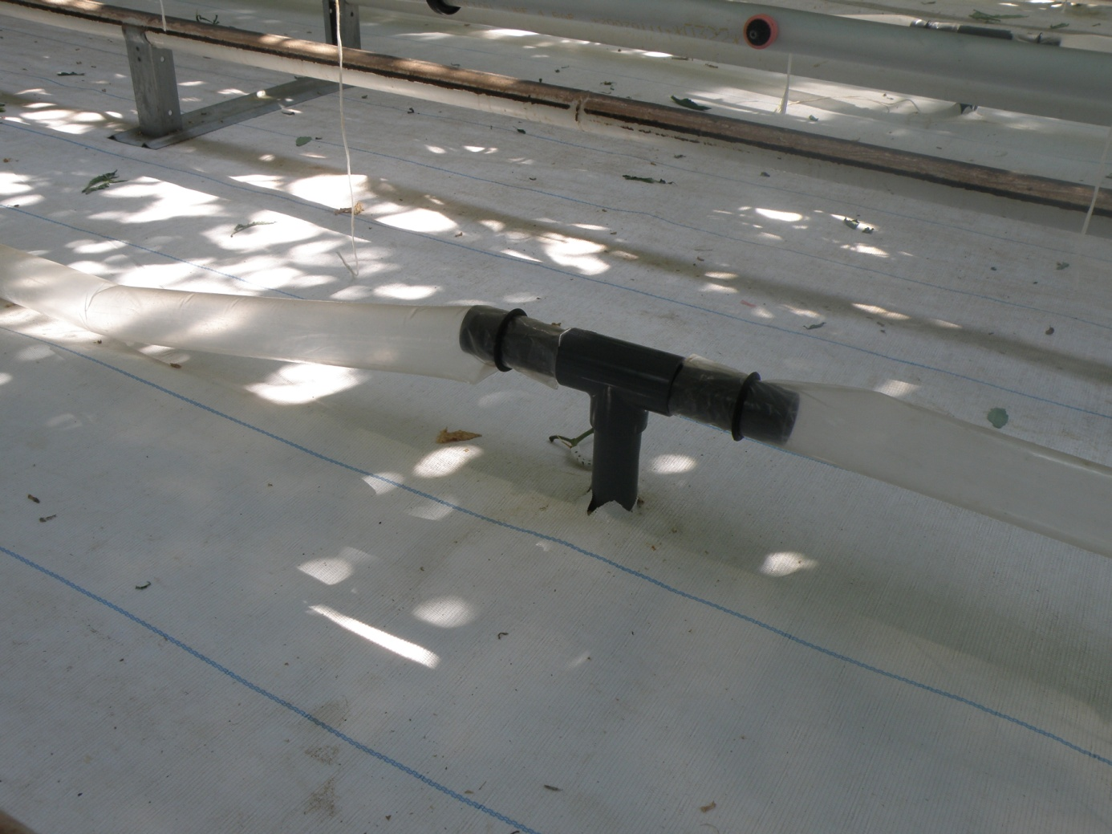
CO₂ distribution inside the greenhouse
The CO₂ is distributed to the greenhouse air via perforated plastic tubes.

Slide 43
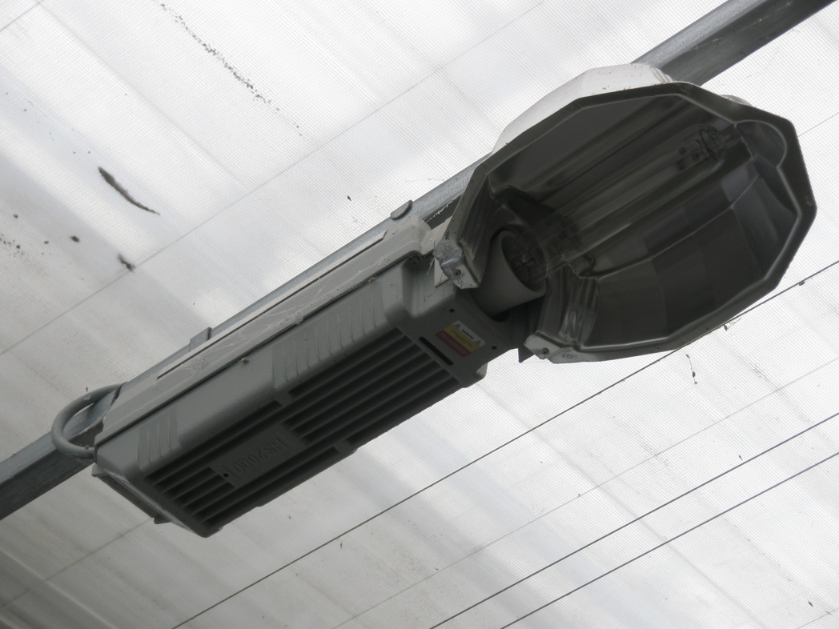
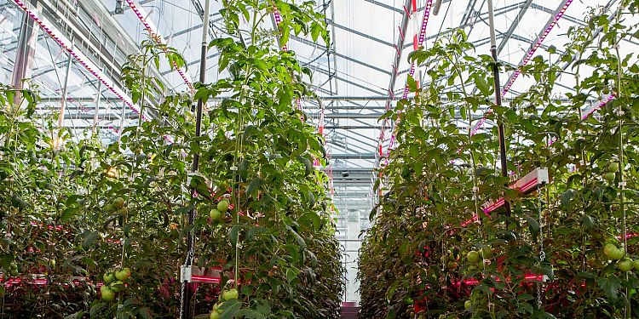
Artificial lighting to increase photosynthetic assimilation
HPS: high-pressure sodium
Υψηλό κόστος εγκατάστασης & λειτουργίας
LED (light emitting diode)

